Slide 1
CWS-CARES Training
Probation
July-October 2026
https://cwds.ca.gov/
1
Notes:
Instructor Notes
Do: Display slide
Say:

Slide 2
Course Introduction
2

Slide 3
Training Introduction
We will start class with a quick introduction from Jessica Rougeux, the Chief of the Child Welfare System Branch: Training Intro Video - Jessica Rougeux.mp4

Slide 4
Ground Rules & Housekeeping
01
02
03
04
Stay Engaged
Ask Questions​
Minimize Distractions
Vegas Rules
Follow along with your trainer(s) throughout the session.
If you are in-person, raise your hand in the main sessions to ask questions.
If you are virtual, use the Microsoft Teams chat to type your questions directly in the chat.​ We will get to them as soon as possible.
Avoid checking your cell phone, email, or CWS-CMS during the session.
Do not share any sensitive or confidential information you may encounter during the class outside the session.
Please use fictional names in the Training Environment
4
Notes:
Instructor Notes:
Do:
Display PPT slide.
Review the slide.

Slide 5







About This Course
Course Content
Tech Support
Parking Lot
Recording Notice
Training
Environment
Q&A Options
Course Feedback

Slide 6
Meet Your Facilitators!
6

Slide 7
Course Objectives
Item | Objectives
1. | Understand key processes to open a case in CWS-CARES
2. | Understand key processes to create a placement in CWS-CARES, including: Removal and Child Location Record STRTP placement Transitional Housing placement Supervised Independent Living placement Conducting Level of Care (LOC) assessment, if needed
3. | Understand key processes to maintain and monitor placement in CWS-CARES, including: Updating Placement Stability Creating Placement Preservation Strategy Creating 14-day notice/exemption Recording absences

Slide 8
Course Objectives (Continued)
Item | Objectives
4. | Understand key processes to gather and provide information to authorize Foster Care Eligibility, including: Updating placement information in CWS-CARES which will create an eligibility record Verifying information in the eligibility record Sending a case link request to CalSAWS Collecting and uploading vital documents to the eligibility record Obtaining acknowledgments and signatures, if needed, on the ARC 1 Completing and submitting the “good cause” form CW51 Modifying information in person record, if needed Reviewing CWS-CARES for eligibility determination, payment authorization, and issuance record
5. | Understand key processes to gather and provide information to authorize Foster Care Eligibility Redetermination, including: Reviewing and updating the eligibility record to ensure that it is accurate Sending updated information to CalSAWS
6. | Understand key processes to support Extended Foster Care (EFC), including: Create initial/reentry into EFC and opt-out or exit from EFC Gather and provide information to authorize EFC benefits

Slide 9
Course Agenda (AM)
Activity | Duration
Welcome | 10 min
Lesson 1: Key Processes to Open a Case | 120 min
Lesson 2: Creating Emergency Placements & Entering Rates | 90 min
Lesson 3: Key Processes to Gather and Provide Information to Authorize Foster Care Eligibility | 60 min
Lunch | 1 hour
9

Slide 10
Course Agenda (PM)
Activity | Duration
Lesson 4: Key Processes to Maintain and Monitor Placement | 60 min
Lesson 5: Short-Term Residential Treatment Program (STRTP) Placements | 45 min
Lesson 6: Extended Foster Care (EFC) Processes | 45 min
Estimated Total Duration | 8 Hours
9

Slide 11
Logging in to CWS-CARES
11

Slide 12
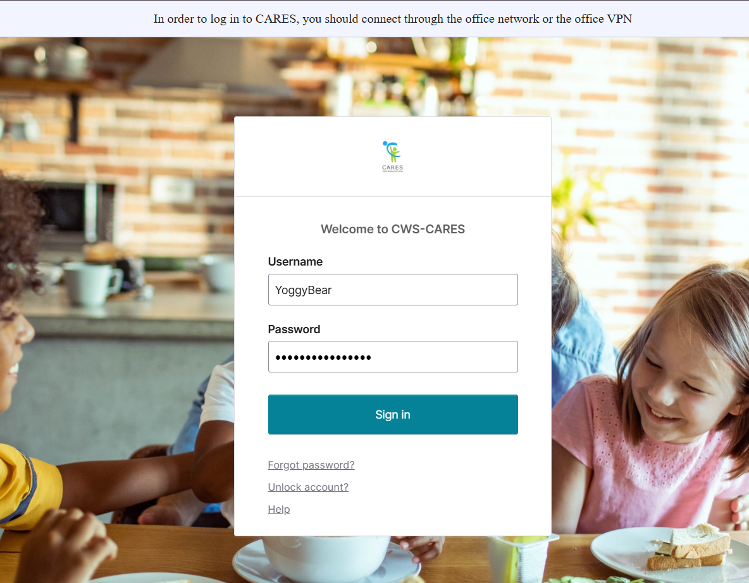
Logging into CWS-CARES
Navigate to: https://login.2.cares.cwds.ca.gov/
Enter your County Email associated with the CARES account in the Username field.
Enter the password you created for your CARES account in the Password field.
Click Sign in.
2
3
4
Important Note: If you have difficulty logging in, we will capture your information and route it to the support team for action.

Slide 13
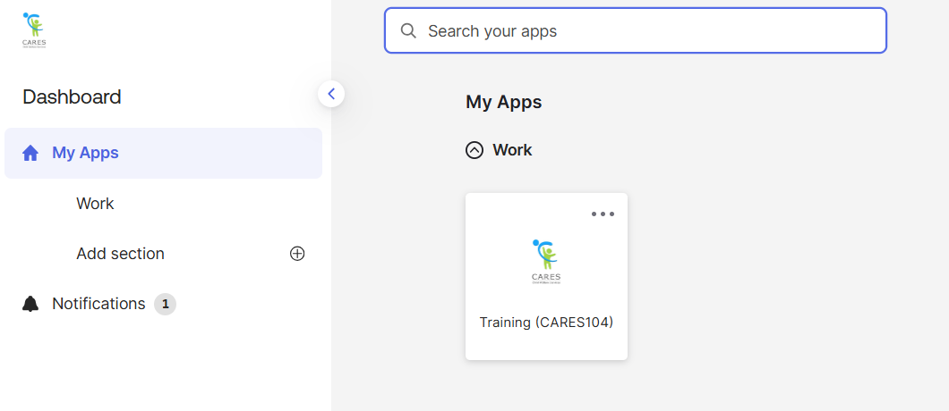
Accessing the CARES Training Environment (104)
The first screen shown upon login is the Okta My Apps dashboard.
To enter CWS-CARES training environment, choose the Training (CARES 104) tile

Slide 14
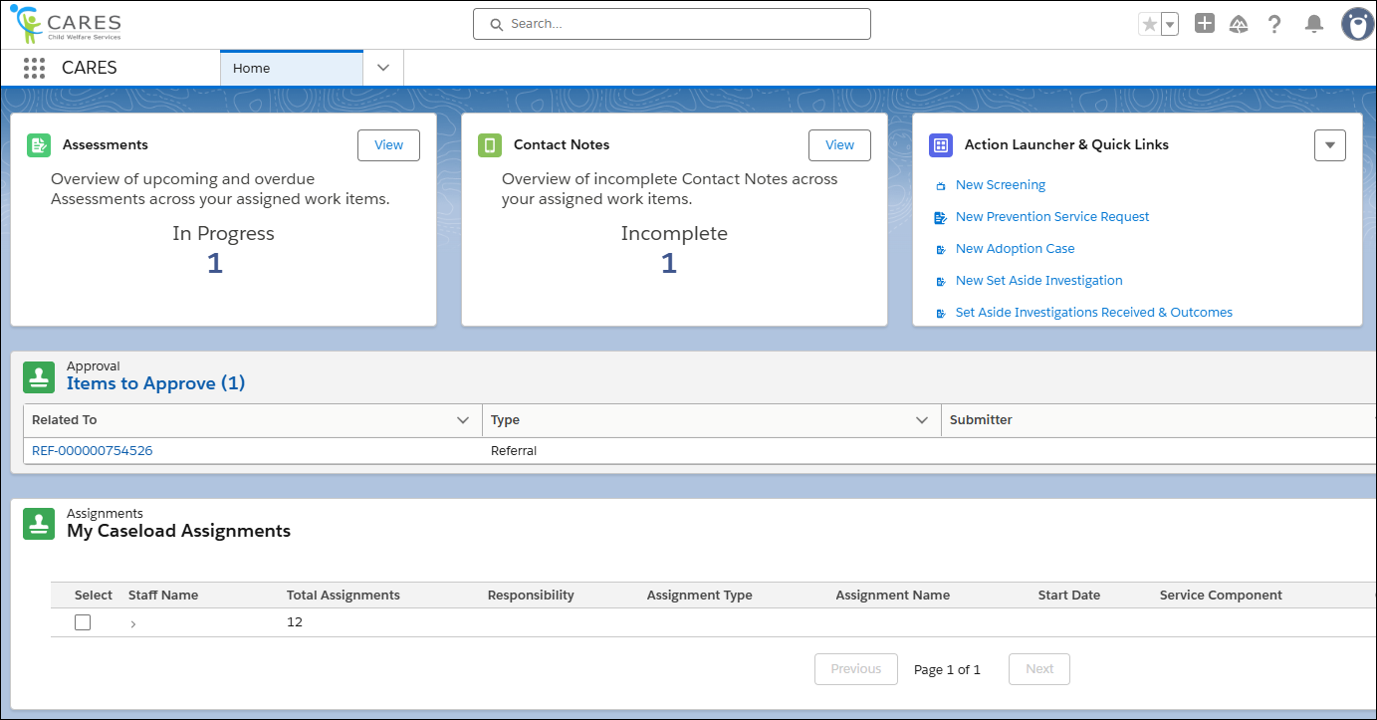
How to Know You're In the Right Place: CWS-CARES
Verify that you are in CARES application tile in the App Launcher in the top left corner of your homepage.
After clicking the CARES tile in the App Launcher, the CWS-CARES Home Page displays.
Important Note: If you are NOT in the CARES application, click the App Launcher (highlighted in the screenshot). Then, select the CARES application.
14

Slide 15
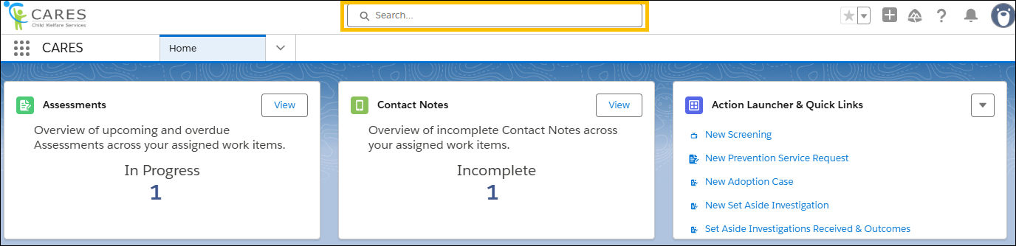
Global Search
Use Global Search to broadly search across the system. This search is best suited for:
Locating knowledge articles
Searching for glossary terms
Finding general content using keywords
To perform a Global Search, enter a keyword or phrase in the search bar available at the top of the screen. The system will begin to pull areas that meet the search criteria as text is entered.
15

Slide 16
Lesson 1: Key Processes to Open a Case
Notes:
Instructor Notes
Do: Display slide
Say:

Slide 17
Scenario Narrative
A youth (age 15) has a history of involvement with local law enforcement and was recently arrested. Due to an escalation in their criminal behavior and the fact that the youth’s parent stated that they cannot control their behavior, the Juvenile Court took jurisdiction under Section 602 of the Welfare and Institutions Code (WIC), the Court made Findings and Orders for out-of-home placement, and the youth was placed on formal probation under supervision of the Probation Department.
Once the Probation Department receives the court order, a designated probation staff person reviews the case, approves it, and assigns the new case to a Juvenile Probation Officer in their dedicated probation system and the Juvenile Probation Officer opens a new non-investigative case for the youth in CWS-CARES.

Slide 18
Key Actions
Create a New Non-Investigative Case
Search & Add Persons
Update New Case Information
Submitting & Approving the Probation Case
Add Core Participants to the Probation Case

Slide 19
Lesson 1
Key Actions:
Create a New Case
Search For and Add Youth
Update New Case Information
Add Core Participants to Case - Parent
19

Slide 20

Lesson 1
Follow-Up
Any questions?
20

Slide 21
Lesson 2: Creating Emergency Placements & Entering Rates
Notes:
Instructor Notes
Do: Display slide
Say:

Slide 22
Scenario Narrative
This will be a continuation of the scenario we had in Lesson 1...
The youth will be placed with his paternal aunt and uncle in an emergency placement (pre-RFA approval). The Juvenile Probation Officer creates a Removal Record, indicates Legal Authority 602 and creates a Child Location placement in CWS-CARES to document that the youth is placed with their paternal aunt, who have been approved placement providers.

Slide 23
Key Actions
Add Birth Country to Child's Person Record
Initiate Removal
Manually Create an Emergency Placement
Entering and Requesting Placement Rates

Slide 24
Lesson 2
Follow-Up
Any questions?
24

Slide 25
Lesson 3: Key Processes to Gather and Provide Information to Authorize Foster Care Eligibility
Notes:
Instructor Notes
Do: Display slide
Say:

Slide 26
Scenario Narrative
This will be a continuation of the scenario we had in Lesson 1& 2...
An Eligibility Record is automatically opened and added to the Probation Youth’s Case when the Child Location record is created. The Juvenile Probation Officer completes the ARC 1 and the CW 51 form in CWS-CARES. The Juvenile Probation Officer assigns an Eligibility Resource to the Case according to local protocol and they receive a notification that they have been assigned to an Eligibility Record and given access to the record.

Slide 27
Key Actions
Reviewing and Updating Eligibility Records in CARES
Verifying Information in the Eligibility Record
Entering Income and Property Information
Sending a Case Link Request to CalSAWS
Collect and Upload Vital Documents to the Eligibility Record
Review CWS-CARES for Eligibility Determination, Payment Authorization, and Issuance Record

Slide 28

FCED Demo
Additional recordings can be found on the CARES Hub

Slide 29
Lesson 3
Follow-Up
Any questions?
29

Slide 30
Welcome Back!
We are excited you are here! Let’s get to work!
30
Notes:
Instructor Notes
Do: Display & review slide
Say:

Slide 31
Lesson 4: Maintain and Monitor Placement
Notes:
Instructor Notes
Do: Display slide
Say:

Slide 32
Scenario Narrative
A few weeks later, the aunt notifies the Juvenile Probation Officer the youth ran away from the placement. The Juvenile Probation Officer obtains the Missing Persons Report that was filed with law enforcement and documents that the youth has run away from the placement. The Juvenile Probation Officer notifies the CWS-CARES Eligibility Resource that the youth has run away, and that the placement is being held for 14 days. The Juvenile Probation Officer creates a task to track the 14 days, based on local practice, so that if the youth does not return to care within that timeframe, the Juvenile Probation Officer can end the placement. The youth does not return to placement within 14 days, so the placement is end dated on the Child Location record and is automatically populated to the Eligibility Record. The Eligibility Resource reviews the placement end date information and notifies CalSAWS via the interface so that payments are also end-dated.
Three weeks later, the Juvenile Probation Officer locates the youth, who was staying at the residence of one of his friends. The paternal uncle and aunt are willing to have the youth return to their home. The Juvenile Probation Officer returns the youth to the placement and documents a new child location as the previous child location with the Resource Family Home (paternal uncle and aunt) was ended due to the youth being absent from placement more than 14 days. The Juvenile Probation Officer notifies their Eligibility Resource of the new child location start date.
The Juvenile Probation Officer provides an update to the court as to the youth’s status and the court orders that Placement Preservation efforts must be made on this case. The Juvenile Probation Officer documents the new Placement Preservation Strategy directly on the Child Location Record/Placement Stability Record, including a narrative describing the concerns and planned interventions and specific tasks to address the concerns, who will be responsible for the tasks, and start and end dates for the tasks. The Placement Preservation Strategy is shared with all relevant parties.

Slide 33
Key Actions
Update Placement Stability
Create Placement Preservation Strategy
Creating 14 Day Notice
Recording Absences

Slide 34
Lesson 4
Follow-Up
Any questions?
34

Slide 35
Lesson 5: Short-Term Residential Treatment Program (STRTP) Placements
Notes:
Instructor Notes
Do: Display slide
Say:

Slide 36
Scenario Narrative
Two weeks later, the Juvenile Probation Officer is contacted by the aunt and uncle, who report that the youth’s behavior has been increasingly difficult to manage in the home, including threats to run away, threats to harm the other children who reside in the home, threats to the pets in the home, and self-harm statements. They believe he is in need of a more structured placement than they can provide. The Juvenile Probation Officer schedules an emergency Child and Family Team Meeting to discuss placement options for the youth and the recommendation is to place the child in an STRTP. The Juvenile Probation Officer is able to locate an STRTP placement for the youth and places him in the facility on an emergency basis. The Juvenile Probation Officer schedules the Qualified Individual assessment and the Interagency Placement Committee meeting and provides the Qualified Individual’s assessment, CFT Summary and Action Items, and all available assessments to the Interagency Placement Committee. The Interagency Placement Committee will make a determination about placement, document their decision, and return it to the Juvenile Probation Officer. The Juvenile Probation Officer receives the documentation that the QI approved the STRTP and provides the IPC’s determination along with the QI’s assessment to the STRTP. The Juvenile Probation Officer uploads court minute orders approving the STRTP into CWS-CARES.

Slide 37
Key Actions
Case Management Requirements for STRTPs
STRTP Placements
Update STRTP Placement Decision

Slide 38
Lesson 5
Follow-Up
Any questions?
38

Slide 39
Lesson 6: Extended Foster Care (EFC) Processes
Notes:
Instructor Notes
Do: Display slide
Say:

Slide 40
Key Actions
Change the Service Component to Supportive Transition
Change the Case Type
Complete the EFC Eligibility Page
Create Initial/Re-Entry into EFC
Exiting (Opting Out) from EFC
Gather and Provide Information to Authorize EFC Benefits
Supervised Independent Living Placements (SILPs)
Transitional Housing Placements

Slide 41
Review/Questions/Wrap-up
Notes:
Instructor Notes
Do: Display slide
Say:

Slide 42
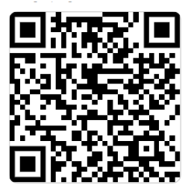
Course Survey
Thank you for completing the course!
Please take a few minutes to fill out the Course Survey, which can be found here:

Slide 43
Thank you!
You have reached the end of this training. Congratulations!
43
Notes:
Instructor Notes
Do: Display & review slide
Say:

Slide 44
Let’s Take a Break!
Please be back and ready to continue in 15 minutes.
44

