Slide 1
CWS-CARES Training
ILT Course: Adoption
July-October 2026
https://cwds.ca.gov/
Notes:
Instructor Notes
Do: Display slide
Say:

Slide 2
Course Introduction

Slide 3
Training Introduction
We will start class with a quick introduction from Jessica Rougeux, the Chief of the Child Welfare System Branch: Introduction to ILT - Jessica Rougeux.mp4

Slide 4
Ground Rules & Housekeeping
01
02
03
04
Stay Engaged
Ask Questions​
Minimize Distractions
Vegas Rules
Follow along with your trainer(s) throughout the session.
If you are in-person, raise your hand in the main sessions to ask questions.
If you are virtual, use the Microsoft Teams chat to type your questions directly in the chat.​ We will get to them as soon as possible.
Avoid checking your cell phone, email, or CWS-CMS during the session.
Do not share any sensitive or confidential information you may encounter during the class outside the session.
Please use fictional names in the Training Environment
Notes:
Instructor Notes:
Do:
Display PPT slide.
Review the slide.

Slide 5







About This Course
Course Content
Tech Support
Parking Lot
Recording Notice
Training
Environment
Q&A Options
Course Feedback

Slide 6
Meet Your Facilitators!

Slide 7
Course Objectives
Item | Objectives
1. | Understand the key processes to conduct Preliminary Adoption Assessment, including: Creating Parent-Child Suitability Summary (PCSS) Creating Tribal Customary Adoption-Parent-Child Suitability Summary (TCA-PCSS) and receiving TCAO from the tribe Creating Non-minor Dependent Adoption Assessment Documenting PCSS Grievance Request and Outcome Generating Forms
2. | Understand the key processes to conduct activities to complete Adoptions documentation, including: Freeing Packets Adoptive Placement Packets Finalization Packets Final Court Hearing

Slide 8
Course Objectives Continued
Item | Objectives
3. | Understand the key processes to gather and provide information to authorize AAP benefits, including: Creating an AAP case Selecting the applicable rate structure Creating and uploading AAP forms Initial AAP Agreements Completing AAP 6, AD 4320 Sending case link to CalSAWS Completing AAP 2 Sending AAP rate information to CalSAWS Amended AAP Agreements Completing AAP 6, AD 4320 Completing AAP 2 and Sending rate information to CalSAWs Closing an AAP case
4. | Understand the key processes to close Adoption Case and process post-Adoption Service Requests. Processing PAS requests on closed Adoption cases found in CWS-CARES Processing PAS requests on closed Adoption cases not found in CWS-CARES
5. | For CDSS Only: Understanding the key processes to document Set Aside Investigations Creating and assigning a Set Aside Investigation Documenting a Set Aside Hearing Creating and submitting the Set Aside Report Closing the Set Aside Investigation

Slide 9
Course Agenda
Activity | Duration
Welcome | 10 min
Lesson 1: Review Activity | 20 min
Lesson 2: Adoption Assessment | 30 min
Break | 15 min
Lesson 3: Adoptions Documentation | 60 min
Lesson 4: Adoption Assistance Program | 55 min
Lesson 5: Adoption Case Closure | 20 min
Review/Questions/Wrap-up | 20 min
Estimated Total Duration | 3.5 Hours

Slide 10
Logging in to CWS-CARES

Slide 11
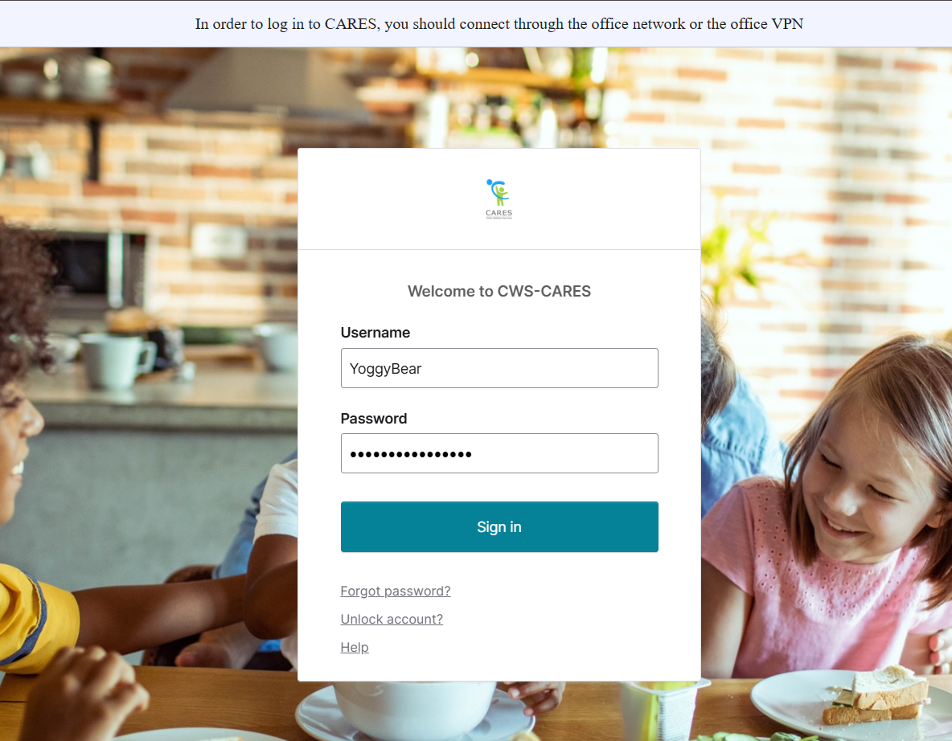
Logging into CWS-CARES
Navigate to: https://login.2.cares.cwds.ca.gov/
Enter your County Email associated with the CARES account in the Username field.
Enter the password you created for your CARES account in the Password field.
Click Sign in.
2
3
4
Important Note: If you have difficulty logging in, we will capture your information and route it to the support team for action.

Slide 12
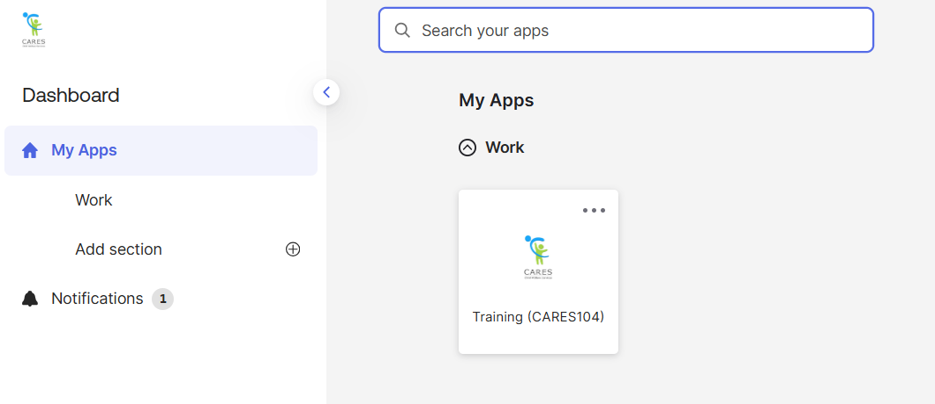
Accessing the CARES Training Environment (104)
The first screen shown upon login is the Okta My Apps dashboard.
To enter CWS-CARES training environment, choose the Training (CARES 104) tile

Slide 13
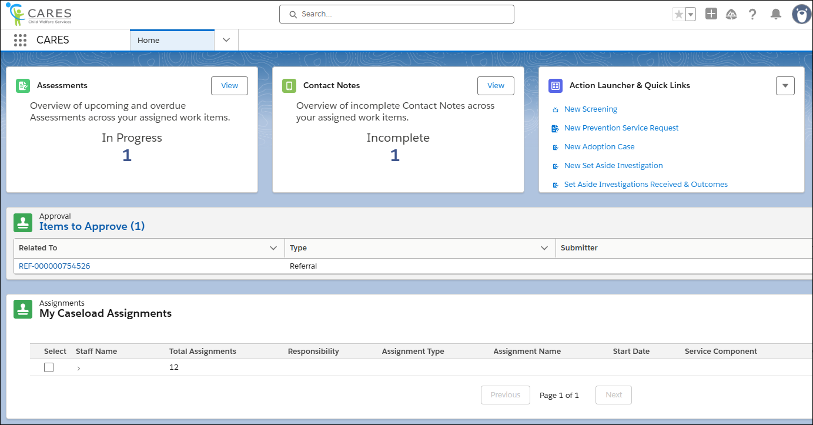
How to Know You're In the Right Place: CWS-CARES
Verify that you are in CARES application tile in the App Launcher in the top left corner of your homepage.
After clicking the CARES tile in the App Launcher, the CWS-CARES Home Page displays.
Important Note: If you are NOT in the CARES application, click the App Launcher (highlighted in the screenshot). Then, select the CARES application.

Slide 14
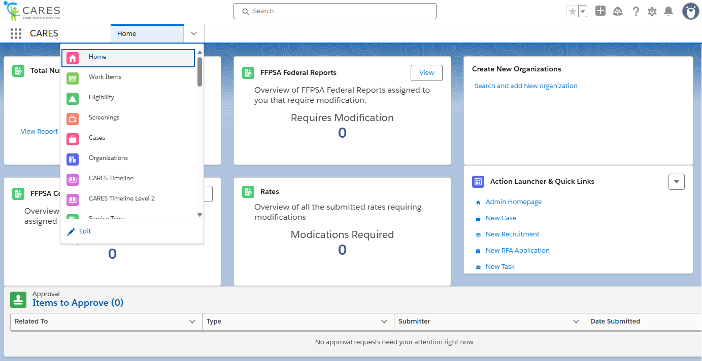
Navigation Menu
The Navigation Menu consists of a dropdown that contains links to sections of CWS-CARES that you have permission to access.
Common selections are:
Home
Screenings
Eligibility
Cases
Reports
Person Search
Work Items

Slide 15
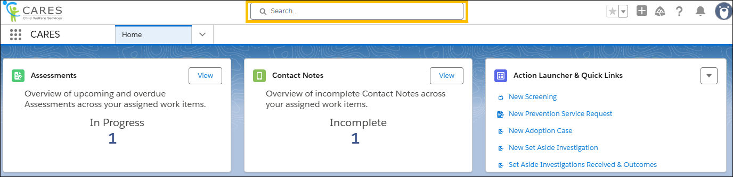
Global Search
Use Global Search to broadly search across the system. This search is best suited for:
Locating knowledge articles
Searching for glossary terms
Finding general content using keywords
To perform a Global Search, enter a keyword or phrase in the search bar available at the top of the screen. The system will begin to pull areas that meet the search criteria as text is entered.

Slide 16
Lesson 1: Review Activity
Notes:
Instructor Notes
Do: Display slide
Say:

Slide 17
Adoptions Service Requests & Opening an Adoptions Case
The trainer will now demonstrate the process of requesting adoptions services and creating a new adoptions case using Peter's Prime Scenario Case.
You may follow along in the Facilitator Guide

Slide 18
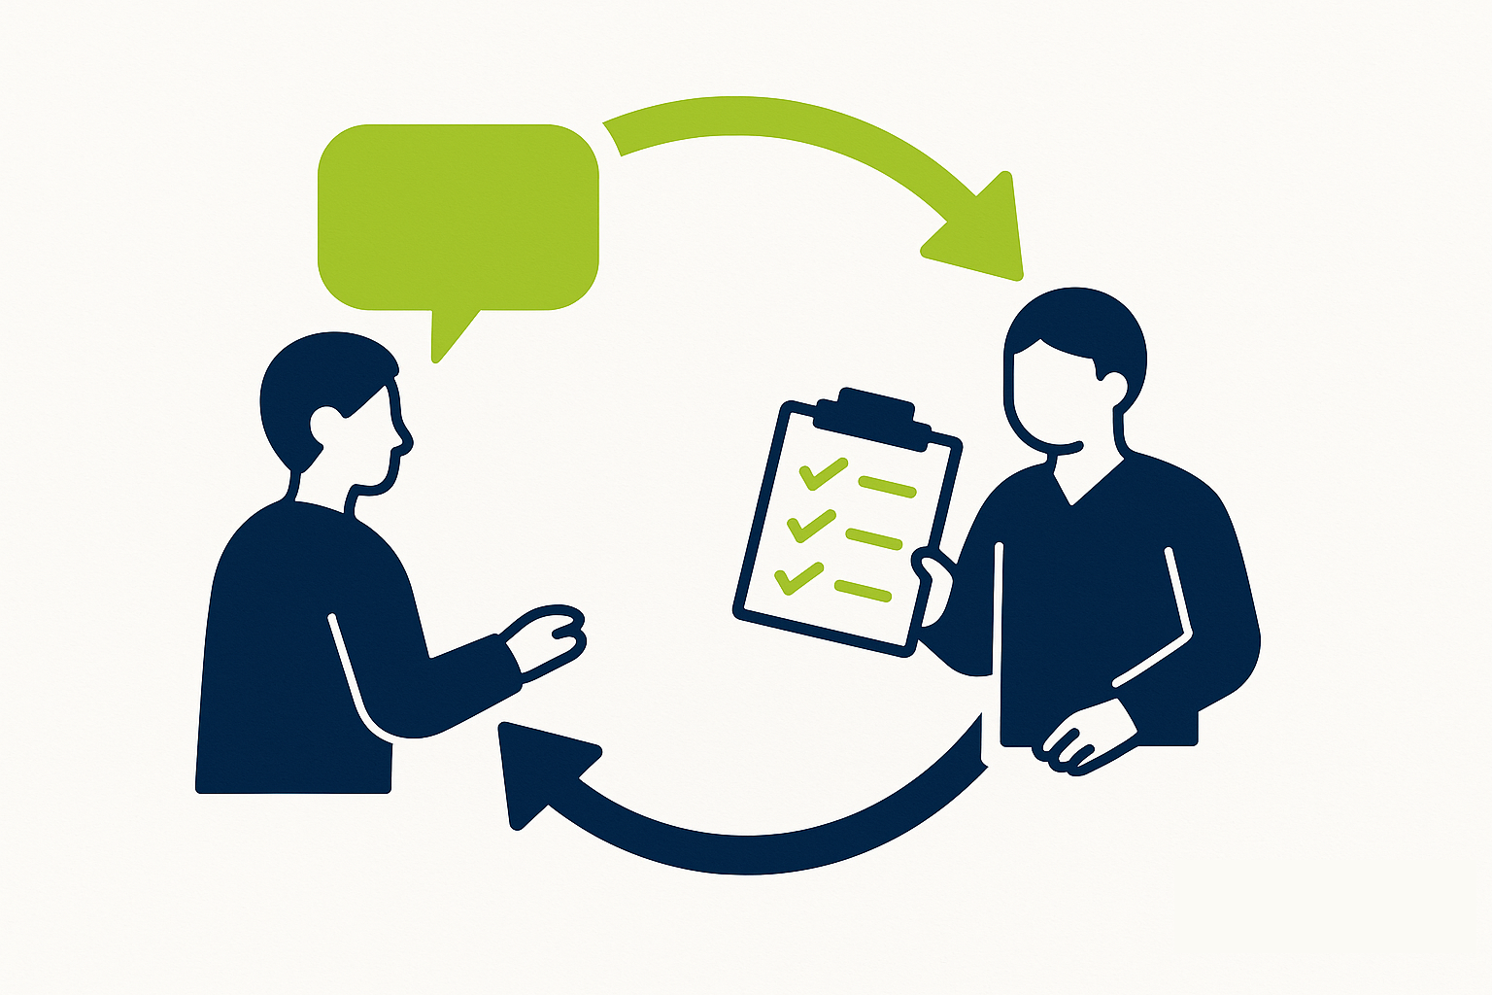
Lesson
Follow-Up
Any questions?

Slide 19
Lesson 2: Adoption Assessments
Notes:
Instructor Notes
Do: Display slide
Say:

Slide 20
Accessing Pre-Seeded Cases for this Scenario
Pre-Seeded cases have been created for TTT Trainings
To access Pre-Seeded cases, please utilize the spreadsheet given to your training facilitators and open the tab that corresponds to the relevant scenario
For CARES Trainers, find the folder for cases seeded for your regional session here: Train the Trainer
  Please make sure you use the tab based on the specific course being taught (i.e., Adoptions)

Slide 21
Lesson 2 Scenario
Although the parents initially participated in services, after Penny’s relapse and Paul’s sentencing, they have not been visiting or completing other components of their case plan. Due to his older sibling’s placement needs, Peter and Victor are no longer placed together. At the review hearing, the case manager recommended that reunification services be terminated. A date for a WIC 366.26 Hearing is set by the Judge.
An Adoptions Service Request is sent to the Adoptions supervisor, and if approved for services, the adoptions supervisor will create a new adoptions case and assign a Primary Adoptions worker

Slide 22

Lesson 2
Key Actions:
Review Adoptions Case
Create Contact Log
Complete Preliminary Adoption Assessment
Generate Parent Child Suitability Summary
Create Child Assessment & History
Complete Grievance for PCSS
Document Termination of Parental Rights

Slide 23
Lesson 2 Scenario (Continued)
Next, the Adoptions worker completes an assessment of the proposed Permanent Plan . Adoption with his current Caregiver, MGM Veronica. Upon completion of the Parent-Child Suitability Summary, the Adoption Worker submits the PCSS to the Adoption Supervisor. The Adoption Supervisor reviews and sends the PCSS back to the Adoption Worker requesting modifications. Once approved by the Adoption Supervisor, the Adoption Worker is made aware that the PCSS is ready and provides a copy of the PCSS to the potential adoptive parents to continue in the adoption process. Additionally, the Case Management Worker made aware that the completed PCSS is available on the child’s Case Management Case Record.

Slide 24
Lesson 2
Follow-Up
Any questions?

Slide 25
Let’s Take a Break!
Please be back and ready to continue in 15 minutes.

Slide 26
Welcome Back!
We are excited you are here! Let’s get to work!
Notes:
Instructor Notes
Do: Display & review slide
Say:

Slide 27
Lesson 3: Adoptions Documentation
Notes:
Instructor Notes
Do: Display slide
Say:

Slide 28
Lesson 3 Scenario
When the Court terminates parental rights to Peter and orders the permanent plan of Adoption, the Adoptions Worker completes the Freeing Packet, including the AD 90 – Supporting Information for Issuance of CDSS Acknowledgement and Confirmation of Receipt of Child Freeing Documents, AD 551A – Notification of Procedure in Lieu of Signing Relinquishment, Waiver or Denial, and submits the necessary documentation. The Adoption Worker delivers the completed documents to the CDSS Adoption Support Unit through physical mail and documents the delivery of the child’s freeing documents to the CDSS Adoption Support Unit in CARES. The CDSS Adoption Support Unit reviews the provided documentation and provides a completed AD 4333 – Acknowledgement or Confirmation of Receipt of Child Freeing Documents to the Adoption Worker. When the worker receives the AD 4333 – Acknowledgement or Confirmation of Receipt of Child Freeing Documents from CDSS Adoption Support Unit, the worker records this information indicating the child is legally free on the Details page of the Freeing Packet and the worker uploads it to the Adoption case.

Slide 29
Lesson 3
Key Actions:
Create a Freeing Packet
Generate Freeing Documents
Packet Submission and Acknowledgement and Confirmation of Receipt (AD4333)
Create an Adoptive Placement Packet
Additional Documentation for Finalization
Create New Finalization Hearing
Create Final Court Report
Submit Final Court Report for Approval and Approve
Generate Court Report

Slide 30
Lesson 3
Follow-Up
Any questions?

Slide 31
Lesson 4: Adoption Assistance Program
Notes:
Instructor Notes
Do: Display slide
Say:

Slide 32
Scenario: Adoption Assistance Program (AAP)
As part of the process, the grandmother is informed about the Adoptions Assistance Program. The CARES User completes the AAP 1 – Request for Adoption Assistance with the grandmother and the AAP case is opened.
Next, the CARES User uploads the completed AAP 1 into the AAP case. The CARES User generates the necessary forms (i.e., FC8 8, AAP 4), works with designated Eligibility Staff to complete them outside of CARES, and uploads to the AAP case in the system.
Since the AAP4 confirms the child is AAP eligible, the CARES User completes the AAP 9A- Rate Determination Protocol Matrix and AAP 9B - Digital Scoring Form to assess the child’s Level of Care (LOC). Once the LOC has been determined, the CARES User completes and generates the AAP 6 - Negotiated Benefit Amount and the AD 4320 – Adoption Assistance Program Agreement forms. These forms are reviewed and approved by a supervisor, then wet signed by the adoptive parents. With the information from the AD4320 and AAP 6, the CARES User completes, generates, and signs the AAP 2. Next, the CARES User submits the child’s AAP information to CalSAWS to initiate the CalSAWS Case Link.
Once this information is sent, CalSAWS establishes an AAP case for the child and sends the CARES User the CalSAWS case number. After receiving an eligibility determination from CalSAWS, CARES creates the necessary payment authorization, rate, and aid code records on the child’s AAP case. The CARES User then navigates to the child’s AAP Case Eligibility Record document section to view the received NA 791 and verifies the information that has been populated into the form.

Slide 33
Lesson 4
Key Actions:
Creation of AAP 1 document
Create a New AAP CASE
Generate FC 8
Upload Final signed FC 8 Document
Document AAP 4 Information
Generating AAP 4 - Eligibility Certification Adoption Assistance Program
Uploading Final AAP 4
Document AAP 9A and AAP 9B
Generating AAP 9A and AAP 9B documents
Document AAP 6 and AD 4320
Submit AAP Agreement for Approval and Approve
Generating AAP 6 and AD 4320
Completing AAP 2 document
Generate AAP 2
Submit to CalSAWS

Slide 34
Lesson 4
Follow-Up
Any questions?

Slide 35
Lesson 5: Adoption Case Closure
Notes:
Instructor Notes
Do: Display slide
Say:

Slide 36
Scenario: Adoption Case Closure
After receiving the Adoption finalization orders, the CARES user creates the Adoption Case Closure Request to prepare the case for closure and submits to their supervisor for approval. After the case is closed, an Adoption Worker receives a Post Adoption Information Request in the mail. The worker searches CARES to locate the closed Adoption case. In the Post Adoption Section of the case, the worker logs the request that was received.

Slide 37
Lesson
Key Actions:
Document Adoption Finalization Hearing Outcome
Receive Adoption Orders
Run AFCARS Data Checking Tool
Complete Tasks
Document Reason for Case Closure
Post-Adoption Services

Slide 38
Lesson 5
Follow-Up
Any questions?

Slide 39
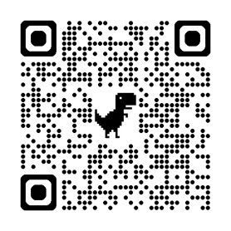
Course Survey
Thank you for completing the course!
Please take a few minutes to fill out the Course Survey, which can be found here:
https://cahhscwds.gov1.qualtrics.com/jfe/form/SV_024TW5uq8KQSBGm

Slide 40
Thank you!
You have reached the end of this training. Congratulations!
Notes:
Instructor Notes
Do: Display & review slide
Say:

Slide 41
Lesson 6: Set Aside Adoptions
Notes:
Instructor Notes
Do: Display slide
Say:

Slide 42
Scenario
The adoptive parent, MGM, of Peter filed a petition to set aside the adoption with the Superior Court of California (Family Law). The CDSS Regional Office worker creates the Set Aside Investigation on Peter's Adoption Case and assigns it to the CDSS Adoptions Worker to complete.
The CDSS Adoptions Worker documents when the Case Consultation is initiated and contact information for the CDSS Attorney and Deputy Attorney General. The worker records contact notes for each interview conducted with the Focus Child, Peter, and the adoptive parent, MGM. The Adoptions Worker then documents the results of their investigation via a Set Aside Report. Once their report receives all required approvals, the worker documents who they have distributed the Set Aside Report to.
After filing the Set Aside Report with the court, the Adoptions Worker creates a Hearing record to capture the Hearing details. Prior to closing the Set Aside Investigation, the worker documents a narrative on the readiness to close the Set Aside Investigation. They also ensure all required documentation is uploaded, merged into one packet, and redacted as required.

Slide 43
Lesson 6
Key Actions:
Update Persons Involved
Create Set Aside Investigation
Document Investigation
Create Report
Submit for Approvals
Generate Report
Documenting Set Aside Hearings and Appeals
Closing Set-Aside Investigation

Slide 44
Lesson 1
Follow-Up
Any questions?

