Slide 1
CWS-CARES Training
ILT Course: Eligibility
July-October 2026
https://cwds.ca.gov/
Notes:
Instructor Notes
Do: Display slide
Say:

Slide 2
Course Introduction

Slide 3
Training Introduction
We will start class with a quick introduction from Jessica Rougeux, the Chief of the Child Welfare System Branch: Introduction to ILT - Jessica Rougeux.mp4

Slide 4
Ground Rules & Housekeeping
01
02
03
04
Stay Engaged
Ask Questions​
Minimize Distractions
Vegas Rules
Follow along with your trainer(s) throughout the session.
If you are in-person, raise your hand in the main sessions to ask questions.
If you are virtual, use the Microsoft Teams chat to type your questions directly in the chat.​ We will get to them as soon as possible.
Avoid checking your cell phone, email, or CWS-CMS during the session.
Do not share any sensitive or confidential information you may encounter during the class outside the session.
Please use fictional names in the Training Environment
Notes:
Instructor Notes:
Do:
Display PPT slide.
Review the slide.

Slide 5







About This Course
Course Content
Tech Support
Parking Lot
Recording Notice
Training
Environment
Q&A Options
Course Feedback

Slide 6
Meet Your Facilitators!

Slide 7
Course Objectives
Item | Objectives
1. | Understand key processes to gather and provide information to request and receive an authorized Foster Care Eligibility determination, including: Reviewing and updating Eligibility records in CARES Verifying information in the Eligibility Record Managing documents in the Eligibility Record Sending a case link request to CalSAWS Entering and requesting Placement Rates Entering Income and Property Information Providing supplementary placement information to CalSAWS
2. | Understand key processes to gather and provide information to authorize Foster Care Eligibility Redetermination, including: Reviewing and updating the eligibility record to ensure that it is accurate Sending updated information to CalSAWS
3. | Understand key processes to gather and provide information to authorize Kin-GAP benefits, including: Requesting information regarding a child’s potential Kin-GAP eligibility from CalSAWS Requesting signatures on a Kin-GAP SOC369 and 369A agreements Providing finalized guardianship documents to CalSAWS

Slide 8
Course Objectives Cont.
Item | Objectives
4. | Understand key processes to gather and provide information to authorize Foster Care benefits for children in Non-related Legal Guardianships (NRLG), including: Updating the Eligibility Record, as needed Sending Letter of Guardianship to CalSAWS
5. | Understand key processes to create and communicate information related to an Alternative Care scenario, including: Reviewing and updating a Medi-Cal Eligibility Record Generating a Medi-Cal application form (MC 250) Requesting a case link from CalSAWS Receiving a Medi-Cal Determination

Slide 9
Course Agenda
Activity | Duration
Welcome | 10 min
Lesson 1: Review Activity | 30 min
Lesson 2: Foster Care Eligibility Determinations | 30 min
Lesson 3: Foster Care Eligibility Redeterminations | 10 min
Break | 15 min
Lesson 4: Kin-GAP Benefits | 15 min
Lesson 5: Non-related Legal Guardian (NRLG) | 15 min
Lesson 6: Medi-Cal | 20 min
Review/Questions/Wrap-up | 20 min
Estimated Total Duration | 3 Hours

Slide 10
Logging in to CWS-CARES

Slide 11
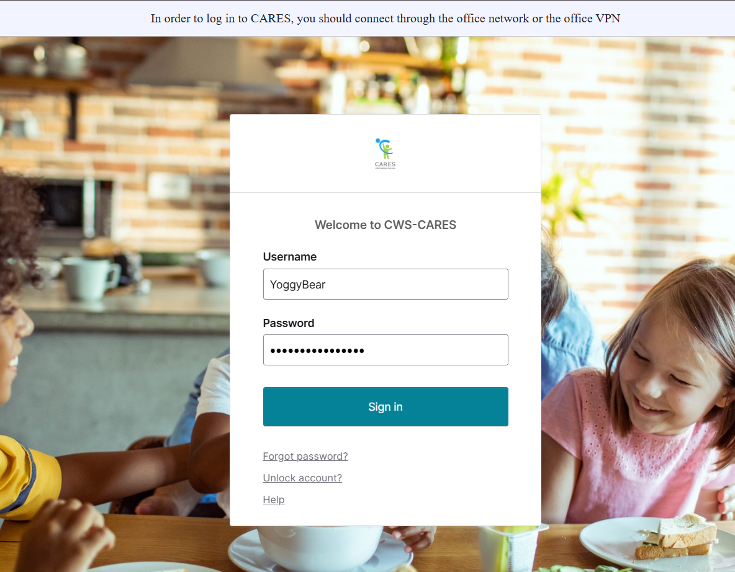
Logging into CWS-CARES
Navigate to: https://login.2.cares.cwds.ca.gov/
Enter your County Email associated with the CARES account in the Username field.
Enter the password you created for your CARES account in the Password field.
Click Sign in.
2
3
4
Important Note: If you have difficulty logging in, we will capture your information and route it to the support team for action.

Slide 12
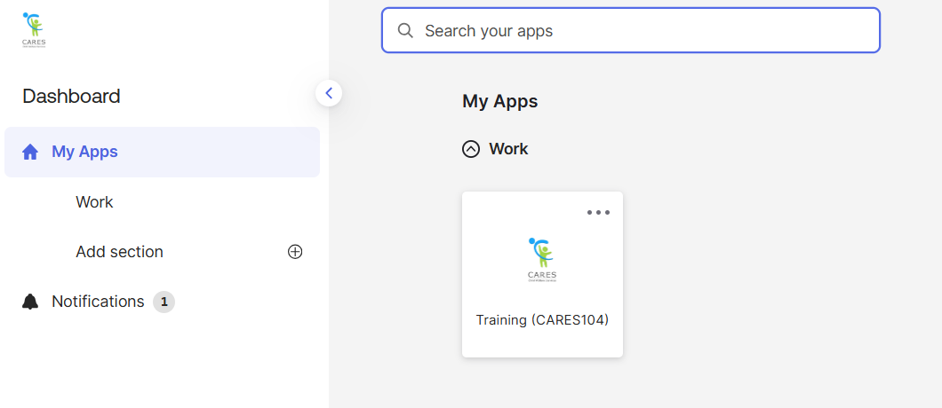
Accessing the CARES Training Environment (104)
The first screen shown upon login is the Okta My Apps dashboard.
To enter CWS-CARES training environment, choose the Training (CARES 104) tile

Slide 13
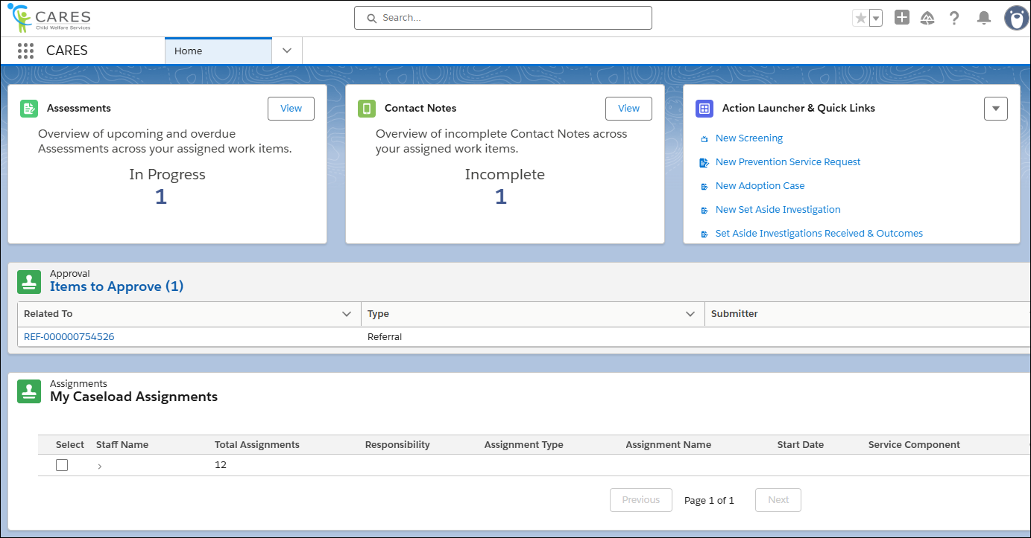
How to Know You're In the Right Place: CWS-CARES
Verify that you are in CARES application tile in the App Launcher in the top left corner of your homepage.
After clicking the CARES tile in the App Launcher, the CWS-CARES Home Page displays.
Important Note: If you are NOT in the CARES application, click the App Launcher (highlighted in the screenshot). Then, select the CARES application.

Slide 14
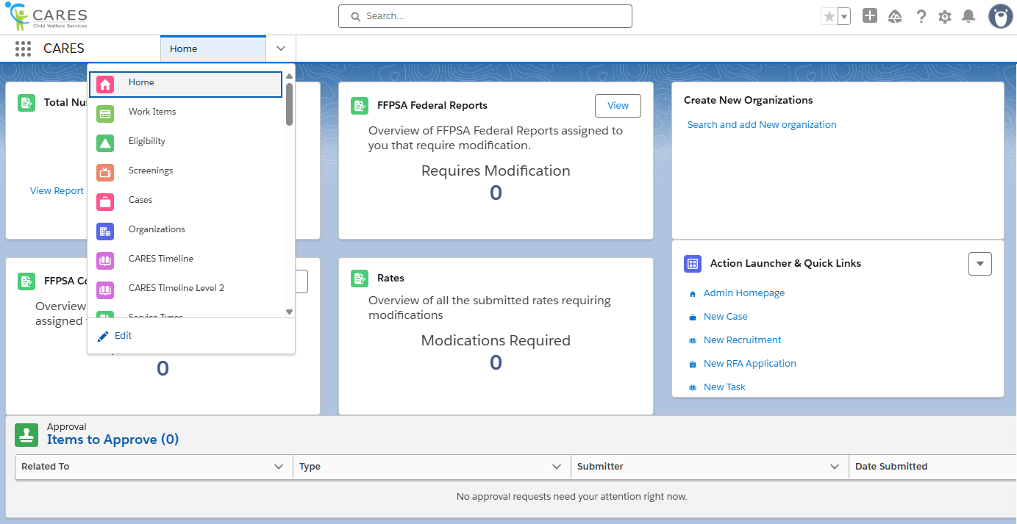
Navigation Menu
The Navigation Menu consists of a dropdown that contains links to sections of CWS-CARES that you have permission to access.
Common selections are:
Home
Screenings
Eligibility
Cases
Reports
Person Search
Work Items

Slide 15
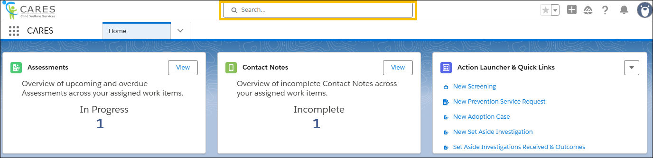
Global Search
Use Global Search to broadly search across the system. This search is best suited for:
Locating knowledge articles
Searching for glossary terms
Finding general content using keywords
To perform a Global Search, enter a keyword or phrase in the search bar available at the top of the screen. The system will begin to pull areas that meet the search criteria as text is entered.

Slide 16
Lesson 1: Review Activity
Notes:
Instructor Notes
Do: Display slide
Say:

Slide 17
Lesson 2: Foster Care Eligibility Determinations
Notes:
Instructor Notes
Do: Display slide
Say:

Slide 18
Accessing Pre-Seeded Cases for this Scenario
For this session, you should be able to use the case created during the Screenings & Referrals course.
If there are issues, Pre-Seeded cases have been created for TTT Trainings
To access Pre-Seeded cases, please utilize the spreadsheet given to your training facilitators and open the tab that corresponds to the relevant scenario
For CARES Trainers, find the folder for cases seeded for your regional session here: Train the Trainer
  Please make sure you use the tab based on the specific course being taught (i.e., Eligibility)

Slide 19
Scenario
Once the children are placed, their cases are assigned to a CARES Eligibility Resource who begins work on the children’s Eligibility Records. The CARES Eligibility Resource initiates a Case Link to CalSAWS. Next, the CARES Eligibility Resource enters the rate information in CARES for Victor and Peter’s placements. Depending on county practice, the Eligibility Resource may need to obtain supervisor approval on the proposed rates prior to sending the information to CalSAWS. When all approvals are received, the rate request information is sent to CalSAWS.
The CARES Eligibility Resource then begins the process of reviewing and gathering the information required to determine eligibility for foster care. The CARES Eligibility Resource first validates that information used to support the SOC 158A and FC 2 has been populated from the child’s case, court, placement, and case plan records. The CARES Eligibility Resource sends information that has been populated into the SOC158A and FC2 to CalSAWS as it becomes available. The Eligibility Resource will enter the child’s income and property information and related Home Removal information in the related Eligibility Record, as needed. Next, based on county business practice, the CARES Eligibility Resource generates and signs the SOC 158A and FC2.
After CalSAWS receives the required information and the eligibility determination request is approved, the child can begin receiving foster care funding to support the costs of housing the child.

Slide 20
Lesson
Key Actions:
Reviewing and updating Eligibility records in CARES
Verifying information in the Eligibility Record
Sending new information to CalSAWS
  Entering and Requesting Placement Rates
  Entering Income and Property Information
  Sibling Information
  Placement change
Complete SOC 158A (Foster Child’s Data Record and AFDC-FC Certification
FC 2 Statement of Facts Supporting Eligibility for AFDC-FC (Foster Care)
Complete the CW52 Child Support: Good Cause Claim for Non-cooperation
Managing documents in the Eligibility Record
  SOC 158A
  FC 2
  ARC 1
  CW 51

Slide 21

FCED Demo (if needed)
Additional recordings can be found on the CARES Hub

Slide 22
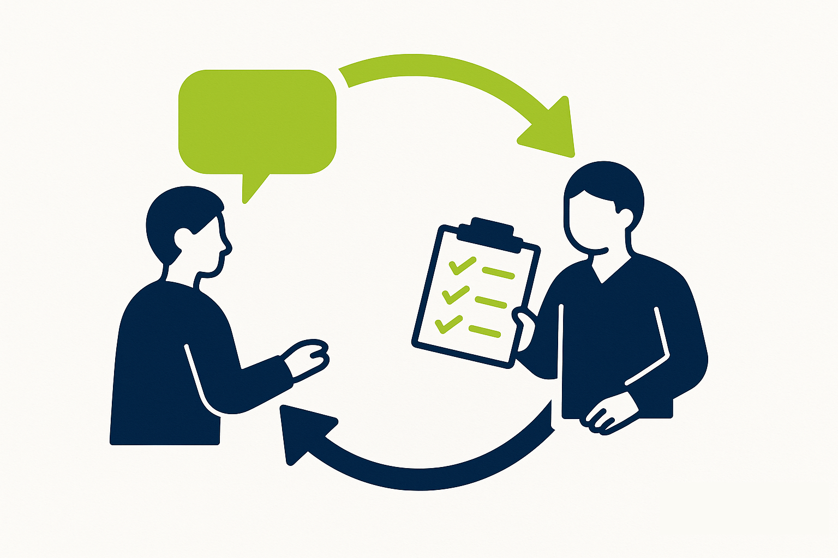
Lesson
Follow-Up
Any questions?

Slide 23
Lesson 3: Foster Care Eligibility Redetermination
Notes:
Instructor Notes
Do: Display slide
Say:

Slide 24

Scenario
A year has passed from the child's initial determination and now it's time for an annual redetermination.
We will run through this scenario as a walkthrough demo, instead of hands-on.

Slide 25
Lesson
Key Actions:
Reviewing and Updating the Eligibility Record for Accuracy
Generating the ARC 2
Sending updated information to CalSAWS

Slide 26
Lesson
Follow-Up
Any questions?

Slide 27
Let’s Take a Break!
Please be back and ready to continue in 10 minutes.

Slide 28
Welcome Back!
We are excited you are here! Let’s get to work!
Notes:
Instructor Notes
Do: Display & review slide
Say:

Slide 29
Lesson 4: Kin-GAP Benefits
Notes:
Instructor Notes
Do: Display slide
Say:

Slide 30
Accessing Pre-Seeded Cases for this Scenario
If there are issues, Pre-Seeded cases have been created for TTT Trainings
To access Pre-Seeded cases, please utilize the spreadsheet given to your training facilitators and open the tab that corresponds to the relevant scenario
For CARES Trainers, find the folder for cases seeded for your regional session here: Train the Trainer
  Please make sure you use the tab based on the specific course being taught (i.e., Eligibility)

Slide 31
Scenario
A child with an active Child Welfare Court case where the Service Component is Permanent Placement is scheduled for a WIC 366.26 (Selection and Implementation) Hearing where the recommendation to the Court is to award legal guardianship to the child’s relative foster caregiver. Prior to the hearing, the child’s social worker will have discussed the option of guardianship with the caregiver, completed and signed SOC369 and SOC369A with the relative caregiver, and changed their role to prospective legal guardian.
At the hearing, the Court granted guardianship and dismissed dependency, and the Worker updates the Court Minute Order in CARES. Afterwards, the CARES User end dates the youth’s current Child Location and records the Foster Care Exit information for the removal episode. The hearing date for termination of dependency and the end date for the Foster Care placement is then sent to CalSAWS in preparation to change the program type from Foster Care to Kin-GAP.
Prior to creating a new Child Location to track the child’s new living arrangement with their legal guardian, the CARES User will change the Case Type from Child Welfare Court to Relative Guardianship-Without Dependency, update the Role for prospective legal guardian to "Legal Guardian", and record a new Removal episode where the Primary Reason for Removal is "Guardianship Established."
A new Kin-GAP eligibility record is automatically created, and the CARES User submits the Case Link request to CalSAWS. The CARES User then completes the Kin-GAP Information details, SOC 369, and SOC 369A sections of the Eligibility record and receives determination from CalSAWS on the Kin-GAP eligibility record.

Slide 32
Lesson
Key Actions:
Requesting Information Regarding a Child’s Kin-GAP Eligibility from CalSAWS
  Generate SOC 369 Predetermination and SOC 369A Predetermination Forms
  Verify Kin-GAP Information is accurate
  Send Request for Information (RFI) to CalSAWS
  Update Prospective Legal Guardian Role
  Complete Prospective Legal Guardian Assessment
  Validate Documents Received from CalSAWS
  Complete the SOC 369A form
  Requesting signatures on a Kin-GAP SOC369 and 369A Agreements
Providing finalized guardianship documents to CalSAWS

Slide 33
Lesson 5: NRLG Benefits
Notes:
Instructor Notes
Do: Display slide
Say:

Slide 34
Accessing Pre-Seeded Cases for this Scenario
If there are issues, Pre-Seeded cases have been created for TTT Trainings
To access Pre-Seeded cases, please utilize the spreadsheet given to your training facilitators and open the tab that corresponds to the relevant scenario
For CARES Trainers, find the folder for cases seeded for your regional session here: Train the Trainer
  Please make sure you use the tab based on the specific course being taught (i.e., Eligibility)

Slide 35
Scenario
A child has been in out of home placement with a non-relative Resource Family for several months. Reunification efforts have ended and a 366.26 Hearing has been scheduled. The CM worker has discussed the possibility of legal guardianship with the Resource Family caregiver, and they are willing to move forward with guardianship.
The courts worker will document that a subsequent 366.26 Hearing took place. At that hearing, a judge determines that legal guardianship is the appropriate path forward and establishes guardianship and terminates dependency. Both of these findings and orders are documented as part of the minute order on the case.
At this point, the case type will automatically change in the system to reflect Non-Related Legal Guardianship - Juvenile Dependency Court/WIC 300, Without Dependency. Depending on county business practice, the worker may choose to close the removal record and open a new one or keep the original one open.

Slide 36
Lesson
Follow-Up
Any questions?

Slide 37
Lesson
Key Actions:
Updating the Eligibility Record, as needed
Sending Letter of Guardianship to CalSAWS

Slide 38
Lesson
Follow-Up
Any questions?

Slide 39
Lesson 6: Alternative Care
Notes:
Instructor Notes
Do: Display slide
Say:

Slide 40
Accessing Pre-Seeded Cases for this Scenario
If there are issues, Pre-Seeded cases have been created for TTT Trainings
To access Pre-Seeded cases, please utilize the spreadsheet given to your training facilitators and open the tab that corresponds to the relevant scenario
For CARES Trainers, find the folder for cases seeded for your regional session here: Train the Trainer
  Please make sure you use the tab based on the specific course being taught (i.e., Eligibility)

Slide 41
Scenario
A Case Management worker has documented a Youth’s Hospitalization in an Alternative Care Setting Child Location Record due to severe physical abuse in the home. The CARES Eligibility Resource is made aware that a Medi-Cal Eligibility record has been automatically created and validate the Mandatory Child Eligibility Request Information section. Following this validation, the CARES Eligibility Resource initiates a Case Link to CalSAWS.
The worker then populates the Medi-Cal application information and generates an MC 250 if required to ensure that there is medical coverage while the child remains hospitalized. After the Case Link has been established, the system sends this additional information to CalSAWS. The CalSAWS Eligibility Worker reviews the Medi-Cal information and approves the determination in CalSAWS. Once complete, the CARES Eligibility Resource receives the determination in the Youth’s Eligibility Record.

Slide 42
Lesson
Key Actions:
Reviewing and updating a Medi-Cal Eligibility Record
Generating a Medi-Cal Application Form (MC 250)
Requesting a case link from CalSAWS
Receiving a Medi-Cal Determination

Slide 43
Lesson
Follow-Up
Any questions?

Slide 44
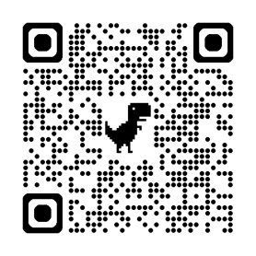
Course Survey
Thank you for completing the course!
Please take a few minutes to fill out the Course Survey, which can be found here:
https://cahhscwds.gov1.qualtrics.com/jfe/form/SV_024TW5uq8KQSBGm

Slide 45
Thank you!
You have reached the end of this training. Congratulations!

