Slide 1
CWS-CARES Training
ILT Course: Resource Family Approval
July-October 2026
https://cwds.ca.gov/
Notes:
Instructor Notes
Do: Display slide
Say:

Slide 2
Course Introduction

Slide 3
Training Introduction
We will start class with a quick introduction from Jessica Rougeux, the Chief of the Child Welfare System Branch: Introduction to ILT - Jessica Rougeux.mp4

Slide 4
Ground Rules & Housekeeping
01
02
03
04
Stay Engaged
Ask Questions​
Minimize Distractions
Vegas Rules
Follow along with your trainer(s) throughout the session.
If you are in-person, raise your hand in the main sessions to ask questions.
If you are virtual, use the Microsoft Teams chat to type your questions directly in the chat.​ We will get to them as soon as possible.
Avoid checking your cell phone, email, or CWS-CMS during the session.
Do not share any sensitive or confidential information you may encounter during the class outside the session.
Please use fictional names in the Training Environment
4
Notes:
Instructor Notes:
Do:
Display PPT slide.
Review the slide.

Slide 5







About This Course
Course Content
Tech Support
Parking Lot
Recording Notice
Training
Environment
Q&A Options
Course Feedback
2026

Slide 6
Meet Your Facilitators!

Slide 7
Course Objectives
Item | Objectives
1. | Understand processes to create and submit a Resource Family Approval Application in CWS-CARES including: Creating and documenting an RFA Recruitment Inquiry Documenting and Submitting an RFA Application for Approval Completing and documenting Background Checks Completing and documenting the Home Health and Safety Evaluation Documenting Pre-Approval Training Completing and documenting the Written Report Completing and documenting References Uploading RFA Forms Generating RFA Approval Certificate
2. | Understand processes to maintain Resource Family homes in CWS-CARES, including: Monitoring and documenting Post Approval Training Indicating Tribal Affiliation for the Resource Family Home Completing the Resource Family Home Biennial Update Documenting the Resource Family Home’s decision for inactive status Creating and Managing a Corrective Action Plan Uploading verification of corrections Closing a Resource Family Home

Slide 8
Course Objectives Cont.
Item | Objectives
3. | Understand processes to create and process Resource Family Home complaints in CWS-CARES, including: Completing a Complaint Investigation Documenting allegations and findings Documenting deficiencies Creating and documenting Registered Sex Offender (RSO) Address Match Investigations Creating and sending cross reports
4. | Understand processes to create and update Resource Family Approval Legal Action in CWS-CARES, including: Creating and scheduling a Legal Consultation Generating Legal Consult memo Creating forms (RFA09, RFA09B, RFA09E, RFA09I) Managing Administrative Action Research System (AARS) Status Creating and processing an Appeal
2026

Slide 9
Course Agenda
Activity | Duration
Welcome | 5 min
Lesson 1: Review Activity | 20 min
Lesson 2: RFA Applications | 45 min
Lesson 3: Home Health & Safety Assessments | 15 min
Break | 10 min
Lesson 4: Maintain Resource Family Home | 30 min
Lesson 5: Resource Family Approval Complaints | 20 min
Lesson 6: Resource Family Approval Legal Action | 30 min
Lesson 7: Registered Sex Offender (RSO) Investigations | 15 min
Review/Questions/Wrap-up | 15 min
Estimated Total Duration | 3.5 Hours
9

Slide 10
Logging in to CWS-CARES

Slide 11
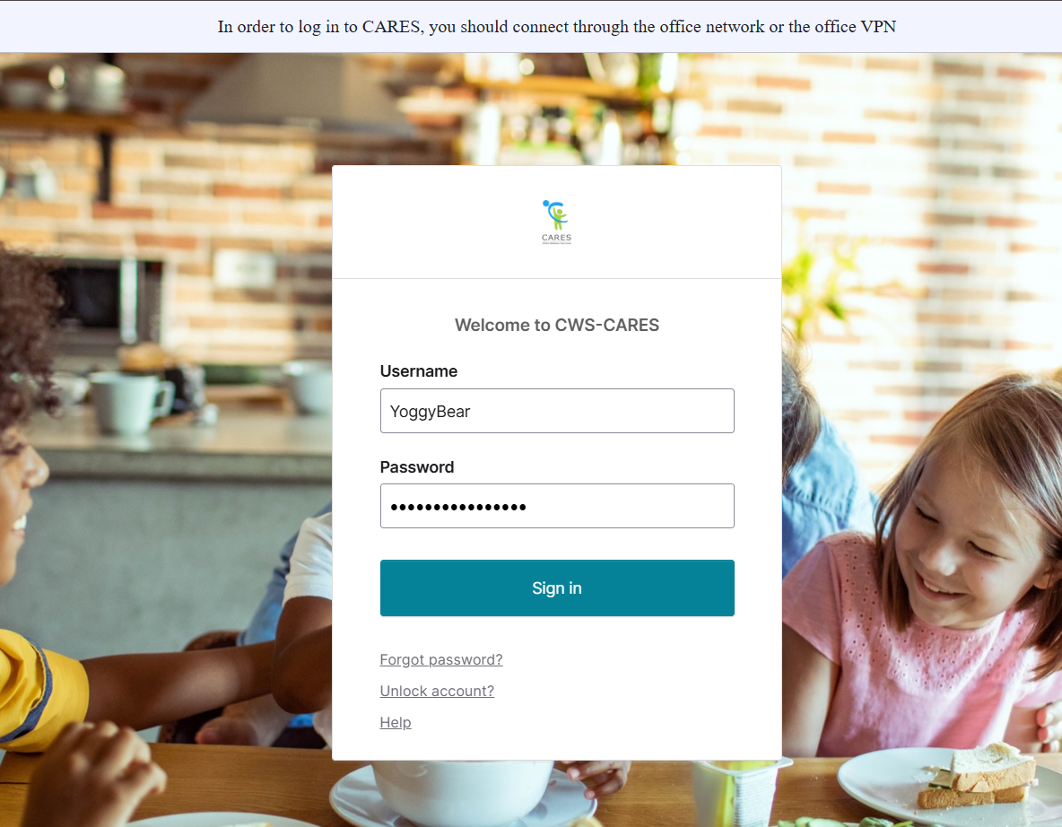
Logging into CWS-CARES
Navigate to CWS-CARES
Enter your County Email associated with the CARES account in the Username field.
Enter the password you created for your CARES account in the Password field.
Click Sign in.
2
3
4
Important Note: If you have difficulty logging in, we will capture your information and route it to the support team for action.

Slide 12
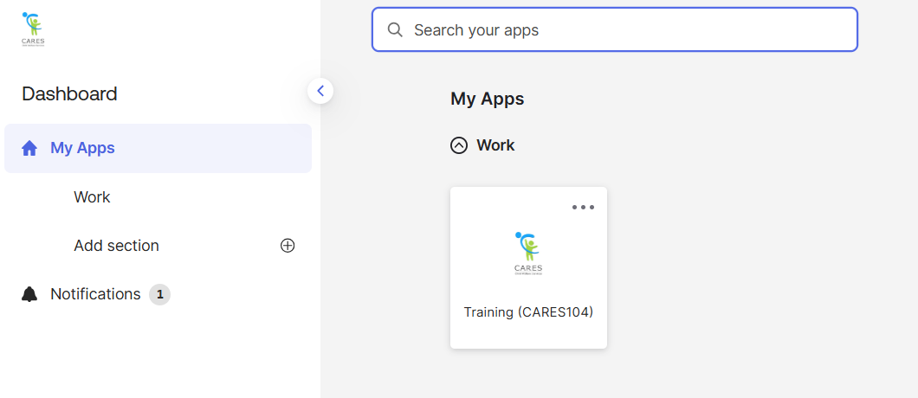
Accessing the CARES Training Environment (104)
The first screen shown upon login is the Okta My Apps dashboard.
To enter CWS-CARES training environment, choose the Training (CARES 104) tile

Slide 13
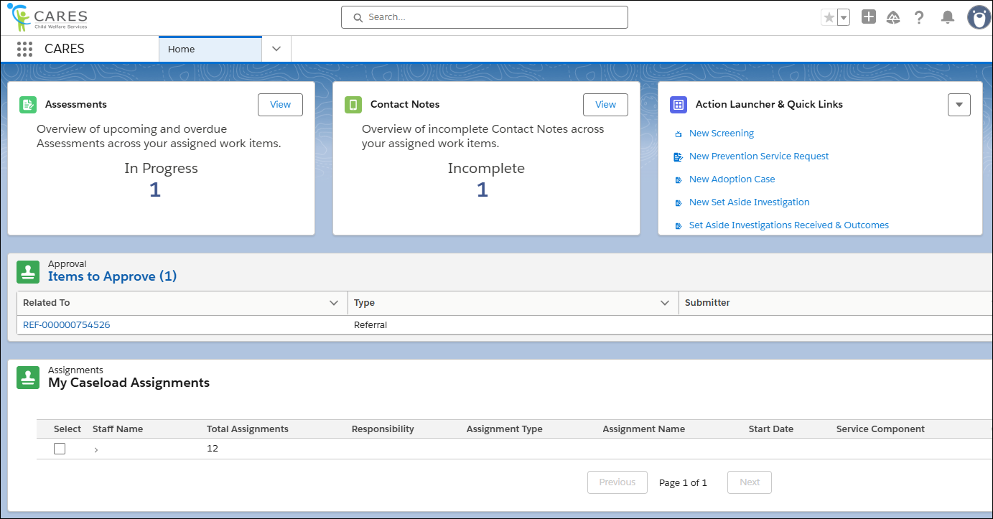
How to Know You're In the Right Place: CWS-CARES
Verify that you are in CARES application tile in the App Launcher in the top left corner of your homepage.
After clicking the CARES tile in the App Launcher, the CWS-CARES Home Page displays.
Important Note: If you are NOT in the CARES application, click the App Launcher (highlighted in the screenshot). Then, select the CARES application.

Slide 14
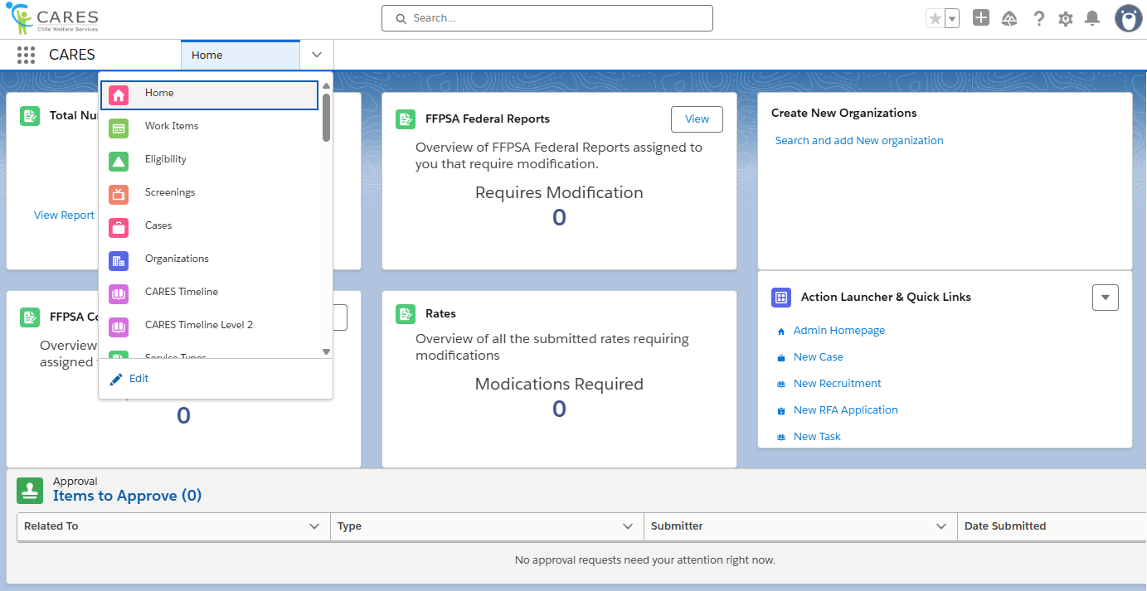
Navigation Menu
The Navigation Menu consists of a dropdown that contains links to sections of CWS-CARES that you have permission to access.
Common selections are:
Home
Screenings
Eligibility
Cases
Reports
Person Search
Work Items

Slide 15
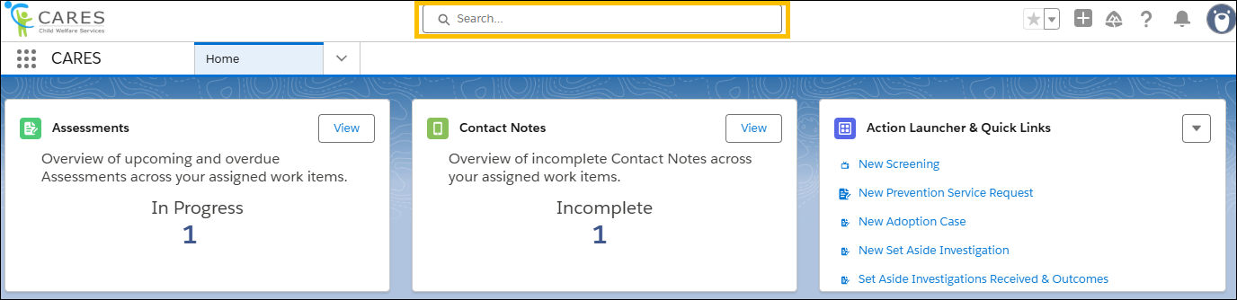
Global Search
Use Global Search to broadly search across the system. This search is best suited for:
Locating knowledge articles
Searching for glossary terms
Finding general content using keywords
To perform a Global Search, enter a keyword or phrase in the search bar available at the top of the screen. The system will begin to pull areas that meet the search criteria as text is entered.

Slide 16
Lesson 1: Review Activity
Notes:
Instructor Notes
Do: Display slide
Say:

Slide 17
Lesson 2: RFA Applications
Notes:
Instructor Notes
Do: Display slide
Say:

Slide 18
Scenario: RFA Applications
As the result of a recent recruitment event, a Resource Family Applicant (RFA) submits an RFA Application to become a Resource Family Home. By completing the RFA Application and providing a signature, the applicant understands that background checks, a family evaluation, pre-approval training, and a Home Health and Safety Assessment must be completed to be an approved Resource Family Home.
Once the Application has been received, a Resource Family Approval (RFA) worker will enter the application in CWS-CARES. The worker self-assigns the application and begins to coordinate with the Applicants to complete pre-approval trainings, receiving any relevant information and scheduling a visit to complete the Home Health and Safety Assessment. The RFA Worker will then begin the background check process. As the background check results are returned, the worker document the results.

Slide 19
Lesson 2
Key Actions:
Create Recruitment Record
Document Recruitment Participant Information
Document Recruitment Closure
Create New RFA Application
Document Application Information
Complete Background Check
19

Slide 20

Lesson 2
Follow-Up
Any questions?

Slide 21
Lesson 3: Home Health & Safety Assessment
Notes:
Instructor Notes
Do: Display slide
Say:

Slide 22
Scenario: Home Health & Safety Assessment (Continued from Lesson 2)
As a part of the process, the RFA Worker must conduct an inspection of the home and complete a Home Health and Safety Assessment with their findings in CWS-CARES. During the inspection, the applicant informed the RFA Worker that they have completed the pre-approval training hours required by their county. The applicant provides 3 references. Following the inspection, the worker documents their Written Report in CWS-CARES as well as their interview with the applicant.
With all required information documented in CWS-CARES, the worker reviews and submits it to their supervisor. The RFA Supervisor approves the application. Upon approval, the applicant is now considered a Resource Family Home and is listed in the CWS-CARES RM Directory. The family completed their CPR and First Aid Training within 90 days.

Slide 23
Lesson 3
Key Actions:
Complete Home Health & Safety Assessment
Complete Telephones
Document Pre-Approval Trainings
Complete Written Report Assessment
Document References
Generate Written Report and Submit for Approval
Verify the Resource Family Home Record is Created
23

Slide 24
Lesson 3
Follow-Up
Any questions?

Slide 25
Let’s Take a Break!
Please be back and ready to continue in 10 minutes.

Slide 26
Welcome Back!
We are excited you are here! Let’s get to work!
2026
26
Notes:
Instructor Notes
Do: Display & review slide
Say:

Slide 27
Lesson 4: Maintain Resource Family Home
Notes:
Instructor Notes
Do: Display slide
Say:

Slide 28
Scenario: Maintain Resource Family Home
The family has received approval to operate as a Resource Family Home (RFH), a Resource Family Approval (RFA) Worker is assigned to ensure ongoing compliance and safety within their household. The RFA Worker visits the RFH and documents it as a contact in CWS-CARES. This consistent documentation ensures that the family provides a safe and nurturing environment for the children in their care.
Annually, the family must complete a minimum of eight hours of training designed to keep them informed about the best practices in caregiving and child welfare. The RFA Worker monitors these training requirements on the Resource Family Home’s profile and through alerts in CWS-CARES that remind them of upcoming deadlines. By logging completed training hours, the worker ensures a clear record of the family's commitment to continuous improvement and adherence to state standards.
Every 24 months, the worker completes an Approval Update for the family. As part of the 24-Month Approval Update, the RFA Worker is made aware that a Resource Parent must be removed due to declining health. As a result, the RFA worker documents Removal of Resource Parent as a Secondary Update Reason. During the Approval Update, the RFA Worker will visit the Resource Family Home to conduct interviews and a Home Health and Safety assessment, verify the family’s information for the Written Report, confirm required trainings and subsequent arrest notifications, and obtain documentation of written request for the Resource Parent removal. The worker uses alerts and documentation tools to ensure all steps are tracked efficiently and all requirements are met. If issues are identified during these reviews, the worker immediately devises and documents a corrective plan to address them, prioritizing the well-being of the children placed within the Johnson home. Through these measures, the worker ensures that the Johnson family remains a safe and compliant Resource Family Home.
Later, during the continued maintenance of the Resource Family Home, the family reaches out to the RFA Worker to verbally request inactive status due to a death in the family. The RFA Worker must update the family’s home status to Inactive in CWS-CARES, as well as the reasonings, effective date, and anticipated end date. Since the family does not have an active placement, the worker is able to successfully update the family’s home status. Then, the family reaches out and informs the worker that they would like to close their Resource Family Home.

Slide 29
Lesson 4
Key Actions:
Document In Home Visit and Training
Create a 24 Month (Biennial) Update
Place a Resource Family Home on Inactive Status
Closing a Resource Family Home
29

Slide 30
Lesson 4
Follow-Up
Any questions?

Slide 31
Lesson 5: Resource Family Approval Complaints
Notes:
Instructor Notes
Do: Display slide
Say:

Slide 32
Accessing Pre-Seeded Cases for this Scenario
If there are issues, Pre-Seeded cases have been created for TTT Trainings
To access Pre-Seeded cases, please utilize the spreadsheet given to your training facilitators and open the tab that corresponds to the relevant scenario
For CARES Trainers, find the folder for cases seeded for your regional session here: Train the Trainer
  Please make sure you use the tab based on the specific course being taught (i.e., Resource Family Approval)
2026

Slide 33
Scenario: Resource Family Approval Complaints
A complaint is filed through hotline, alleging unsafe living conditions that pose a safety risk within a home. As the complaint involves a Resource Family Home (RFH), it is cross reported to the county RFA office after Hotline Supervisor approval. The RFA Investigator selects Complaint Investigation as the Complaint Pathway. An RFA Supervisor is notified that they have a complaint that must go through the pathway determination. Once the pathway has been determined, an RFA Investigator is then assigned to the complaint and begins the investigation. During the investigation, the investigator adds complaint-specific allegations of inadequate childproofing in the home to the record, contacts the complainant to gather additional information, and logs this interaction as a contact. After their review, the investigator substantiates the allegations but determines the issue can be addressed through a Corrective Action Plan (CAP).
The RFA Worker creates a CAP in CWS-CARES and records the issue as a deficiency, that is correctable, and details how the family can resolve it within 30 days. The RFA Worker then generates the RFA 9099C along with the 9099 and delivers it to the RFH, who agrees with the CAP. The RFA Worker will now monitor the CAP and continue to work with the RFH to correct the identified deficiencies.
Ten days prior to the CAP due date, the RFA Worker is notified that the RFH's CAP due date is approaching. The RFA Worker reaches out to the RFH, and the family informs the RFA Worker that they have not corrected the deficiency and the RFA Worker continues to follow up. On the day of the due date, the family informs the RFA worker that they have not corrected the deficiency and will not be doing so. Therefore, the RFA Worker documents that the CAP was not completed by the due date and indicates that they have submitted a request to legal for consult to rescind the approval, along with the 30-day notice prior to consult.

Slide 34
Lesson 5
Key Actions:
Complete Complaint Investigation
  Document Allegations and Findings
  Create Correction Active Plan
  Submit Corrective Action Plan for Approval and Approve
  Create a Deficiency Record
  Submit Complaint for Approval and Approve
34

Slide 35
Lesson 5
Follow-Up
Any questions?

Slide 36
Lesson 6: Resource Family Approval Legal Action
Notes:
Instructor Notes
Do: Display slide
Say:

Slide 37
Scenario: Resource Family Approval Legal Action
The RFA Worker schedules a Legal Consultation and prepares the Legal Consultation Memo. Upon meeting with a CDSS attorney, and it's determined that there is enough evidence to move forward with legal action against the RFH. A Notice of Action (NOA) is sent to the family, detailing the recission of their Resource Family Approval due to failure to comply with RFA Standards. The family decides to appeal the decision. The RFA Worker documents the appeal information in CWS-CARES, preparing the case for hearings.

Slide 38
Lesson 6
Key Actions:
Create Legal Consultation on RFH
Create Notice of Action
Create Appeal
Managing Administrative Action Research System (AARS) Status
38

Slide 39
Lesson 6
Follow-Up
Any questions?

Slide 40
Lesson 7: Registered Sex Offender (RSO) Investigations
SKIPPED DURING TTT
Notes:
Instructor Notes
Do: Display slide
Say:

Slide 41
Scenario (RSO)
Each month, California Department of Social Services (CDSS) receives a spreadsheet listing Resource Family Homes (RFH) potentially linked to Registered Sex Offenders (RSO). If the Address for an RFH is flagged on this list due to an address match, it prompts CDSS RFA Oversight Staff to create an RSO Address Investigation record in CWS-CARES for the home and send it to their corresponding county.
A County RSO Supervisor reviews and assigns the family's Address Investigation record to an RSO Investigator to investigate the address. In CWS-CARES, the RSO Investigator views their assignment on the RSO Investigation homepage. The RSO Investigator contacts the Primary Resource Parent listed on the home’s Provider Person record to schedule a meeting to talk. The RSO Investigator conducts the investigation using a set of questions and documents their findings on the Address Investigation Record.
During this investigation, it is discovered that the RSO lived in the same apartment complex but did not have any associations with the RFH. The RSO Investigator documents that the RSO has no association with the SCP (Substitute Care Provider) home at the identified address, no safety action is required, and the status of the home at the time of completion is “RSO Investigated – ok to place” on the RSO Address Investigation record before submitting it for approval. The RSO Supervisor then reviews the case and approves, which then locks the record so that it is no longer in the RSO Investigators queue. CWS-CARES automatically closes and archives the investigation. The results are sent to CDSS, validating that the family home maintains compliance and remains a secure environment for foster care.

Slide 42
Lesson 7
Key Actions:
Create and Document a Register Sex Offender Address Match Investigation
Complete RSO Address Investigation
42

Slide 43
Lesson 7
Follow-Up
Any questions?

Slide 44
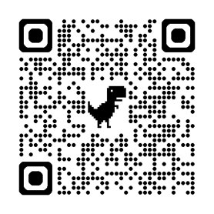
Course Survey
Thank you for completing the course!
Please take a few minutes to fill out the Course Survey, which can be found here:
https://cahhscwds.gov1.qualtrics.com/jfe/form/SV_024TW5uq8KQSBGm
44

Slide 45
Thank you!
You have reached the end of this training. Congratulations!
2026
45
Notes:
Instructor Notes
Do: Display & review slide
Say:

