Slide 1
CWS-CARES Training
ILT Course: Placement
July-October 2026
https://cwds.ca.gov/
Notes:
Instructor Notes
Do: Display slide
Say:

Slide 2
Course Introduction

Slide 3
Training Introduction
We will start class with a quick introduction from Jessica Rougeux, the Chief of the Child Welfare System Branch: Introduction to ILT - Jessica Rougeux.mp4

Slide 4
Ground Rules & Housekeeping
01
02
03
04
Stay Engaged
Ask Questions​
Minimize Distractions
Vegas Rules
Follow along with your trainer(s) throughout the session.
If you are in-person, raise your hand in the main sessions to ask questions.
If you are virtual, use the Microsoft Teams chat to type your questions directly in the chat.​ We will get to them as soon as possible.
Avoid checking your cell phone, email, or CWS-CMS during the session.
Do not share any sensitive or confidential information you may encounter during the class outside the session.
Please use fictional names in the Training Environment
Notes:
Instructor Notes:
Do:
Display PPT slide.
Review the slide.

Slide 5







About This Course
Course Content
Tech Support
Parking Lot
Recording Notice
Training
Environment
Q&A Options
Course Feedback
2026

Slide 6
Meet Your Facilitators!

Slide 7
Course Objectives
Item | Objectives
1. | Understand key processes to initiate a Placement in CWS-CARES, including: Documenting Placement Preferences and Needs Documenting a removal Conducting Placement Matching Search
2. | Understand key processes to make an Emergency Placement – Pre RFA Approval in CWS-CARES
3. | Understand key processes to make a Tribally Approved Home (TAH) placement in CWS-CARES
4. | Understand key processes to maintain and monitor placement in CWS-CARES, including: Updating Placement Stability Creating Placement Preservation Strategy Creating 14-day notice/exemption Recording absences
5. | Understand key processes to make a Short Term Residential Therapeutic Program (STRTP) placement in CWS-CARES
6. | Understand key processes to initiate Presumptive Transfers in CWS-CARES, including: Requesting and recording a presumptive transfer waiver Documenting outcomes of the waiver determination process

Slide 8
Course Agenda
Activity | Duration
Welcome | 10 min
Lesson 1: Review Activity | 20 min
Lesson 2: Initiate Placement | 25 min
Lesson 3: Emergency Placement – Pre RFA Approval | 25 min
Lesson 4: Tribally Approved Homes (TAHs) | 25 min
Break | 15 min
Lesson 5: Monitoring Placements | 20 min
Lesson 6: STRTPs | 25 min
Lesson 8: Presumptive Transfer | 15 min
Review/Questions/Wrap-up | 15 min
Estimated Total Duration | 3.5 Hours
8

Slide 9
Logging in to CWS-CARES

Slide 10
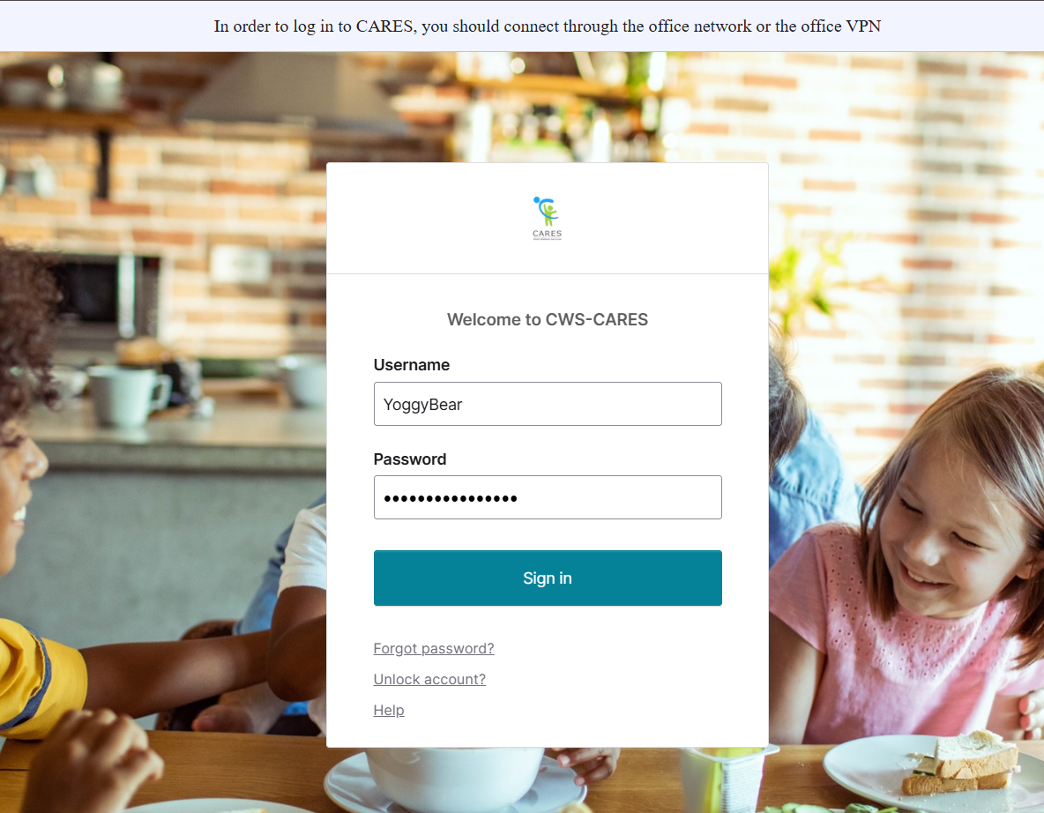
Logging into CWS-CARES
Navigate to: https://login.2.cares.cwds.ca.gov/
Enter your County Email associated with the CARES account in the Username field.
Enter the password you created for your CARES account in the Password field.
Click Sign in.
2
3
4
Important Note: If you have difficulty logging in, we will capture your information and route it to the support team for action.

Slide 11
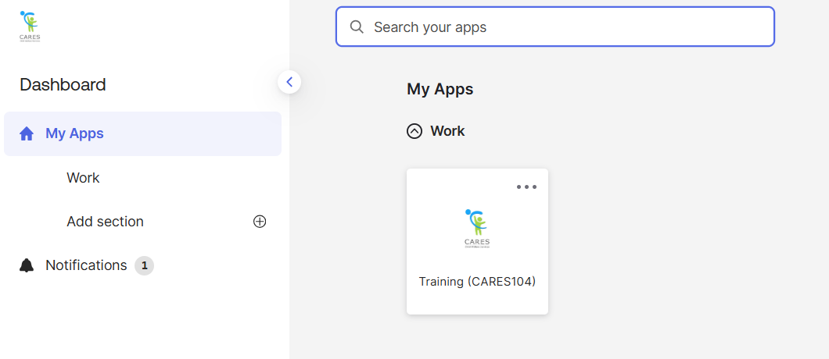
Accessing the CARES Training Environment (104)
The first screen shown upon login is the Okta My Apps dashboard.
To enter CWS-CARES training environment, choose the Training (CARES 104) tile

Slide 12
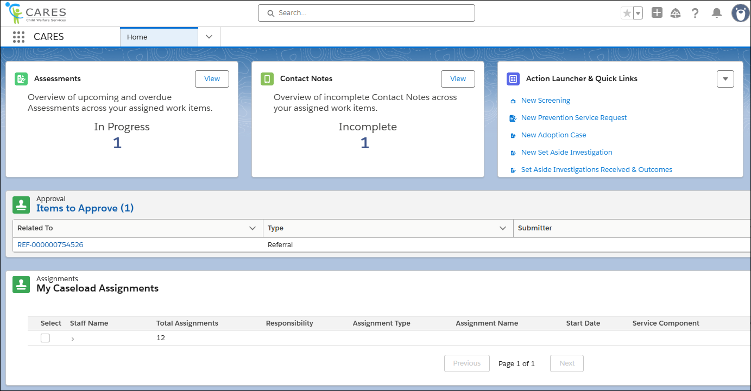
How to Know You're In the Right Place: CWS-CARES
Verify that you are in CARES application tile in the App Launcher in the top left corner of your homepage.
After clicking the CARES tile in the App Launcher, the CWS-CARES Home Page displays.
Important Note: If you are NOT in the CARES application, click the App Launcher (highlighted in the screenshot). Then, select the CARES application.

Slide 13
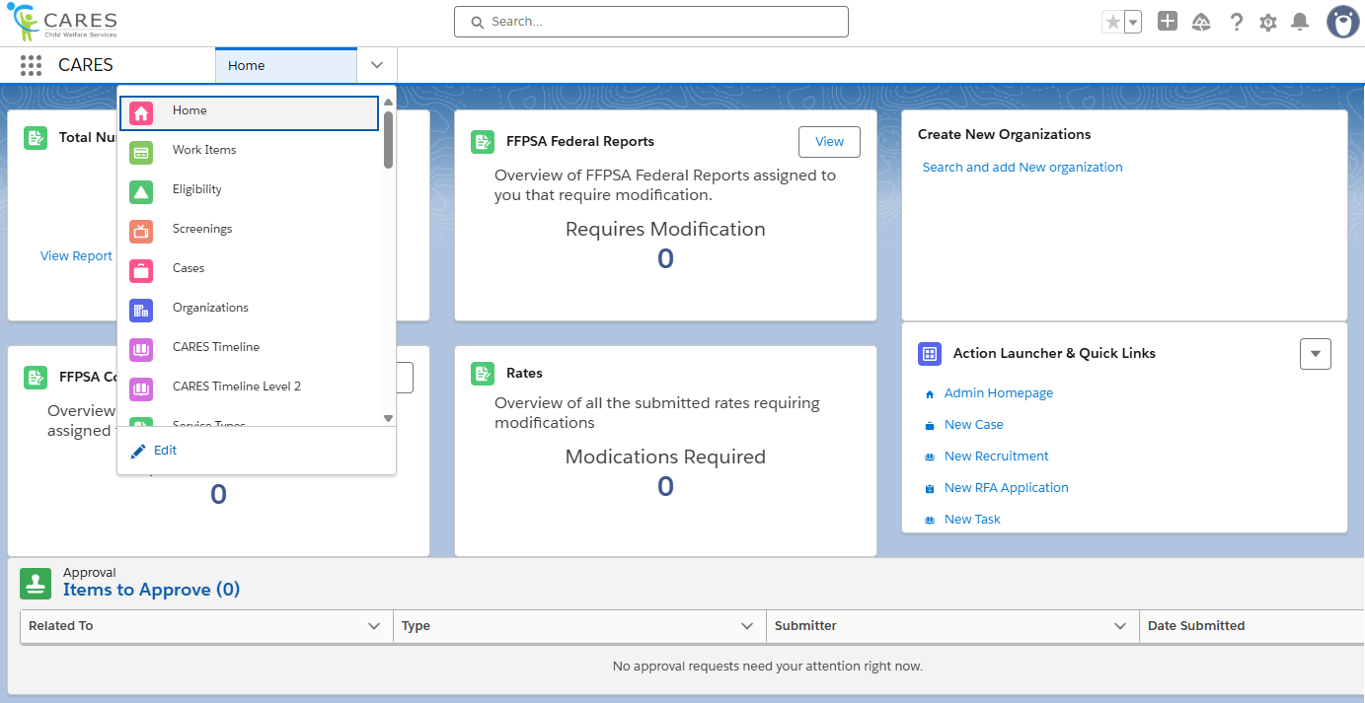
Navigation Menu
The Navigation Menu consists of a dropdown that contains links to sections of CWS-CARES that you have permission to access.
Common selections are:
Home
Screenings
Eligibility
Cases
Reports
Person Search
Work Items

Slide 14
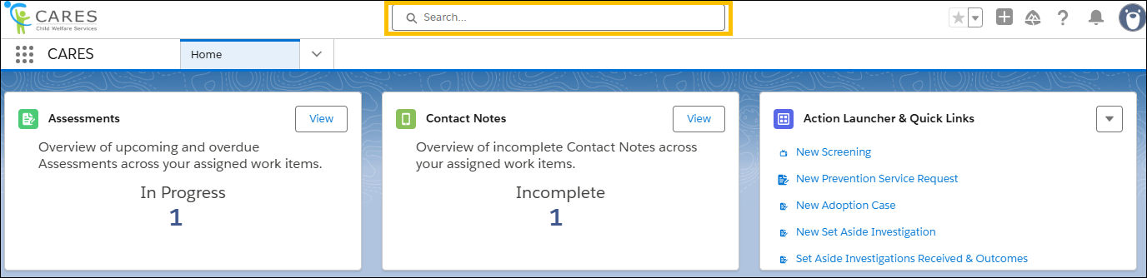
Global Search
Use Global Search to broadly search across the system. This search is best suited for:
Locating knowledge articles
Searching for glossary terms
Finding general content using keywords
To perform a Global Search, enter a keyword or phrase in the search bar available at the top of the screen. The system will begin to pull areas that meet the search criteria as text is entered.

Slide 15
Lesson 1: Review Activity
Notes:
Instructor Notes
Do: Display slide
Say:

Slide 16
Lesson 2: Initiate Placement
Notes:
Instructor Notes
Do: Display slide
Say:

Slide 17
Accessing Pre-Seeded Cases for this Scenario
For this session, you should be able to use the case created during the Screenings & Referrals course.
If there are issues, Pre-Seeded cases have been created for TTT Trainings
To access Pre-Seeded cases, please utilize the spreadsheet given to your training facilitators and open the tab that corresponds to the relevant scenario
For CARES Trainers, find the folder for cases seeded for your regional session here: Train the Trainer
  Please make sure you use the tab based on the specific course being taught (i.e., Placement)
2026

Slide 18
Scenario: Initiate Placement
Placements are needed for Peter, age 4, and Victor, age 17, who have been removed due to Physical Abuse and General Neglect. The placement worker documents the removal of the children from their parents’ home. The worker asks the children and parents about their Placement Preferences and records the information in their cases. The MGM Veronica states she can meet Peter’s Care needs. MGM shares she is unable to accommodate Victor due to his significant mental health and behavioral needs. Peter is placed with his MGM after emergency background checks are cleared and a home inspection is completed.
Peter has difficulty adapting being in placement with his MGM and the worker updates Placement Stability and works with the MGM to create a Placement Preservation Strategy that works in a short amount of time.
18

Slide 19
Lesson 2
Key Actions:
Add Birth Country to Child's Person Record
Initial Removal
Create a New Placement Needs Record
Create a New Parent/Guardian Placement Preferences Record
Create a New Tribal Placement Preference Record
Search for Placement
19

Slide 20

Lesson 2
Follow-Up
Any questions?
20

Slide 21
Lesson 3: Emergency Placement/Pre RFA
Notes:
Instructor Notes
Do: Display slide
Say:

Slide 22

Lesson 3
Key Actions:
Manually Create Placement
Create a New Contact for Placement
Create CLETS and CACI Background Checks
Inspection
Document Placement Decision
Add Child Location
Generate Placement Documents
Generate the Notification of Child’s Placement
22

Slide 23
Lesson 3
Follow-Up
Any questions?

Slide 24
Lesson 4: Tribally Approved Homes
Notes:
Instructor Notes
Do: Display slide
Say:

Slide 25
Lesson 4
Key Actions:
Searching for a Tribally Approved Home

Slide 26
Lesson
Follow-Up
Any questions?

Slide 27
Let’s Take a Break!
Please be back and ready to continue in 15 minutes.

Slide 28
Welcome Back!
We are excited you are here! Let’s get to work!
Notes:
Instructor Notes
Do: Display & review slide
Say:

Slide 29
Lesson 5: Monitoring Placements
Notes:
Instructor Notes
Do: Display slide
Say:

Slide 30
Lesson 5
Key Actions:
Update Placement Stability
Update Placement Stability Contact
Creating Placement Preservation Strategy
Upload Placement Preservation Strategy Document
Create 14 Day Notice
Create 14 Day Notice Exemption
Recording Absences
30

Slide 31
Lesson 5
Follow-Up
Any questions?

Slide 32
Lesson 6: Short-Term Residential Treatment Program (STRTP)
Notes:
Instructor Notes
Do: Display slide
Say:

Slide 33
Scenario: Short-Term Residential Treatment Program (STRTP)
The maternal grandmother (MGM) stated she was unable to meet Victor’s need at the time of removal. The family relays that prior to intervention, Victor has had numerous psychiatric hospitalizations and is currently not stable. As a result, the worker starts the process of temporarily placing Victor in a Short Term Residential Therapeutic Program (STRTP). Since the STRTP is located in another county, the worker initiates a Presumptive Transfer of these services, requesting a waiver as the placement is intended to be short-term.
After receiving specialized mental health services, the plan is for Victor to be Placed with his MGM. The MGM visits Victor regularly and decides that she wants him placed with her. All agree to this change when Victor is ready to step down.

Slide 34
Lesson 6
Key Actions:
Initiate Removal
Search and Associate STRTP Placement Options
Create a New Contact with a STRTP Placement
Update STRTP Placement Option Details
Update STRTP Placement Decision
Create a New Child Location Record

Slide 35
Lesson 6
Follow-Up
Any questions?

Slide 36
Lesson 7: Presumptive Transfer
Notes:
Instructor Notes
Do: Display slide
Say:

Slide 37
Lesson 7
Key Actions:
Requesting and Recording a Presumptive Transfer Waiver
Create a Waiver for a Presumptive Transfer Request
Document Waiver Request Communication
JV 214-Presumptive Transfer Request for Hearing on Waiver
End Child Location Placement

Slide 38
Lesson 7
Follow-Up
Any questions?

Slide 39
Course Survey
Thank you for completing the course!
Please take a few minutes to fill out the Course Survey, which can be found here:
https://cahhscwds.gov1.qualtrics.com/jfe/form/SV_024TW5uq8KQSBGm

Slide 40
Thank you!
You have reached the end of this training. Congratulations!
Notes:
Instructor Notes
Do: Display & review slide
Say:

