Slide 1
CWS-CARES Trainer
ILT Course: Financial Management – County Focused
https://cwds.ca.gov/
Notes:
Instructor Notes
Do: Display slide
Say:

Slide 2
Course Introduction

Slide 3
Training Introduction
We will start class with a quick introduction from Jessica Rougeux, the Chief of the Child Welfare System Branch: Introduction to ILT - Jessica Rougeux.mp4

Slide 4
Ground Rules & Housekeeping
01
02
03
04
Stay Engaged
Ask Questions​
Minimize Distractions
Vegas Rules
Follow along with your trainer(s) throughout the session.
If you are in-person, raise your hand in the main sessions to ask questions.
If you are virtual, use the Microsoft Teams chat to type your questions directly in the chat.​ We will get to them as soon as possible.
Avoid checking your cell phone, email, or CWS-CMS during the session.
Do not share any sensitive or confidential information you may encounter during the class outside the session.
Please use fictional names in the Training Environment
Notes:
Instructor Notes:
Do:
Display PPT slide.
Review the slide.

Slide 5







About This Course
Course Content
Tech Support
Parking Lot
Recording Notice
Training
Environment
Q&A Options
Course Feedback

Slide 6
Meet Your Facilitators!

Slide 7
Course Objectives
Item | Objectives
1. | Understand the key components and processes for viewing child-level payment data in CWS-CARES, including: Authorization and issuance data from CalSAWS interface Payment data from the county-specific supplemental form (CA-800CSF)
2. | Understand the key components and processes for viewing county-specific DFA600 data in CWS-CARES via the CECRIS interface.
3. | Understand the key components and processes for viewing statewide and county-specific rate tables in CWS-CARES.
4. | Understand the key components and processes for service cost tracking to support FFPSA in CWS-CARES, including: Creating FFPSA cost-tracking reports Reviewing and approving FFPSA Cost-Tracking Reports submitted via the portal Reviewing and approving Ongoing/Final Federal Reports submitted via the portal Reviewing and monitoring missing/overdue cost-tracking reports

Slide 8
Course Agenda
Activity | Duration
Welcome | 10 min
Lesson 1: Review Activity | 15min
Lesson 2: Supplemental Form Uploads | 20 min
Break | 10 min
Lesson 3: Gathering Data for CB-496 Reporting | 20min
Lesson 4: Maintaining Rate Tables in CWS-CARES | 30 min
Review/Questions/Wrap-up | 20min
Estimated Total Duration | 2 Hours
7

Slide 9
Logging in to CWS-CARES

Slide 10
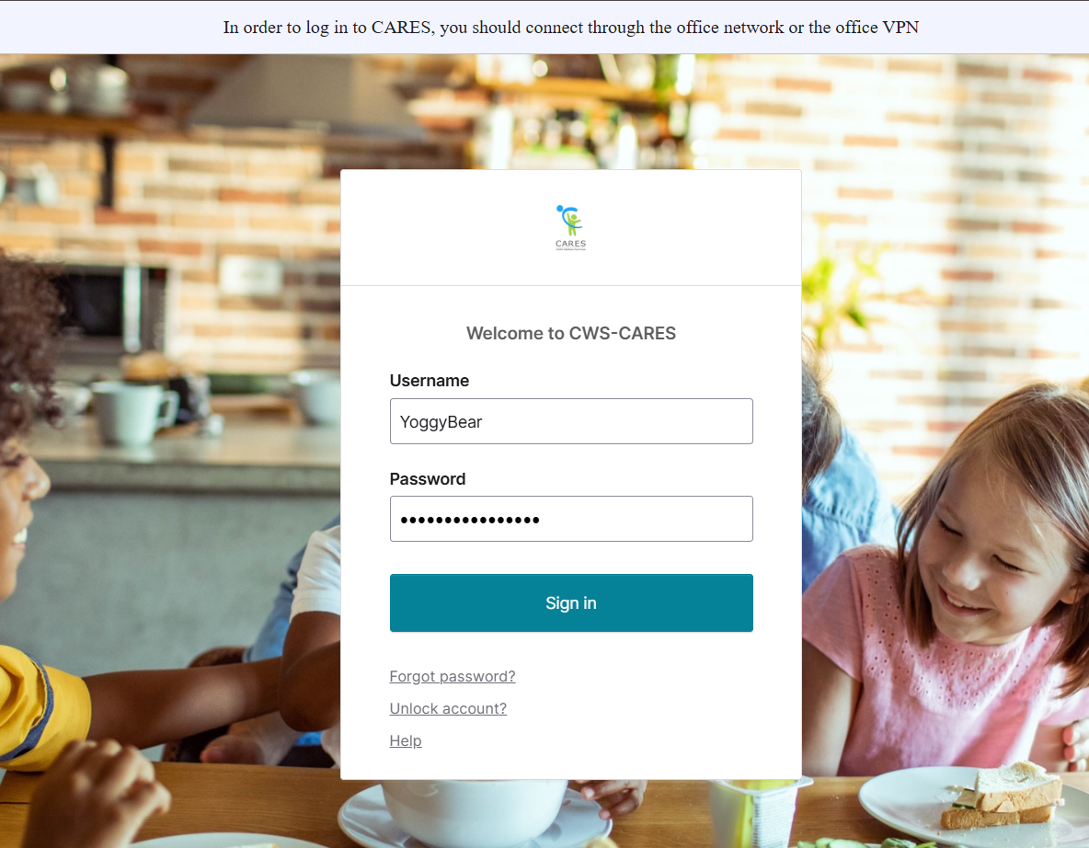
Logging into CWS-CARES
Navigate to: https://login.2.cares.cwds.ca.gov/
Enter your County Email associated with the CARES account in the Username field.
Enter the password you created for your CARES account in the Password field.
Click Sign in.
2
3
4
Important Note: If you have difficulty logging in, we will capture your information and route it to the support team for action.

Slide 11
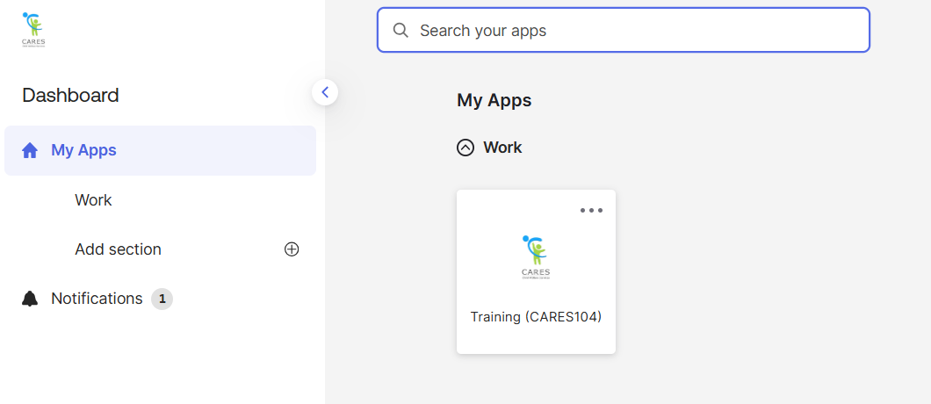
Accessing the CARES Training Environment (104)
The first screen shown upon login is the Okta My Apps dashboard.
To enter CWS-CARES training environment, choose the Training (CARES 104) tile

Slide 12
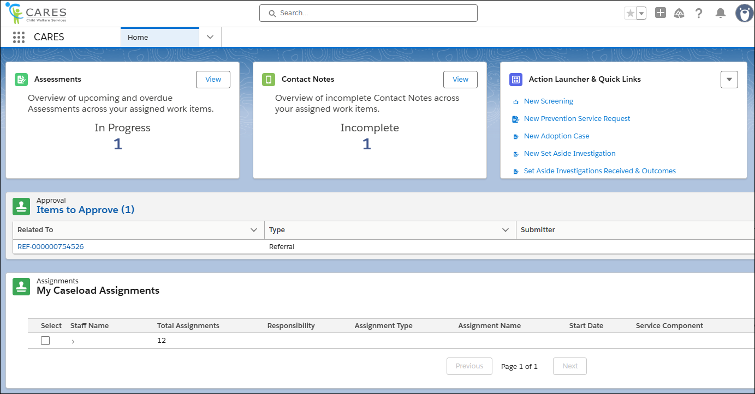
How to Know You're In the Right Place: CWS-CARES
Verify that you are in CARES application tile in the App Launcher in the top left corner of your homepage.
After clicking the CARES tile in the App Launcher, the CWS-CARES Home Page displays.
Important Note: If you are NOT in the CARES application, click the App Launcher (highlighted in the screenshot). Then, select the CARES application.

Slide 13
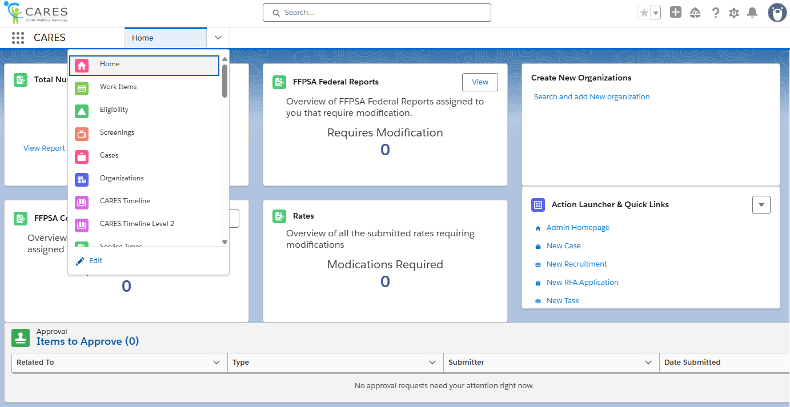
Navigation Menu
The Navigation Menu consists of a dropdown that contains links to sections of CWS-CARES that you have permission to access.
Common selections are:
Home
Screenings
Eligibility
Cases
Reports
Person Search
Work Items

Slide 14
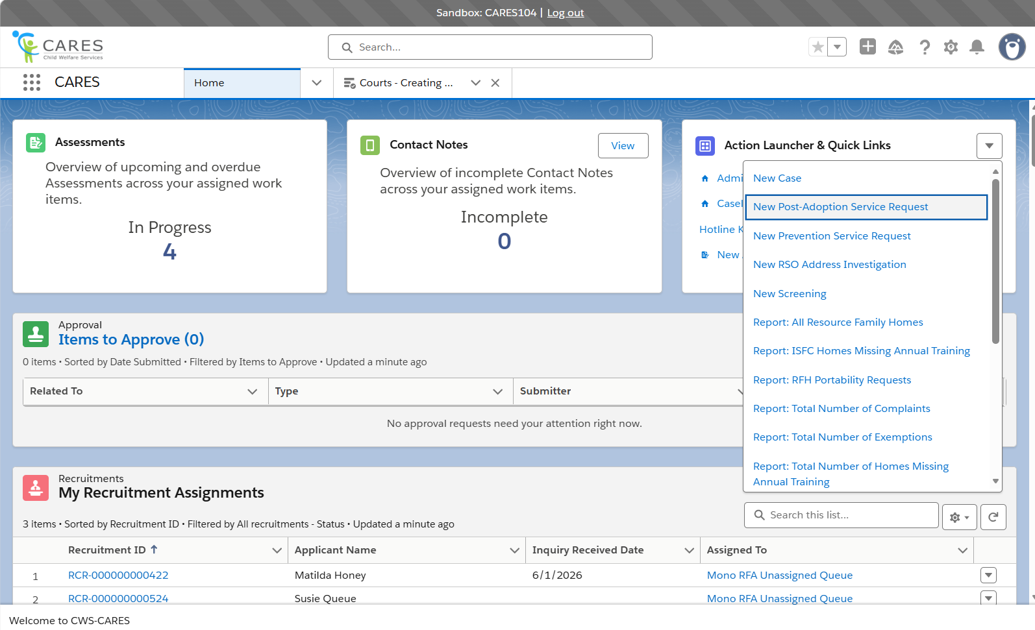
Action Launcher & Quick Links
Role-dependent links reside here for you to navigate to common tasks in CWS-CARES.
You may find links here to begin a New Screening, or a New Case. If your role permits, you may have a link here to the Admin Homepage.
Due to your hybrid permissions in the training environment, you will see many more options here than the typical user. For this reason, clicking the drop-down caret on the right of the header will display additional item options.

Slide 15
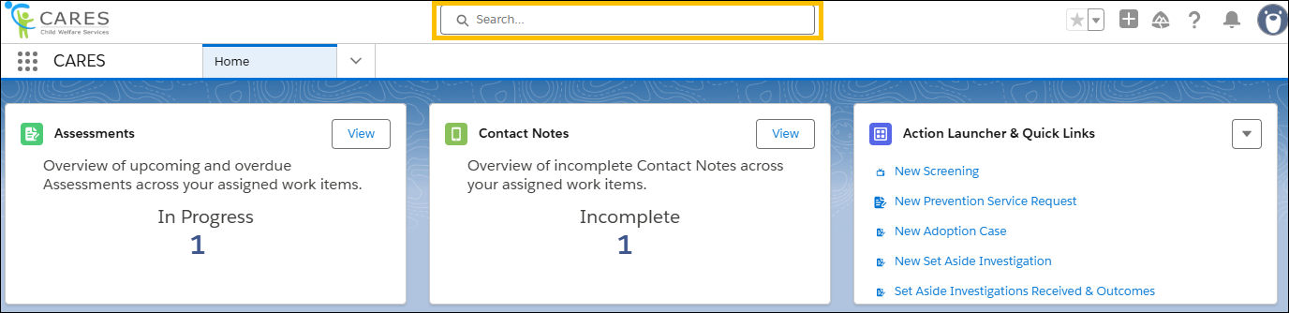
Global Search
Use Global Search to broadly search across the system. This search is best suited for:
Locating knowledge articles
Searching for glossary terms
Finding general content using keywords
To perform a Global Search, enter a keyword or phrase in the search bar available at the top of the screen. The system will begin to pull areas that meet the search criteria as text is entered.

Slide 16
Lesson 1: Review Activity
Notes:
Instructor Notes
Do: Display slide
Say:

Slide 17
Accessing Pre-Seeded Cases for this Scenario
For this session, you should be able to use the case created during the Screenings & Referrals course.
If there are issues, Pre-Seeded cases have been created for TTT Trainings
To access Pre-Seeded cases, please utilize the spreadsheet given to your training facilitators and open the tab that corresponds to the relevant scenario
For CARES Trainers, find the folder for cases seeded for your regional session here: Train the Trainer
  Please make sure you use the tab based on the specific course being taught (i.e., Case Management Services)
2026

Slide 18
Lesson 2: Supplemental Form Uploads
Notes:
Instructor Notes
Do: Display slide
Say:

Slide 19
Scenario: Assistance Costs in CWS-CARES
A child has been removed, is placed into a new home, and their new caregiver has begun receiving assistance benefits. In real-time, CWS-CARES will receive issuance details for each payment made on behalf of their placement.
A worker needs to view what payments have been issued to the placement home, so they log into CWS-CARES and search for the child’s related case. The worker navigates to the centralized area for assistance payments on the case and is able to view the most recent payment that was issued to the caregiver.
In addition, the county made an assistance payment for the child from their general ledger, instead of CalSAWS. Therefore, they have reported the payment on their supplemental form (CA-800CSF), which was uploaded by CDSS. The payment is visible in a centralized area for assistance payments on the child’s case.

Slide 20
Lesson 2
Key Actions:
Accessing Assistance Records on a Case Record
Accessing Assistance Records on a Placement Record
Viewing External System Assistance Payment on a Case Record

Slide 21
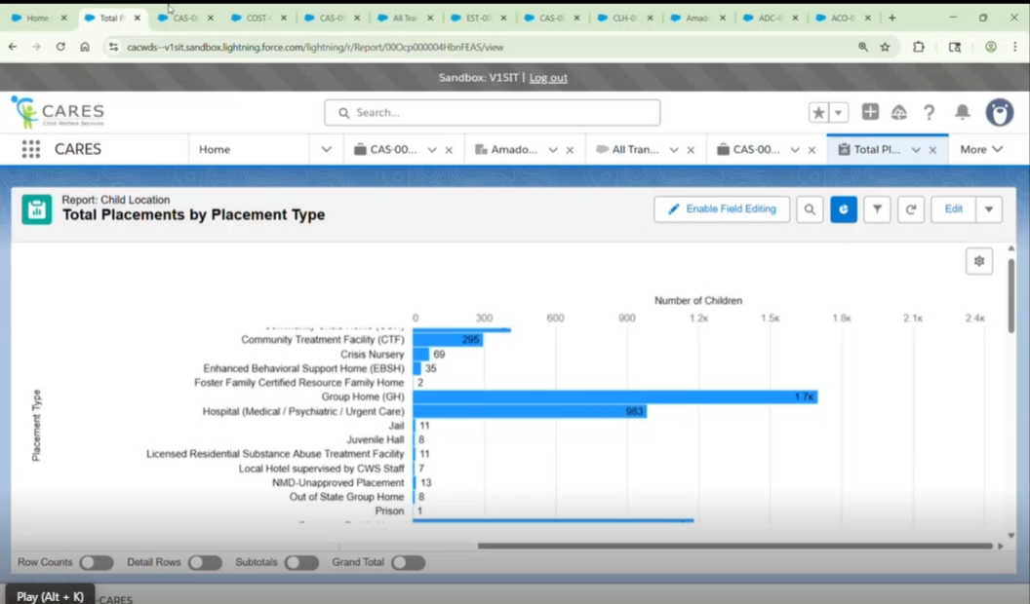
Assistance Cost Demo Video

Slide 22
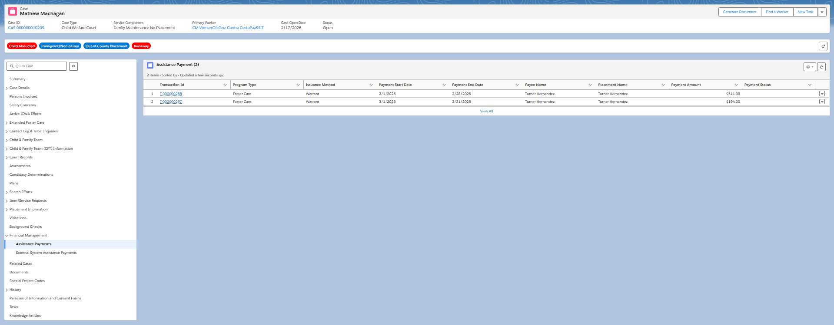
Viewing Assistance Payment on a Case Record

Slide 23
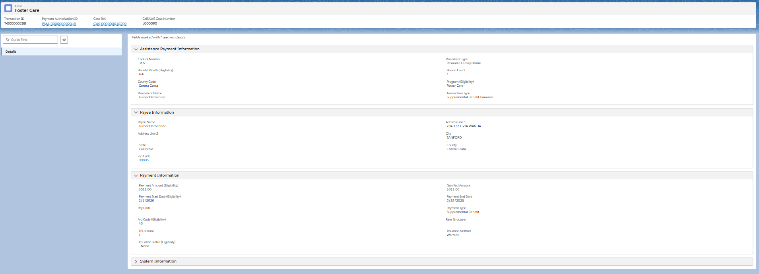
Viewing Assistance Payment on a Case Record Cont.

Slide 24

Lesson 2
Follow-Up
Any questions?

Slide 25
Lesson 3: Gathering Data for CB-496 Reporting
Notes:
Instructor Notes
Do: Display slide
Say:

Slide 26
Scenario: Administrative Claims in CWS-CARES
CWS-CARES will have an interface with the County Expense Claim Information Reporting System (CECRIS) that will allow County Fiscal Workers to view their county’s DFA600 data from their County Expense Claim (CEC) on a read-only basis.
When a County Fiscal Worker logs into CWS-CARES, they will navigate to Quick Links for Administrative Claims and will be able to view quarterly DFA600 costs for each program code.

Slide 27
Lesson 3
Key Actions:
Access Administrative Costs by Program Code Dashboards from Homepage
Access Administrative Claims from a County's Organization Record

Slide 28
Lesson 3
Follow-Up
Any questions?

Slide 29
Lesson 4: Maintaining Rate Tables in CWS-CARES
Notes:
Instructor Notes
Do: Display slide
Say:

Slide 30
Scenario: Rate Tables in CWS-CARES
A CARES User logs into CWS-CARES and would like to view a knowledge management source to view statewide and county-specific rates to identify an applicable rate for a family they are working with.
The user navigates to the Quick Links area for rate tables in the system and is able to conduct a search for the rate table they’d like to view. The user searches for the STRTP rate and is able to view current and historical rates.

Slide 31
Lesson 4
Key Actions:
Viewing Rate Tables

Slide 32
Lesson 4
Follow-Up
Any questions?

Slide 33
Let’s Take a Break!
Please be back and ready to continue in 10 minutes.

Slide 34
Welcome Back!
We are excited you are here! Let’s get to work!
Notes:
Instructor Notes
Do: Display & review slide
Say:

Slide 35
Lesson 5: FFPSA Service Cost-Tracking
Notes:
Instructor Notes
Do: Display slide
Say:

Slide 36
Scenario: FFPSA Service Cost-Tracking
A family with an open Family Maintenance case is receiving prevention services directly from the county’s child welfare agency to support their issues with substance abuse. As a result, the county Prevention Services Worker is certified and providing Motivational Interviewing for Substance Abuse as an evidence-based practice to the IV-E eligible focus child. The child has an active Family Well-Being Plan and is receiving services.
The County Fiscal Supervisor in that county will log into CWS-CARES and will be made aware of a case that requires monthly cost-tracking due to federal FFPSA reporting requirements. As a result, the County Fiscal Supervisor assigns a County Fiscal Worker in their county to be responsible for entering cost-information for the IV-E service monthly.
The assigned County Fiscal Worker will be able to create a monthly cost-tracking record within the existing case in CWS-CARES. Once all required fields are complete, the worker will submit to their supervisor for review and approval.

Slide 37
Lesson 5
Key Actions:
Monthly Cost Tracking to Meet Federal FFPSA reporting Requirements
Access Unassigned Cost Tracking Records
Maintaining Cost Tracking Record

Slide 38
Lesson 5
Follow-Up
Any questions?

Slide 39
Course Survey
Thank you for completing the course!
Please take a few minutes to fill out the Course Survey, which can be found here:
https://cahhscwds.gov1.qualtrics.com/jfe/form/SV_024TW5uq8KQSBGm

Slide 40
Thank you!
You have reached the end of this training. Congratulations!
Notes:
Instructor Notes
Do: Display & review slide
Say:

Slide 41
Introduction to CWS-CARES
Navigation Terms

Slide 42
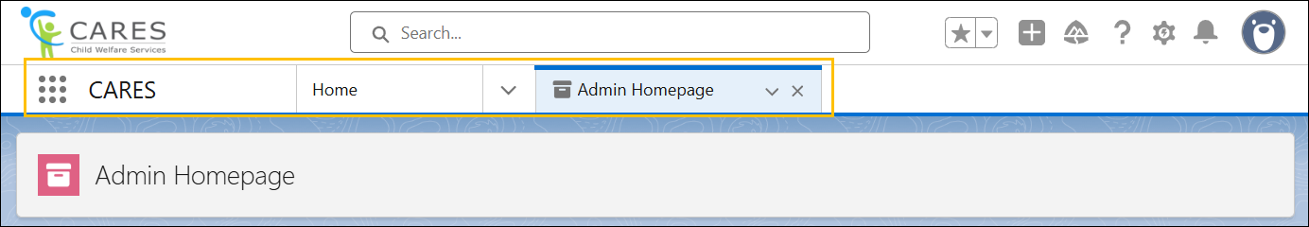
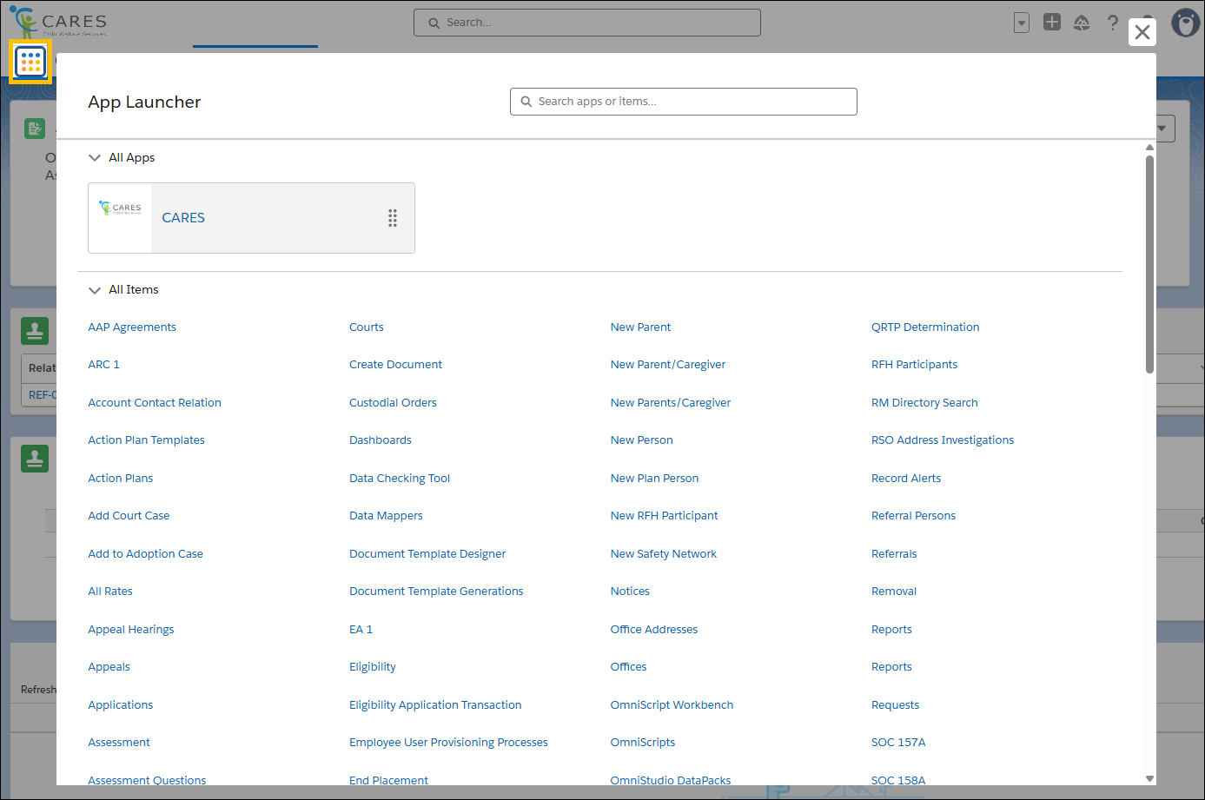
App Launcher
The App Launcher displays at the top left corner.
Clicking the App Launcher displays different sections in the App Launcher popup depending on the user's permissions.
Clicking the CARES tile in the App Launcher displays the CARES Home Page.

Slide 43
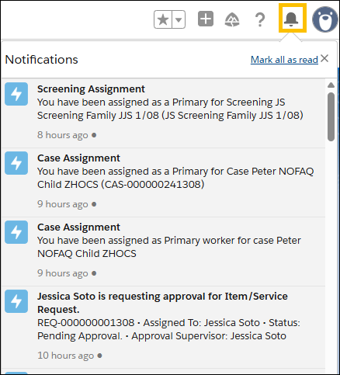
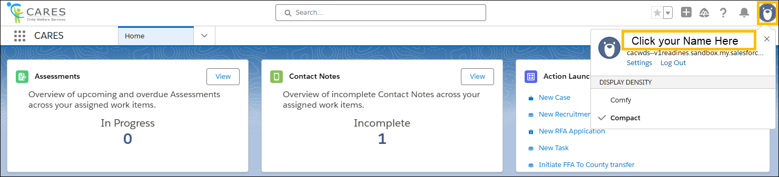
Notifications and Profile
Notification Bell
Profile
Click on Profile
Click on Your Name Heading
Click on Associated Caseload
Click Caseload ID Hyperlink

Slide 44
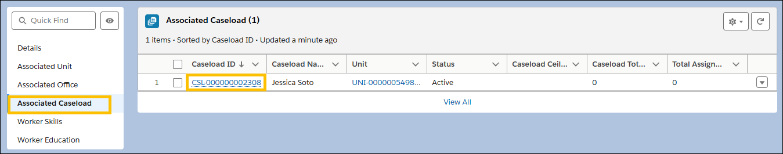
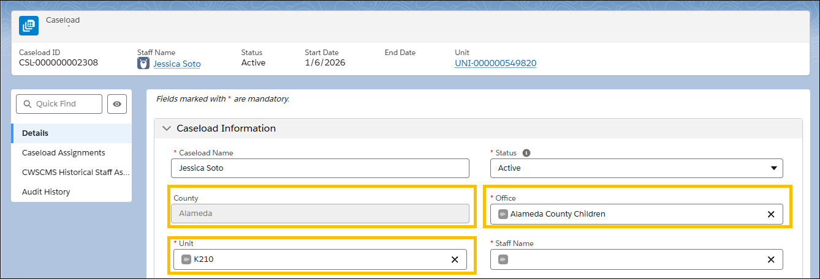
Profile
Clicking the Profile icon displays your Associated Office, Unit, and Caseload Assignment. The corresponding links display in the left-hand panel.

Slide 45
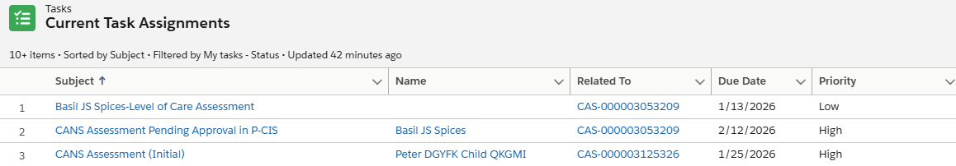
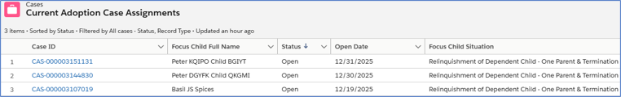
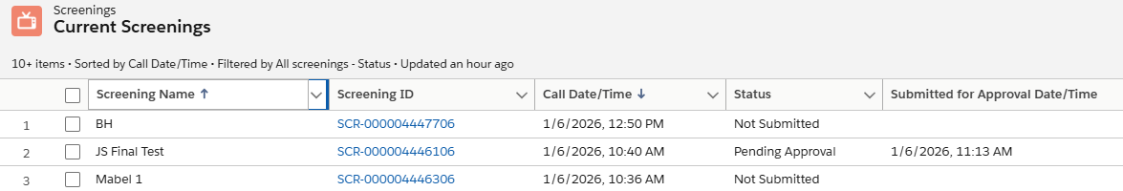
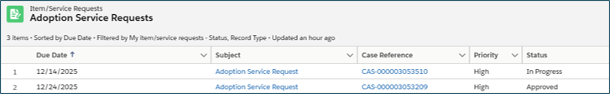
Sections of Home Page

Slide 46
App Launcher
The App Launcher displays at the top left corner. Clicking the App Launcher displays different sections in the App Launcher popup depending on the user's permissions.
Clicking the CARES Application in the App Launcher displays the CARES Home Page.

Slide 47
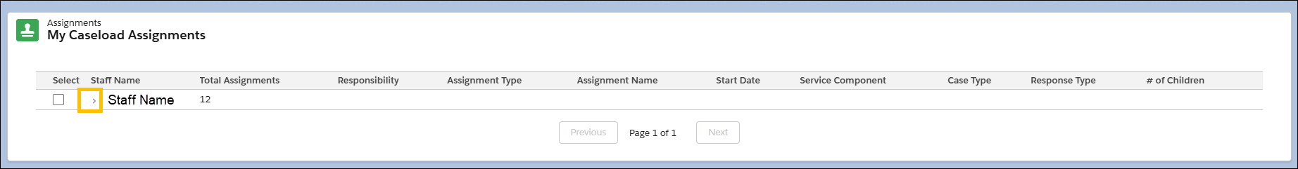
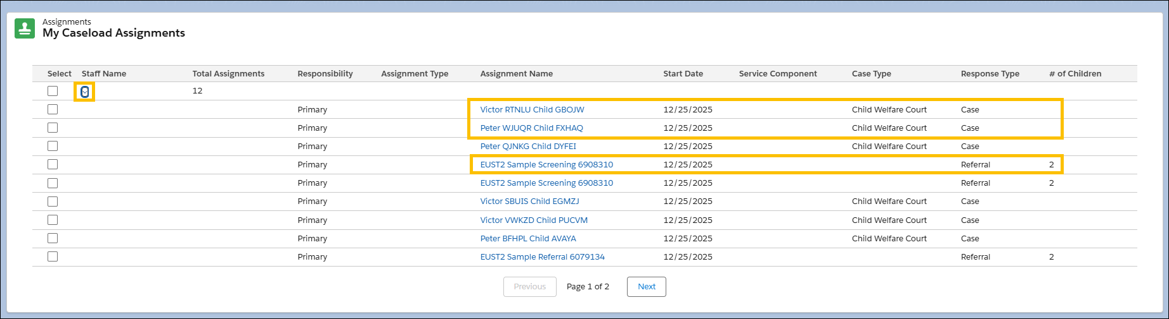
My Caseload Assignments

Slide 48
Follow-Up
Any questions?

Slide 49
Illustrations
Illustrations can also be used to enhance your slide. If make them larger, ensure that you maintain the aspect ratio so they are not distorted. Find an illustration that complements/matches the content on your slide.

Slide 50

Circles
You can use these circle graphics to add color and visual interest. Some of them overlap if you want more layers.
If you put text in or around these, please check the color contrast for accessibility. (If you don’t know what that means, please don’t use these with text.)

Slide 51
Numbered Steps
You can use this specific circle graphic, layered over screenshots, to delineate steps.
1
A

Slide 52
Doodles
You can use these doodle graphics to add interest.

Slide 53
Road Graphics

Slide 54
Moving to the Breakout Rooms
How to work in this room:
If you have a question or get stuck:
Use your Training Guide to go through the steps of the scenario we are currently working on.
Please do not work ahead in the Training Guide.
If you complete the scenario before our allotted time expires, please exit the breakout room to the main meeting room, or you can stay here until the time expires and you are automatically sent to the main meeting room.
Come off mute in this room and let the breakout room moderator know you are experiencing an issue.
Be prepared to share your screen and demonstrate the step you are attempting so the moderator can help you and so that others in the room can see the solution for when they get to that point in the scenario.
You are not required to finish the scenario before time expires. Getting familiar with the system for actual testing is our goal.

