Slide 1
Organization OCM Guidance
CWS-CARES
Stakeholder Engagement
June 30, 2026

Slide 2
Purpose & Audience
The OCM Guidance is designed to equip organizations with the context, tools, and direction needed to carry out change management activities successfully in support of the CWS-CARES V1 Go-live.
Purpose
Audience
The Organization OCM Guidance Materials are designed to equip Organizations with background, processes, tools, and templates for executing change management activities in preparation for CARES Go-Live.
The OCM Guidance is intended for the Organizations impacted by the CARES implementation. OCM Coordinators are encouraged to leverage the following content to guide the execution of change management activities within their local organizations.
Key Terms Repository: CWDS Glossary
Leading Practice: Check the repository for updates bi-weekly

Slide 3
Background
CWS-CARES Project Overview
Child Welfare Digital Services (CWDS) is a collaboration between the California Department of Social Services (CDSS), the Office of Systems Integration (OSI), and the County Welfare Directors Association (CWDA), in collaboration with 58 local child welfare agencies. CWDS supports end-users through technology and aims to ensure the safety, permanency, and well-being of children at risk of abuse, neglect, or exploitation. CWDS is responsible for maintaining and operating the existing Child Welfare Services/Case Management System (CWS/CMS), as well as developing the replacement system, the Child Welfare Services-California Automated Response and Engagement System (CWS-CARES).
The goal of the CWS-CARES Project (hereinafter referred to as “project”) is to replace the CWS/CMS with a compliant Comprehensive Child Welfare Information System (CCWIS), which keeps the needs of local child welfare and juvenile probation practitioners at the forefront and meets the regulations and policies of state and federal laws. This project will deliver the CWS-CARES operational applications on the Salesforce platform, using an agile development methodology and user-centered design. In tandem, CWDS will establish the CWS-CARES data services, an integral component of CCWIS, on the CWS-CARES Data Infrastructure (CDI). The state will maintain its own copy of all data contained within the Salesforce database, along with immutable longitudinal data on the CDI, which will satisfy the state’s requirement to maintain ownership and control of child welfare data as a vital asset.
Organizations Receiving CWS-CARES Include:
58 County Child Welfare Services Departments
58 County Juvenile Probation Departments
Tribes with Title IV-E agreements: Yurok and Karuk
CDSS Divisions: CDSS-Community Care Licensing Division (CCLD), CDSS-Finance & Accounting Division (FAD), CDSS-Office of Equity (OOE), CDSS-Research, Automation, Data Division (RADD), CDSS-CFSD-Adoptions, CDSS-CFSD-Child Welfare Services Branch (CWSB), CDSS-CFSD-Children’s Services Quality Management Branch (CSQMB), CDSS-CFSD-Family Permanency & Support Services Branch (Permanency), CDSS-CFSD-Safety, Prevention, Early Intervention Branch (SPEIB), and CDSS-CFSD-System of Care Branch (SOC)
Family First Prevention Services Act (FFPSA) Providers

Slide 4
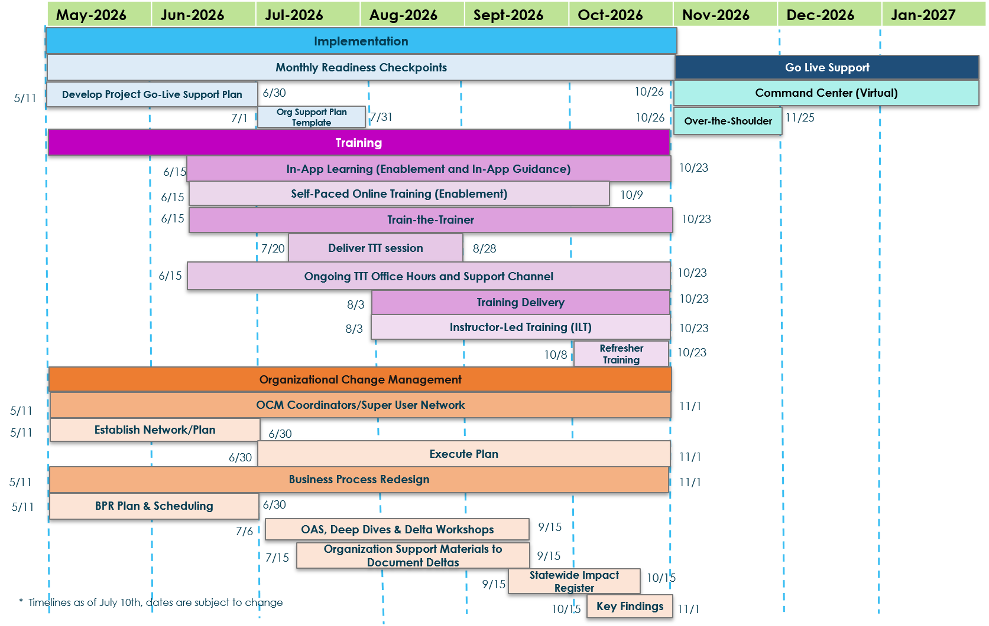
Implementation Timeline
The implementation timeline outlines the major workstreams, sequencing, and critical milestones that guide the path to Go‑Live.

Slide 5
Organizational Change Management (OCM) Overview
Organizational Change Management (OCM) has a crucial role in the success of the CWS-CARES Go-Live.
Strategic Planning & Preparation
Aligns people, processes, and technology for Go‑Live readiness
Identifies how changes will affect end users and workflows
Builds a structured approach to minimize disruption and resistance
Ensures stakeholders understand what is changing and why
Stakeholder Engagement & Transparency
Analyzes the stakeholder landscape to identify key groups and influencers
Clarifies worker permissions and role‑specific impacts
Provides clear, timely, and consistent communication
Reduces uncertainty by keeping stakeholders informed throughout the transition
Adoption, Support & Trust Building
Drives acceptance and adoption of the new CWS‑CARES system
Supports end users through training, readiness activities, and ongoing engagement
Builds trust by addressing concerns early and reinforcing benefits
Ensures a smooth transition at Go‑Live and beyond

Slide 6
Stakeholder
Engagement

Slide 7
Stakeholder Engagement Overview
To foster two-way communication, gain new insights, and maintain transparency throughout the CWS‑CARES V1 implementation, the following engagement activities should be executed to support greater end user adoption.
Definition
The process of identifying, understanding, and collaborating with individuals or groups who can influence or are affected by the CWS-CARES V1 implementation. Stakeholder engagement involves ongoing, two-way communication to surface needs and concerns, build trust and buy-in, inform decisions, and reduce risks.
Outcome
Enables higher-quality, more relevant decisions informed by diverse stakeholder insights
Increases buy-in and trust, leading to a smoother CWS-CARES V1 implementation and change adoption
Identifies risks and issues earlier with collaborative mitigation and clearer accountability.
Key Activities
1 | Review: Reference the Organization stakeholder landscape and identify stakeholders by influence, interest, and expectations. Reference existing engagement forums to building understanding of existing engagement tactics.
2 | Identify: Define objectives and scope for engagement; tailor messages, channels, and cadence for each stakeholder group.
3 | Execute: Perform engagement activities such as interviews, workshops, briefings, surveys, and regular updates to enable two-way dialogue
4 | Refine: Monitor sentiment and outcomes, report progress, and iteratively adjust the engagement plan to close the feedback loop.
CWDS / 7

Slide 8
Review: Existing Forums
CWS-CARES uses three distinct forums to keep counties informed, engaged, and represented. Each has a specific scope and audience.
01
02
03
OCM Advisory Workgroup
Training, Information, Planning and Sharing (TIPS)
County Advisory
Committee (CAC)
Creates an ongoing forum for county input on organizational change management
Creates an ongoing forum for county input on the training plan, content design, and delivery
Cross-workgroup escalation body where unresolved items from all three forums come for county input and resolution
CWDS / 8

Slide 9
Identify: Engagement Objectives
Effective engagement begins with a clear understanding of stakeholder needs and the communication approaches best suited for each group. By assessing these needs, analyzing preferences, and tailoring engagement methods, organizations can execute a more strategic and efficient engagement plan.
Identify key objectives and promote greater stakeholder engagement by completing the following steps.
1
Clarify the purpose of engagement for each stakeholder group.
3
Match communication methods to each group’s needs, influence, and expectations.
2
Determine the level of involvement needed (inform, consult, collaborate).
4
Establish the timing and frequency of engagement touchpoints.

Slide 10
Execute: Engagement Activities
After identifying the channels and activities that will resonate most with your stakeholder group(s) or address gaps in your Organization, plan and execute activities such as interviews, workshops, briefings, surveys, and regular updates to enable two-way dialogue.
Listed below are four engagement activities that may aid in capturing new insights and support change management efforts for CWS-CARES V1 across Organizations.
Stakeholder Engagement Surveys (Change Readiness Assessments)
Stakeholder Listening Sessions/Interviews
Leverage existing Organization meetings/forums (e.g., service monthly meetings, weekly syncs, town halls, etc. within your Organization)
Organization OCM Coordinator and Super User Meetings
CWDS / 10

Slide 11
Refine: Stakeholder Engagement is a Continuous Effort
The sequence of activities will be utilized for individual stakeholder engagement and management throughout the CWS-CARES V1 implementation. Organizations are encouraged to leverage the following process for engaging with stakeholder in their own Organization.
1
2
Identify key stakeholder participants
Identify and develop key stakeholder approach and methods
Conduct initial stakeholder listening sessions
Determine current state level of engagement
Assess feedback to identify early change management risks and readiness opportunities
Develop targeted change plan for groups/individuals as required
Plan
Analyze
Review
Measure progress and effectiveness of Change Plans and the OCM Coordinator and Super User meetings
Adjust Engagement Plan as needed and incorporate lessons learned into future phases
Prepare to start the cycle again with each release and/or transition (as needed)
Activate and sustain Change Strategy and Communications Plan
Activate OCM Coordinators and Super Users
Deliver on-going engagement and additional check-ins as needed
Engage
4
3
CWDS / 11

Slide 12

How OCM Coordinators and Super Users Support the Transition
OCM Coordinators and Super Users work together to support Organizations throughout the change journey. Together, they help extend the reach of the OCM activities across functional areas by connecting impacted teams and stakeholder groups with timely information, resources and support.
Guiding Principles
Expectations
Organization Implementation Teams
Representation from impacted functions, different location types, and external roles provide “ears” on the ground to understand issues, questions, and risks to be addressed before they become problems
OCM Coordinators and Super Users embedded in project activities, empowering with messages to take back to their teams
Feedback collected from OCM Coordinators and Super Users throughout the journey
Create a better change experience for those who have a familiar, local colleague to ask questions, obtain information, and find support
Support delivery of change management, communication, and learning resources
OCM Coordinators and two designated Super Users from each Organization actively participate in OCMAW meetings
Super Users attend Super User Readiness Meetings
Leverage materials provided to coach and encourage teams and key stakeholder groups
Engage with employees as our eyes and ears, proactively identifying issues, questions, risks, and opportunities
Cascade wins and benefits, building employee confidence and support of the new ways of working
Host meetings and share resources and information
OCM Coordinators / Super Users
Communicate, engage, and support
Share feedback, raise risks and request support
Impacted Stakeholders
Provide feedback and ask questions
CWDS / 12

Slide 13
Why OCM Coordinators and Super Users Are Critical to Success
These core activities illustrate how OCM Coordinators and Super Users enhance communication flow, trust, and adoption throughout the Organization.
Facilitate Communication
OCM Coordinators and Super Users share accurate and timely information, making sure the change is communicated across the Organization
Build Trust and Credibility
OCM Coordinators and Super Users are a part of existing Organizations and have already established trust and credibility, encouraging the acceptance of change
Provide Valuable Feedback
OCM Coordinators and Super Users gather feedback from their teams; highlighting concerns and insights from stakeholders that help refine the change strategy
Bridge Organizational Levels
OCM Coordinators and Super Users bridge the gap between leadership and staff, creating alignment and consistent understanding of the change objectives
Accelerate Adoption
OCM Coordinators and Super Users can demonstrate the benefits of the change and support colleagues through the transition, in turn, accelerating the adoption process and mitigating resistance
CWDS / 13

Slide 14
OCM Coordinators and Super Users Characteristics and Selection Criteria
  OCM Coordinators and Super Users should be willing and able representatives selected from across all levels of the impacted stakeholders and identified based on the below characteristics to maximize their effectiveness.
OCM Coordinators and Super Users can be chosen from all levels of impacted stakeholder groups and should have the following characteristics:
Influential
Supportive
Effective Communicator
Realistic
Open and Positive
    Respected amongst peers
    Has credibility
    Understands the bigger picture
    Not necessarily “the boss”
    Personally supportive of change
    Listens and learns
    Respects differences
    Builds genuine relationships
    Follows through
    Able to clearly convey messages both written and verbal
    Functions as a bridge between views
    Perceptive qualities to monitor and provide feedback on areas of change resistance
    Flexible
    Good problem solver
    Pragmatic and resourceful
    Recognizes and addresses barriers
    Works to change attitudes
    Provides a sense of possibility
    Inclusive, accessible and engaged
    Quickly adopts to rapidly changing circumstances
CWDS / 14

Slide 15
Identifying OCM Coordinators and Super Users
  We can consider gaining champion representation from different Organization Subgroups. The worker permission validation conducted by Organization OCM Teams helps inform the analysis for identifying OCM Coordinators and Super Users to ensure a holistic representation.
Organization Subgroup | Headcount | OCM Coordinators and Super Users Identified (Yes or No) | Number of OCM Coordinators and Super Users Needed | Notes
(Service areas, etc.) | Headcount of that subgroup | Is there a need or desire from this subgroup to participate? (Yes or No) | How many OCM Coordinators and Super Users are needed from this subgroup? Note: Number of OCM Coordinators and Super Users should be representative of Organization subgroup headcount | Any additional information about the subgroup (specific departments that have already expressed interest, notable stakeholders, etc.)
CWDS / 15

Slide 16
OCM Coordinators and Super Users Engagement Timeline
The timeline below illustrates potential OCM Coordinator and Super User activities and notional timeframes.
Identify (T-Minus 180 Days)
Initiate (T-Minus 90 Days)
Inform (T-Minus 60 Days)
Go-Live (T-Minus 0 Days)
Post Go-live (T+60 Days)
    Identify OCM Coordinators and Super Users
    Confirm OCM Coordinators and Super Users nominations
    Distribute Welcome Message
    Attend OCM Coordinators and Super Users Kick Off Session
    Attend OCM Coordinators and Super Users spotlight
    Participate in OCM Coordinators and Super Users feedback opportunities
    Perform exercises requested by Organization Implementation teams
    Participate in regular OCM Coordinator and Super User sessions
    Cascade Organization communication items
    Proactive advocate for upcoming activities
    Start/Stop/Continue activities
    Support the understanding of cut over activities
    Host “office-hour” sessions as needed
    Answer basic impromptu support questions
    Direct individuals to additional resources
    Provide live feedback to the Organization Implementation team
    Continued support
    Document post-go live questions / concerns / issues in a tracker
    Feedback calls with the Implementation support team (Organization Implementation team, State Implementation team, Implementation team)
Cascade Communications, Stay up to date with CWS-CARES V1 progress, and Escalate readiness risks to Organization Implementation team
CWDS / 16

Slide 17
Sample OCM Coordinator Meeting Cadence and Topics
  The table below outlines the recommended meeting cadence, topics, and actions that OCM Coordinators can engage in to support adoption.
 | JUNE | JULY |  | AUGUST | SEPTEMBER | OCTOBER
 | Envision |  | Activate |  |  | Realize
Cadence | 1x / month (1 hour) |  |  | 1x / month (1 hour) | 2x / month (1 hour) | 2x / month (1 hour)
Meeting Topics | Kick-Off Meeting Discuss OCM Coordinator role and responsibilities Answer initial questions Collect updates and feedback from OCM Coordinators on what they are hearing from their teams Provide a general CWS-CARES V1 status update Introduce CWS-CARES V1 site Discuss documented change impacts Q&A Session |  |  | Overview of Production Simulation Phase 2 and Training pathways Review of key program impacts – breakout sessions where needed Review stakeholder specific WIIFM content | Training strategy overview Review learning curriculum and different types of training offerings Review Production Simulation environment and scenarios | Overview of post-go-live strategy Deployment and cutover plan Training deployment and feedback Review go-live communications
Actions for OCM Coordinators | Explain OCM Coordinator role in an already scheduled staff meeting with your team and ask for questions / initial feedback Provide feedback heard from team members to Organization Implementation team to shed light on any early pain points Remind fellow team members about upcoming events or surveys Continue to gather feedback heard informally and share with your Organization Implementation team Gather feedback from teams and share with OCM Coordinators and Super Users |  |  | Gather feedback from teams and share with OCM Coordinators, Super Users, and Organization Implementation team | Continue to be available for questions and informal learning sessions Gather feedback from teams and share with OCM Coordinators, Super Users, and Organization Implementation team | Continue to be available for questions and informal learning sessions Gather feedback from teams and share with OCM Coordinators, Super Users, and Organization Implementation team
CWDS / 17

