Slide 1
Organization OCM Guidance
CWS-CARES
Stakeholder Analysis
June 30, 2026

Slide 2
Purpose & Audience
The OCM Guidance is designed to equip organizations with the context, tools, and direction needed to carry out change management activities successfully in support of the CWS-CARES V1 Go-live.
Purpose
Audience
The Organization OCM Guidance Materials are designed to equip Organizations with background, processes, tools, and templates for executing change management activities in preparation for CARES Go-Live.
The OCM Guidance is intended for the Organizations impacted by the CARES implementation. OCM Coordinators are encouraged to leverage the following content to guide the execution of change management activities within their local organizations.
Key Terms Repository: CWDS Glossary
Leading Practice: Check the repository for updates bi-weekly

Slide 3
Background
CWS-CARES Project Overview
Child Welfare Digital Services (CWDS) is a collaboration between the California Department of Social Services (CDSS), the Office of Systems Integration (OSI), and the County Welfare Directors Association (CWDA), in collaboration with 58 local child welfare agencies. CWDS supports end-users through technology and aims to ensure the safety, permanency, and well-being of children at risk of abuse, neglect, or exploitation. CWDS is responsible for maintaining and operating the existing Child Welfare Services/Case Management System (CWS/CMS), as well as developing the replacement system, the Child Welfare Services-California Automated Response and Engagement System (CWS-CARES).
The goal of the CWS-CARES Project (hereinafter referred to as “project”) is to replace the CWS/CMS with a compliant Comprehensive Child Welfare Information System (CCWIS), which keeps the needs of local child welfare and juvenile probation practitioners at the forefront and meets the regulations and policies of state and federal laws. This project will deliver the CWS-CARES operational applications on the Salesforce platform, using an agile development methodology and user-centered design. In tandem, CWDS will establish the CWS-CARES data services, an integral component of CCWIS, on the CWS-CARES Data Infrastructure (CDI). The state will maintain its own copy of all data contained within the Salesforce database, along with immutable longitudinal data on the CDI, which will satisfy the state’s requirement to maintain ownership and control of child welfare data as a vital asset.
Organizations Receiving CWS-CARES Include:
58 County Child Welfare Services Departments
58 County Juvenile Probation Departments
Tribes with Title IV-E agreements: Yurok and Karuk
CDSS Divisions: CDSS-Community Care Licensing Division (CCLD), CDSS-Finance & Accounting Division (FAD), CDSS-Office of Equity (OOE), CDSS-Research, Automation, Data Division (RADD), CDSS-CFSD-Adoptions, CDSS-CFSD-Child Welfare Services Branch (CWSB), CDSS-CFSD-Children’s Services Quality Management Branch (CSQMB), CDSS-CFSD-Family Permanency & Support Services Branch (Permanency), CDSS-CFSD-Safety, Prevention, Early Intervention Branch (SPEIB), and CDSS-CFSD-System of Care Branch (SOC)
Family First Prevention Services Act (FFPSA) Providers

Slide 4
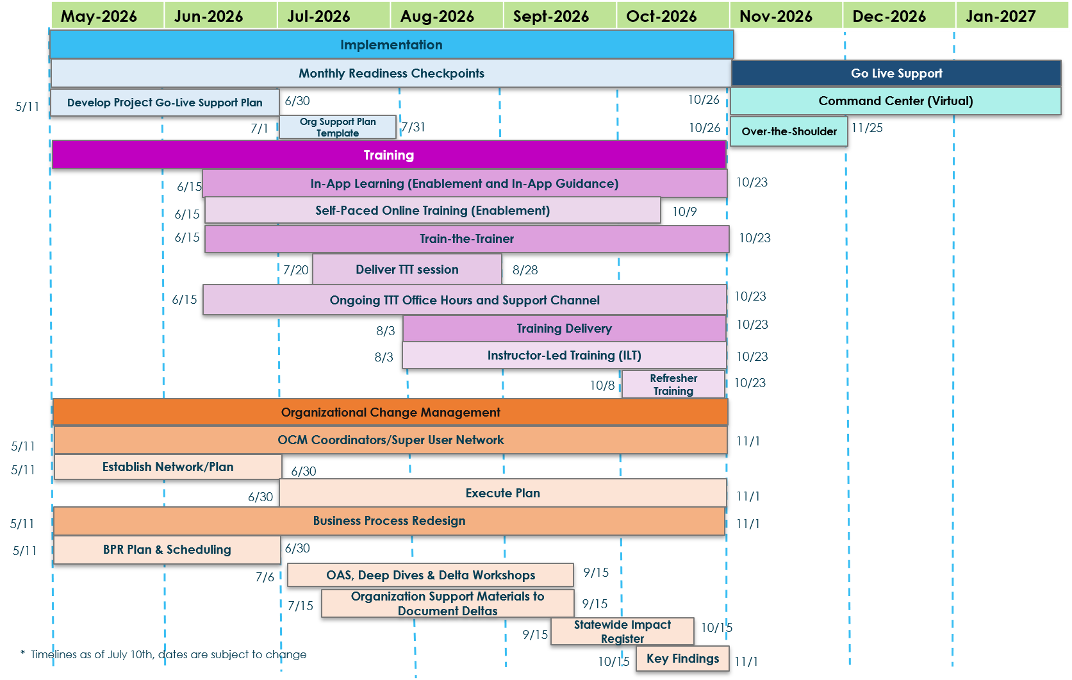
Implementation Timeline
The implementation timeline outlines the major workstreams, sequencing, and critical milestones that guide the path to Go‑Live.

Slide 5
Organizational Change Management (OCM) Overview
Organizational Change Management (OCM) has a crucial role in the success of the CWS-CARES Go-Live.
Strategic Planning & Preparation
Aligns people, processes, and technology for Go‑Live readiness
Identifies how changes will affect end users and workflows
Builds a structured approach to minimize disruption and resistance
Ensures stakeholders understand what is changing and why
Stakeholder Engagement & Transparency
Analyzes the stakeholder landscape to identify key groups and influencers
Clarifies worker permissions and role‑specific impacts
Provides clear, timely, and consistent communication
Reduces uncertainty by keeping stakeholders informed throughout the transition
Adoption, Support & Trust Building
Drives acceptance and adoption of the new CWS‑CARES system
Supports end users through training, readiness activities, and ongoing engagement
Builds trust by addressing concerns early and reinforcing benefits
Ensures a smooth transition at Go‑Live and beyond

Slide 6
Stakeholder Analysis

Slide 7
Stakeholder Analysis Overview
Stakeholder analysis provides insight into who is impacted by the change and how best to engage and support them throughout the implementation.
Definition
An assessment of key CWS‑CARES stakeholders who must remain informed and engaged throughout the CARES V1 implementation. The insights gathered will inform communications and engagement strategy. The stakeholder analysis supports timely and targeted information is disseminated in support of stakeholder groups across the state. This analysis will also inform the identification and articulation of change impacts to support effective adoption across the CWS‑CARES community.
Outcome
Guides the communication and engagement plans by ensuring changes are shared with the right stakeholders
Highlights where the change will have interest and influence outside of the end users
Supports understanding what level of influence and control stakeholder have over the success of the change.
Key Activities
1 | Identify Stakeholders: Compile a comprehensive list of roles, groups, organizations impacted by the CWS-CARES implementation within your organization. The Implementation OCM Team developed a stakeholder registry reflecting CWS-CARES stakeholders. Reference the CWS-CARES Stakeholder Registry as a starting point.
2 | Tailor: Identify the key stakeholders of the CARES V1 system implementation within your Organization. Stakeholders can be individuals or groups
3 | Assess: Determine their level of influence on the implementation. Consider who will make key decisions, who has the knowledge to move the implementation forward, who will need to be involved, etc. Determine the level of interest for each stakeholder or stakeholder group.
4 | Build: Once the level of influence and interest have been determined, agree how often and by what communication channel(s) stakeholders need to be engaged. Leverage the Stakeholder Landscape template to develop an Organizational Stakeholder Landscape.

Slide 8
How to Build Your Organization Stakeholder Landscape
Categories and groupings may be consistent across the State level landscape and your specific Organization.
1) Identify Stakeholders
The Implementation OCM Team identified stakeholder groups (as reflected on slide #11), which can serve as your starting point. This provides a baseline view of key stakeholder groups, influence levels, and engagement needs.
2) Tailor to Your Organization
Conduct an abbreviated stakeholder analysis within your Organization using the Stakeholder Registry to identify:
Unique stakeholder groups
Local nuances in influence or interest
Additional roles not captured at the State level
Update the baseline analysis to reflect your Organization’s structure and priorities.
3) Build Your Stakeholder Landscape
Use the provided template to map your Organization’s stakeholder groups into categories such as: Leadership, Primary Stakeholders, Secondary Stakeholders. This landscape will guide engagement, communications, and impact analysis.

Slide 9
Understanding the Stakeholder Landscape Framework
This matrix maps stakeholder groups based on two dimensions:
Stakeholder’s Level of Influence on CARES: how much power or input they have in shaping decisions.
Stakeholder’s Level of Impact by CARES: how significantly CARES affects their work or outcomes.
Together, these dimensions define four engagement strategies:
High
Keep Informed
Engage Directly
Keep Informed
They need consistent updates and transparency to understand how CARES affects their work.
Focus on clear messaging and accessible information channels.
Engage Directly
These stakeholders are deeply involved in day‑to‑day operations and decision‑making.
Requires frequent communication, collaboration, and feedback loops.
Stakeholders Level of
Impact by CARES
Monitor & Engage Indirectly
Maintain awareness of their perspectives and monitor for emerging needs.
Periodic updates and opportunities for input are sufficient.
Monitor & Engage Indirectly
Involve & Collaborate
Involve & Collaborate
Engage these groups in planning and policy discussions.
Their insights can guide strategic alignment and resource decisions.
Low
Stakeholders Level of
Influence on CARES
High
The goal is to match engagement intensity to each group’s influence and impact, ensuring resources are focused where collaboration yields the most value.

Slide 10
CWS-CARES Stakeholder Landscape
Intake Hotline Workers
Intake Hotline Supervisors
Emergency Response Workers
Clerical Workers
Mandated Reporters
Other Reporters
Tribal Representatives
Community Providers
Prevention Providers
Investigative Support Staff
CDSS/Federal Partner Oversight
Quality Assurance
County Counsel
OCM Coordinators
Social Workers
Social Worker Supervisors
CDSS Adoptions Regional Offices
Eligibility Workers
County Fiscal Workers
High
Keep Informed
Engage Directly
24
22
7
1
2
Engage Directly
20
3
21
23
6
8
9
4
5
11
25
18
14
10
12
15
19
13
16
17
Stakeholders Level of
Impact by CARES
Keep Informed
Title IV-E Agency/State Admin Staff
CDSS Directory Oversight Staff
State Fiscal Workers
County Fiscal Workers
Placement Providers
CWCAs
Monitor & Engage Indirectly
Involve & Collaborate
39
33
40
34
32
Involve & Collaborate
Other State Entities
Governor’s Office
Legislature
Provider Portal (FFPSA)
Courts (External to CARES)
CDSS – Fiscal Division
Federally recognized non-Title IV-E Tribes
36
35
31
26
37
41
29
38
27
28
30
CWS Recipients
Advocacies and Associations
Federal Government
Research Contractors
Media
Attorneys
County Behavioral Health Staff
Coordinator of Services
Court Appointed Special Advocates (CASA)
Low
Stakeholders Level of Influence on CARES
High
Monitor & Engage Indirectly
Stakeholder groups from quadrants with higher levels of impact and influence were further assessed to determine their current and desired levels of engagement.

