Slide 1
Organization OCM Guidance
CWS-CARES
OCM Measurement & Evaluation
June 30, 2026

Slide 2
Purpose & Audience
The OCM Guidance is designed to equip organizations with the context, tools, and direction needed to carry out change management activities successfully in support of the CWS-CARES V1 Go-live.
Purpose
Audience
The Organization OCM Guidance Materials are designed to equip Organizations with background, processes, tools, and templates for executing change management activities in preparation for CARES Go-Live.
The OCM Guidance is intended for the Organizations impacted by the CARES implementation. OCM Coordinators are encouraged to leverage the following content to guide the execution of change management activities within their local organizations.
Key Terms Repository: CWDS Glossary
Leading Practice: Check the repository for updates bi-weekly

Slide 3
Background
CWS-CARES Project Overview
Child Welfare Digital Services (CWDS) is a collaboration between the California Department of Social Services (CDSS), the Office of Systems Integration (OSI), and the County Welfare Directors Association (CWDA), in collaboration with 58 local child welfare agencies. CWDS supports end-users through technology and aims to ensure the safety, permanency, and well-being of children at risk of abuse, neglect, or exploitation. CWDS is responsible for maintaining and operating the existing Child Welfare Services/Case Management System (CWS/CMS), as well as developing the replacement system, the Child Welfare Services-California Automated Response and Engagement System (CWS-CARES).
The goal of the CWS-CARES Project (hereinafter referred to as “project”) is to replace the CWS/CMS with a compliant Comprehensive Child Welfare Information System (CCWIS), which keeps the needs of local child welfare and juvenile probation practitioners at the forefront and meets the regulations and policies of state and federal laws. This project will deliver the CWS-CARES operational applications on the Salesforce platform, using an agile development methodology and user-centered design. In tandem, CWDS will establish the CWS-CARES data services, an integral component of CCWIS, on the CWS-CARES Data Infrastructure (CDI). The state will maintain its own copy of all data contained within the Salesforce database, along with immutable longitudinal data on the CDI, which will satisfy the state’s requirement to maintain ownership and control of child welfare data as a vital asset.
Organizations Receiving CWS-CARES Include:
58 County Child Welfare Services Departments
58 County Juvenile Probation Departments
Tribes with Title IV-E agreements: Yurok and Karuk
CDSS Divisions: CDSS-Community Care Licensing Division (CCLD), CDSS-Finance & Accounting Division (FAD), CDSS-Office of Equity (OOE), CDSS-Research, Automation, Data Division (RADD), CDSS-CFSD-Adoptions, CDSS-CFSD-Child Welfare Services Branch (CWSB), CDSS-CFSD-Children’s Services Quality Management Branch (CSQMB), CDSS-CFSD-Family Permanency & Support Services Branch (Permanency), CDSS-CFSD-Safety, Prevention, Early Intervention Branch (SPEIB), and CDSS-CFSD-System of Care Branch (SOC)
Family First Prevention Services Act (FFPSA) Providers

Slide 4
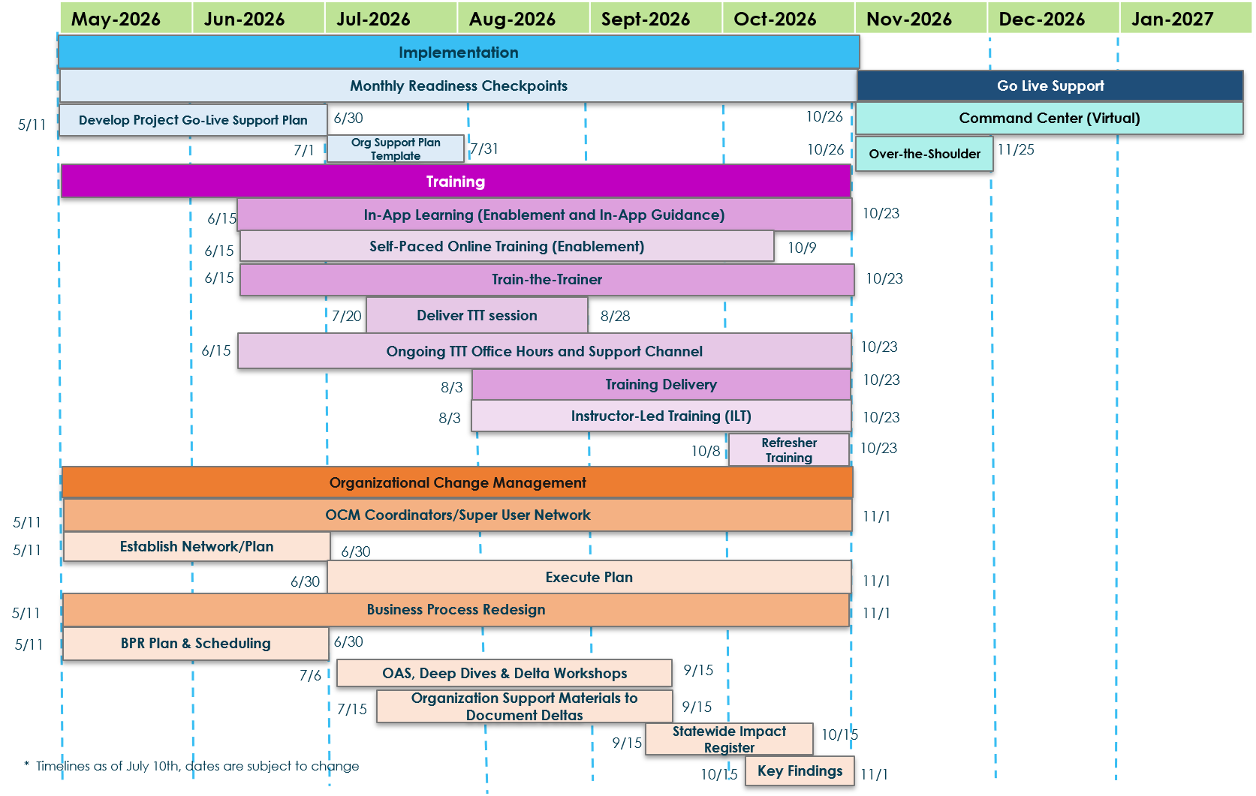
Implementation Timeline
The implementation timeline outlines the major workstreams, sequencing, and critical milestones that guide the path to Go‑Live.

Slide 5
Organizational Change Management (OCM) Overview
Organizational Change Management (OCM) has a crucial role in the success of the CWS-CARES Go-Live.
Strategic Planning & Preparation
Aligns people, processes, and technology for Go‑Live readiness
Identifies how changes will affect end users and workflows
Builds a structured approach to minimize disruption and resistance
Ensures stakeholders understand what is changing and why
Stakeholder Engagement & Transparency
Analyzes the stakeholder landscape to identify key groups and influencers
Clarifies worker permissions and role‑specific impacts
Provides clear, timely, and consistent communication
Reduces uncertainty by keeping stakeholders informed throughout the transition
Adoption, Support & Trust Building
Drives acceptance and adoption of the new CWS‑CARES system
Supports end users through training, readiness activities, and ongoing engagement
Builds trust by addressing concerns early and reinforcing benefits
Ensures a smooth transition at Go‑Live and beyond

Slide 6
OCM Measurement & Evaluation

Slide 7
Measuring OCM Effectiveness
Stakeholder Engagement Surveys generate the insights required to highlight risks, prioritize interventions, and inform decisions that support successful change adoption.
Definition
A structured evaluation of how prepared an Organization, its leaders, and its people are to adopt the CWS-CARES V1. It gauges awareness, willingness, capability, capacity, and risk through methods like surveys, interviews, and stakeholder mapping. The results identify gaps and inform targeted follow-on actions such as additional communications or training to improve adoption.
Outcome
Provide a clear view of engagement levels and risk or resistance hotspots by stakeholder group, function, or geography
Identify prioritized interventions and plan adjustments (targeted communications, training, etc.)
Measure baseline metrics and feedback mechanisms to track engagement and adoption over time and inform decision making
Key Activities
1 | Review: Reference provided materials outline stakeholder engagement surveys and metrics. Clarify the impacted groups and processes, and what ‘ready’ means (criteria and success measures)
2 | Build: Develop survey questions (qualitative and quantitative) to measure engagement. Collect data, review communications, engagement, and training plans
3 | Analyze: Evaluate and visualize results, identify gaps/risks, and roots causes
4 | Refine: Build and agree on mitigation actions with timelines, owners, and a re-assessment cadence

Slide 8
Review: Stakeholder Engagement Survey Approach
Stakeholder engagement should be owned and managed by the Organization Implementation team. All relevant stakeholders (CWDS Leadership, CWS-CARES Sponsors, etc.) must be aware of progress, risks, dependencies and actions required and make the informed decision.
01
Define Engagement Criteria
02
Measure Engagement
03
Take Actions and MaceI informed Decisions
Why:
To identify and assess the focus areas of change readiness (Purpose & Objectives, Leadership, Communications & Engagement, Readiness & Capability)
How:
Identify focus areas
Identify stakeholder groups
Prepare questionnaire for each focus area
Why:
To measure stakeholder engagement based on engagement criteria and questionnaire responses
How:
Launch stakeholder engagement survey/interview questionnaire
Analyze responses
Conduct focus groups
Why:
To inform decision-making and have an evidence-based view of readiness
To decide whether the implementation goes ahead or not on the assigned go-live date
How:
Develop an action plan based on stakeholder engagement survey/interview responses for necessary interventions
Present insights for decision making on go-live date

Slide 9
Review: Defining Baseline Stakeholder Engagement
To establish a strong foundation for engagement planning, it is important to define how baseline and ongoing stakeholder engagement surveys will be used throughout the change journey.
Organizational Stakeholder Engagement Survey
(Baseline)
Ongoing Stakeholder Engagement Survey Checkpoints
Used to baseline stakeholder understanding and engagement for the upcoming change and identifies initial challenges / barriers for change
Informs Change Management strategy and initiatives for the CWS-CARES V1 Implementation
Enables leaders to understand potential roadblocks and challenges to adoption by key stakeholders
Enables the OCM teams to checkpoint future activities against baseline to understand progress or mitigation needed
Regular checkpoints completed throughout the lifecycle of the project
Used to measure the engagement progress of stakeholder groups for the upcoming change
Provides feedback on whether change management activities are moving stakeholders through the Change curve
Identifies changes needed to OCM activities to mitigate adoption challenges along the CWS-CARES V1 Implementation journey
  Ongoing Stakeholder Engagement Surveys are intended to be used:
  Internally within the OCM leadership team to checkpoint stakeholder movement along the commitment curve, individual responses remain anonymous
  As an input to the activities included within the OCM Plan

Slide 10
Build: Survey Item Development
To ensure surveys generate meaningful and actionable insights, survey questions should be designed to measure key focus areas critical to successful change adoption.
Focus Area | Description
Purpose & Objectives | Clarifies the rationale behind the change, ensuring all stakeholders understand the 'why' and 'what'.
 | Aligns the change initiative with broader Organizational goals, making the purpose resonate with individual and team objectives.
Leadership | Involves leaders actively supporting and championing the change, serving as role models for adaptation.
 | Encourages leaders to communicate openly about the change, addressing concerns and motivating their teams.
Communications & Engagement | Ensures consistent, clear, and transparent communication about the change process, timelines, and expectations.
 | Engages stakeholders through interactive platforms, allowing them to voice concerns, ask questions, and provide feedback.
Readiness & Capability | Assesses and builds the organizations and individuals’ readiness and capability to embrace and implement the change effectively.
 | Involves training, upskilling, and providing the necessary resources to ensure everyone is equipped for the change.

Slide 11
Stakeholder Engagement: Defining Metrics
Defining change readiness metrics is essential for objectively measuring the Organization's preparedness for change, enabling targeted improvements and supporting the success of the change initiative.
Sample change readiness metrics:
Focus Area Covered | Metric | Description | Baseline | Target
Purpose & Objectives Leadership | Understanding Level | Percentage of stakeholders with a high understanding of the change purpose and process. | 50% | 75%
Leadership Communications & Engagement | Engagement Level | Stakeholders' average engagement score with change initiatives. | 2.5 out of 5 | 4 out of 5
Readiness & Capability Communications & Engagement | Support Need | Number of stakeholders requesting additional support or resources. | 100 requests | 50 requests
Readiness & Capability Leadership Communications & Engagement | Resistance Indicators | Percentage of stakeholders expressing concerns or resistance to change. | 30% | 15%
Final Outcomes for recommendation/action plan | Response Rate | Percentage of stakeholders who completed the survey. | 60% | 0.8
Final Outcomes for recommendation/action plan | Readiness Score | Average score rating stakeholders' readiness for change. | 3 out of 5 | 4 out of 5

Slide 12
Stakeholder Engagement: Preparing Survey Questions
Preparing survey questions is an important step towards gathering valuable insights into stakeholder perceptions and readiness for change – informing strategic decisions and actions.
 | Sample Questions | Focus Area | Purpose
1 | I understand how the upcoming CWS-CARES V1 will directly impact my day-to-day work. | Readiness & Capability | To diagnose role clarity and practical understanding.
2 | My team is being provided with adequate training to support this transition. | Readiness & Capability, Communications & Engagement | To evaluate training quality and effectiveness.
3 | I receive timely and regular updates regarding the progress of CWS-CARES V1. | Communications & Engagement | To assess the impact of communication cadences.
4 | My direct manager provides the support I need to navigate this transition. | Leadership, Communications & Engagement | To measure leadership preparation and internal communication and support.
5 | I feel that my feedback and concerns regarding the CWS-CARES V1 are heard and valued. | Communications & Engagement | To assess two-way engagement efficacy.
6 | How do you feel about the upcoming CWS-CARES V1 and why? | Readiness & Capability, Communications & Engagement | To explore emotional responses and underlying reasons.
7 | What are your main concerns regarding the CWS-CARES V1? | Leadership, Communications & Engagement | To identify specific apprehensions or uncertainties.
8 | Can you suggest any improvements to the change plan? | Leadership, Communications & Engagement | To collect actionable insights for enhancing the plan.
9 | How do you think the change will affect your daily tasks? | Readiness & Capability | To understand perceived personal impacts in greater detail.
10 | What kind of support do you need to feel prepared for the change? | Leadership, Communications & Engagement , Readiness & Capability | To determine specific support needs for better preparation.
Quantitative
Qualitative

Slide 13
Analyze: Evaluating Survey Data and Interpreting Results
Analyzing survey data helps reveal engagement levels, highlight risks, and identify the factors influencing stakeholder readiness for the change.
Examples: Use dashboards, heat maps, or charts to show strengths, gaps, and variations across roles or locations.
01
Review Data
Examine quantitative and qualitative survey responses to understand overall engagement levels and patterns.
03
Identify Gaps/Risks
Assess visualized data to pinpoint areas of low engagement, misalignment, or potential resistance.
02
Visualize Findings
Translate survey findings into clear visuals that make trends and differences easy to interpret.
Examples: Compare scores across stakeholder groups, identify recurring comments, and note emerging sentiment trends.
Examples: Flag groups with declining scores, highlight readiness risks, and surface underlying drivers needing intervention.

Slide 14
Refine: Engagement Surveys to Inform Mitigation Actions
Survey results highlight which stakeholder groups need deeper engagement, alternative communication approaches, or greater clarity on upcoming changes. Using these insights, you can refine mitigation plans by:
Target High‑Risk Stakeholder Groups
Prioritizing groups with emerging risks or low engagement
Customize Support and Enablement
Defining tailored interventions and training
Stakeholder Engagement Findings
Optimize Communication Approach
Adjusting communication cadence, messaging, or channels
Refresh Metrics to Reflect Current State
Updating readiness measures to track progress
The refinement step should translate these findings into clear, actionable mitigation plans with defined owners, timelines, and a reassessment cadence to ensure progress is monitored and actions remain aligned with evolving stakeholder needs.

