Slide 1
Organization OCM Guidance
CWS-CARES
Communications
June 30, 2026

Slide 2
Purpose & Audience
The OCM Guidance is designed to equip organizations with the context, tools, and direction needed to carry out change management activities successfully in support of the CWS-CARES V1 Go-live.
Purpose
Audience
The Organization OCM Guidance Materials are designed to equip Organizations with background, processes, tools, and templates for executing change management activities in preparation for CARES Go-Live.
The OCM Guidance is intended for the Organizations impacted by the CARES implementation. OCM Coordinators are encouraged to leverage the following content to guide the execution of change management activities within their local organizations.
Key Terms Repository: CWDS Glossary
Leading Practice: Check the repository for updates bi-weekly

Slide 3
Background
CWS-CARES Project Overview
Child Welfare Digital Services (CWDS) is a collaboration between the California Department of Social Services (CDSS), the Office of Systems Integration (OSI), and the County Welfare Directors Association (CWDA), in collaboration with 58 local child welfare agencies. CWDS supports end-users through technology and aims to ensure the safety, permanency, and well-being of children at risk of abuse, neglect, or exploitation. CWDS is responsible for maintaining and operating the existing Child Welfare Services/Case Management System (CWS/CMS), as well as developing the replacement system, the Child Welfare Services-California Automated Response and Engagement System (CWS-CARES).
The goal of the CWS-CARES Project (hereinafter referred to as “project”) is to replace the CWS/CMS with a compliant Comprehensive Child Welfare Information System (CCWIS), which keeps the needs of local child welfare and juvenile probation practitioners at the forefront and meets the regulations and policies of state and federal laws. This project will deliver the CWS-CARES operational applications on the Salesforce platform, using an agile development methodology and user-centered design. In tandem, CWDS will establish the CWS-CARES data services, an integral component of CCWIS, on the CWS-CARES Data Infrastructure (CDI). The state will maintain its own copy of all data contained within the Salesforce database, along with immutable longitudinal data on the CDI, which will satisfy the state’s requirement to maintain ownership and control of child welfare data as a vital asset.
Organizations Receiving CWS-CARES Include:
58 County Child Welfare Services Departments
58 County Juvenile Probation Departments
Tribes with Title IV-E agreements: Yurok and Karuk
CDSS Divisions: CDSS-Community Care Licensing Division (CCLD), CDSS-Finance & Accounting Division (FAD), CDSS-Office of Equity (OOE), CDSS-Research, Automation, Data Division (RADD), CDSS-CFSD-Adoptions, CDSS-CFSD-Child Welfare Services Branch (CWSB), CDSS-CFSD-Children’s Services Quality Management Branch (CSQMB), CDSS-CFSD-Family Permanency & Support Services Branch (Permanency), CDSS-CFSD-Safety, Prevention, Early Intervention Branch (SPEIB), and CDSS-CFSD-System of Care Branch (SOC)
Family First Prevention Services Act (FFPSA) Providers

Slide 4
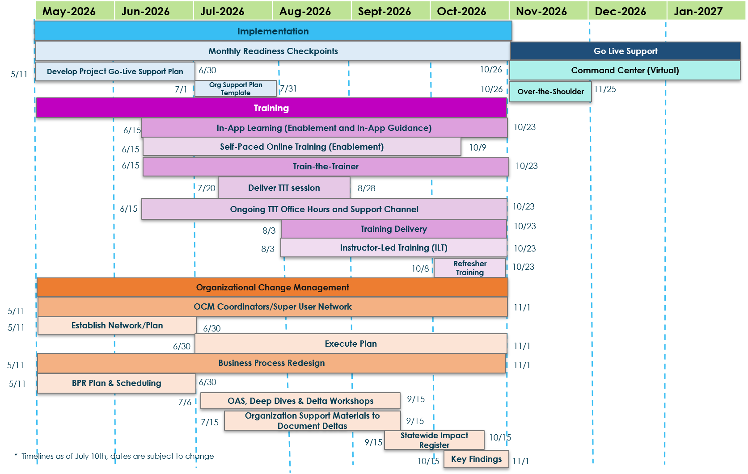
Implementation Timeline
The implementation timeline outlines the major workstreams, sequencing, and critical milestones that guide the path to Go‑Live.

Slide 5
Organizational Change Management (OCM) Overview
Organizational Change Management (OCM) has a crucial role in the success of the CWS-CARES Go-Live.
Strategic Planning & Preparation
Aligns people, processes, and technology for Go‑Live readiness
Identifies how changes will affect end users and workflows
Builds a structured approach to minimize disruption and resistance
Ensures stakeholders understand what is changing and why
Stakeholder Engagement & Transparency
Analyzes the stakeholder landscape to identify key groups and influencers
Clarifies worker permissions and role‑specific impacts
Provides clear, timely, and consistent communication
Reduces uncertainty by keeping stakeholders informed throughout the transition
Adoption, Support & Trust Building
Drives acceptance and adoption of the new CWS‑CARES system
Supports end users through training, readiness activities, and ongoing engagement
Builds trust by addressing concerns early and reinforcing benefits
Ensures a smooth transition at Go‑Live and beyond

Slide 6
Communication

Slide 7
Communication Overview
The following framework outlines the foundation, goals, and actions necessary to ensure clear, consistent, and targeted communication throughout the CWS‑CARES V1 implementation.
Definition
A comprehensive document that outlines the goals, objectives, tactics, and resources needed for effective communication with stakeholders throughout the CWS-CARES V1 implementation it includes a detailed plan of the types of communication, channels, timings, and the methods that will be used to convey relevant information to all stakeholders.
Outcome
Facilitates effective communication with stakeholders through the appropriate channels and messengers
Provides clear and consistent communication to stakeholders
Provides a clear statement of the approach to be used for the development and execution of all communication activity and defines the parameters for delivering key messages to stakeholders
Key Activities
1 | Review: Reference key information for the CWS-CARES V1 implementation provided by the Implementation OCM Team
2 | Identify: Determine any potential gaps for each stakeholder group
3 | Build: Develop a communication plan and respective materials in support of the CWS-CARES V1 implementation that address potential gaps or nuances within the Organization
4 | Refine: Socialize the plan with stakeholders and deploy communications in accordance with the communications plan
CWDS / 7

Slide 8
Review: CWS-CARES V1 Key Messages
Listed below are some common questions and key messages that may support communication efforts during CWS-CARES V1 implementation.
What is changing? | The purpose of the Child Welfare Services-California Automated Response and Engagement System (CWS-CARES) project is to replace the existing legacy child welfare system, the Child Welfare Services/Case Management System (CWS/CMS), with a Comprehensive Child Welfare Information System (CCWIS) compliant system.
Why is it changing? | The new system will be designed to be more accessible and will be a highly regulated, safety-critical, and data-intensive system. CWS-CARES will provide an intuitive user experience and new capabilities not currently provided by CWS/CMS. Federal regulations include new requirements around system standards that California must adhere to draw down federal funding
What are the benefits of the new system? | Business Process Improvements–Opportunities to improve and standardize business processes designed to help children and families. ​ IT System Modernization–Migration from a decades-old mainframe IT system to a modern, cloud-based environment that will make it easier for CWS staff to access real-time data and make more informed decisions. ​ Effective & Efficient Tools–Provides CWS staff with modern technology and an application with customized tools that will streamline the paperwork process to enhance their work with families, partners, and stakeholders. ​ Compliant CCWIS System–The CWS-CARES Project keeps the needs of local child welfare and juvenile probation practitioners at the forefront and meets the regulations and policies of state and federal laws.
When will this change happen? | CWS-CARES V1 will have a statewide rollout approach, which means all end users will implement V1 at the same time. CWS-CARES V1 is scheduled to go live in October 2026.
CWDS / 8

Slide 9
Review: CWS-CARES V1 Planned Campaigns & Sub-Campaigns
Planned campaigns and sub-campaigns are used to organize strategic communication efforts. Listed below are specific campaigns and sub-campaigns that will support the CWS-CARES V1 implementation.
Go-Live Information
Training
New OCM & BPR Engagement & Adoption Activities
This campaign will focus on preparing Organizations on what to expect leading up to Go-Live and the audience for this campaign will be Organizations and end-users.
Early preview of Go-Live information and support
This campaign will focus on preparing Organizations for what training for CWS-CARES V1 will entail and how they can receive support and guidance throughout the different phases of CWS-CARES V1 rollout; the audience for this campaign will be Organizations and end-users.
Early preview of training
Training Registration
This campaign will focus on engaging Organizations with the new OCM and BPR activities taking place in the months leading up to CWS-CARES V1 go-live.
OCM Engagement overhaul
BPR Readiness
CWDS / 9

Slide 10
Review: Communication & Engagement Map
The engagement map below provides a consolidated view of how communication and engagement efforts will be planned, executed, and reinforced across each phase of the CWS‑CARES V1 implementation.
Objective |  | Planning and Prep (May – June 2026) | Readiness and Cutover (July – September 2026) | Go-Live and Support (October – December 2026)
 |  | Strengthen stakeholder awareness, readiness, and commitment for the CWS-CARES implementation | Build organizational readiness by defining impacts, preparing for future-state processes, training, and establishing tailored plans that support adoption | Reinforce adoption and drive continuous improvement
Expected Activities | Implementation Readiness | Restart Organizational Readiness meetings Communicate timeframes and guidance for Organizations to select users for the Product Simulation Environment | Confirm readiness requirements have been completed Communicate Go-Live logistics Define success metrics Track readiness checkpoints | Execute cut-over and go-live activities Help resolve and track issues Activate post-go-live support
 | OCMBPR | Introduce the BPR strategy and OCM plan Continue to build the terminology crosswalk and glossary to familiarize stakeholders with new CWS-CARES terminology Relaunch the OCM Advisory Workgroup with a new focus on developing OCM Coordinators | Conduct an Organizational Alignment Session to prepare Organizations to attend Delta Sessions Walk Organization Implementation teams through CWS-CARES to=be processes and identified change impacts Share change impacts and recommended mitigation Engage OCM Coordinators/Super Users Provide OCM Guidance | Reinforce ways of working Share success stories Gather feedback for continuous improvement Share lessons learned
 | Training | Relaunch the Training Advisory Workgroup to focus on information sharing and training updates Outline the training strategy Introduce role-based training resources | Explain learning pathways Share role-based training overviews Provide training schedules and open course registration Deliver role-based training and provide training support materials Support training completion | Provide job aids Support on-demand learning
Key Messaging |  | The CWS-CARES Implementation is on track for go-live October 2026 Organizations should continue/resume engaging in readiness activities, understand the upcoming changes, and determine what support is needed to be successful. | Prepare for Go-Live Organizational readiness activities, change impacts, OCM Guidance and training are underway to support a successful transition to CWS-CARES. | CWS-CARES is live and support is available Support a positive user experience with focus on applying new processes and leveraging available support to drive successful adoption.
Communication Channels
Email Updates | CWDS Website | Meetings: CAC, OCMAW, Organization Monthly Readiness Meetings, Stakeholder Briefings, TIPS | OCM Coordinator Meetings | Weekly Digest | CARES Explorer | CARES Compass
CWDS / 10

Slide 11
Review: Communication Channels
The following communication channels represent the core methods used to deliver key messages, support understanding, and engage stakeholders throughout each campaign or sub‑campaign.
Newsletter Articles
Visuals
Tailored Email
Live Meetings
Frequently Asked Questions
Facts Sheets
Talking Points
Answers to a list of typical questions that users might ask around a particular key message or sub-campaign. These are currently posted to the CWDS website, and can also be compiled into a single-page document arranged around a specific topic
A single-page document containing essential information about a sub-campaign with concise, simple language that provides clarification to various audiences
Approved bullet point statements that are provided to the appropriate leaders to communicate needed details around each sub-campaign
Virtual or in-person meetings discussing Sub-Campaign materials.
Infographics and other graphic representations of key messages that stakeholders can print and post physically or add to digital resources, like intranet pages.
A single or set of dedicated email(s) around the key messages outlined in the sub-campaigns
Key messages will be included in an article published in the quarterly CWS-CARES Explorer newsletter
CWDS / 11

Slide 12
Communications Plan Template
The Communications Plan outlines key elements of the CWS-CARES V1 implementation communications approach. It includes identifying the audience, planning essential messages for these stakeholder, and delivering the messages through the appropriate mechanisms.
Key Details:
Communication Phase: Timing of the communication distribution based on the phases identified by the Implementation OCM Team (e.g., Planning and Preparation, Readiness and Cutover, Go-Live and Support)
Target Date for Distribution: Discrete date at which the communication will have been drafted, approved, and is to be sent by.
Communication Topic: High-level description of the topic that will be addressed within the communication
Communication Description: Detailed explanation of what messaging will be included in the communication
Communication Type: The distribution method for the communication (e.g., Email, Live Meeting, Talking Points, Visuals)
Audience: Who is the targeted recipient of the communication (e.g., Organization wide, distinct departments)
Recommended Channel: Detailed method of distributing the communication (Specific meetings, tailored emails, Organization websites)
Communication Phase | Target Date for Distribution | Communication Topic | Communication Description | Communication Type | Audience | Recommended Channel
Planning and Preparation | Jun-2026 | Role-Based Training | An email to the Organizations to highlight available role-based training resources | Email | All Organizations | Tailored Email

Slide 13
Identify: Communications
Organizations may need to determine where additional or customized communications are required based on unique stakeholder needs, organizational context, and change impacts.
Based on Organization nuances and stakeholder needs, additional communications may be needed to support adoption.
Utilize the Communications & Engagement Map, Key Messages, and Campaign/Sub-Campaign plans to identify areas where Organizations may need to provide supplemental communications tailored to the specifics of the Organization.
Additionally, stakeholder needs may vary by Organization. Leverage Organization Change Impacts and Stakeholder Landscape to identify stakeholder communication needs that may vary from State Level plans.

Slide 14
Build: Communications
To effectively craft communications for your specific organizations, quality and effective inputs are necessary. By leveraging the below inputs collected at the State and Organization level, Organizations can create messaging that is tailored to their unique needs and circumstances, while retaining cohesion across the State.
Organizations should align timing of communications to the Communications and Engagement map, to create consistency between State level messaging and Organizational level messing.
STAKEHOLDER ANALYSIS (WORKER PERMISSIONS)
KEY MESSAGES
CHANGE IMPACTS
CHANGE PLANS
CHANGE RISKS
Conducting a Stakeholder Analysis lets the OCM team identify which stakeholder groups are impacted across multiple areas and how efforts to engage and train these stakeholders can be consolidated.
Change Impacts help the OCM team pinpoint how stakeholders need to change their behaviors for the new ways of working and identifying connection points related to changes in behavior that are related across roles and workstreams.
Change Plans are critical inputs because they help OCM teams identify opportunities to efficiently collaborate, streamline, and integrate change activities across workstreams while telling an overarching connected story to effectively engage stakeholders.
Change Risks are potential challenges or obstacles that may arise as changes are implemented and accepted. Identifying these early is important in order to begin building mitigation strategies to lessen the negative effects as early as possible.
Key Messages are important because they allow the OCM teams to streamline consistent messaging across service areas, find ways to connect and a build a story.

Slide 15
Refine: Communications
The following actions show how organizations can strengthen communication effectiveness through an iterative cycle of feedback, refinement, and partnership.
Collect Feedback
Leverage two-way feedback channels (meetings, surveys, email responses, and in-person comments) to identify ways to iterate upon communications.
Communication Optimization
Update Communication Plans
Communication plans are a continuous effort, as more information is learned about stakeholder needs, communication preferences, plans may change.
Collaborate with Others
Work with your Implementation Coordinator to refine and iterate upon your communication plan.

