Slide 1
Organization OCM Guidance
CWS-CARES
Change Impacts
June 30, 2026

Slide 2
Purpose & Audience
The OCM Guidance is designed to equip organizations with the context, tools, and direction needed to carry out change management activities successfully in support of the CWS-CARES V1 Go-live.
Purpose
Audience
The Organization OCM Guidance Materials are designed to equip Organizations with background, processes, tools, and templates for executing change management activities in preparation for CARES Go-Live.
The OCM Guidance is intended for the Organizations impacted by the CARES implementation. OCM Coordinators are encouraged to leverage the following content to guide the execution of change management activities within their local organizations.
Key Terms Repository: CWDS Glossary
Leading Practice: Check the repository for updates bi-weekly

Slide 3
Background
CWS-CARES Project Overview
Child Welfare Digital Services (CWDS) is a collaboration between the California Department of Social Services (CDSS), the Office of Systems Integration (OSI), and the County Welfare Directors Association (CWDA), in collaboration with 58 local child welfare agencies. CWDS supports end-users through technology and aims to ensure the safety, permanency, and well-being of children at risk of abuse, neglect, or exploitation. CWDS is responsible for maintaining and operating the existing Child Welfare Services/Case Management System (CWS/CMS), as well as developing the replacement system, the Child Welfare Services-California Automated Response and Engagement System (CWS-CARES).
The goal of the CWS-CARES Project (hereinafter referred to as “project”) is to replace the CWS/CMS with a compliant Comprehensive Child Welfare Information System (CCWIS), which keeps the needs of local child welfare and juvenile probation practitioners at the forefront and meets the regulations and policies of state and federal laws. This project will deliver the CWS-CARES operational applications on the Salesforce platform, using an agile development methodology and user-centered design. In tandem, CWDS will establish the CWS-CARES data services, an integral component of CCWIS, on the CWS-CARES Data Infrastructure (CDI). The state will maintain its own copy of all data contained within the Salesforce database, along with immutable longitudinal data on the CDI, which will satisfy the state’s requirement to maintain ownership and control of child welfare data as a vital asset.
Organizations Receiving CWS-CARES Include:
58 County Child Welfare Services Departments
58 County Juvenile Probation Departments
Tribes with Title IV-E agreements: Yurok and Karuk
CDSS Divisions: CDSS-Community Care Licensing Division (CCLD), CDSS-Finance & Accounting Division (FAD), CDSS-Office of Equity (OOE), CDSS-Research, Automation, Data Division (RADD), CDSS-CFSD-Adoptions, CDSS-CFSD-Child Welfare Services Branch (CWSB), CDSS-CFSD-Children’s Services Quality Management Branch (CSQMB), CDSS-CFSD-Family Permanency & Support Services Branch (Permanency), CDSS-CFSD-Safety, Prevention, Early Intervention Branch (SPEIB), and CDSS-CFSD-System of Care Branch (SOC)
Family First Prevention Services Act (FFPSA) Providers

Slide 4
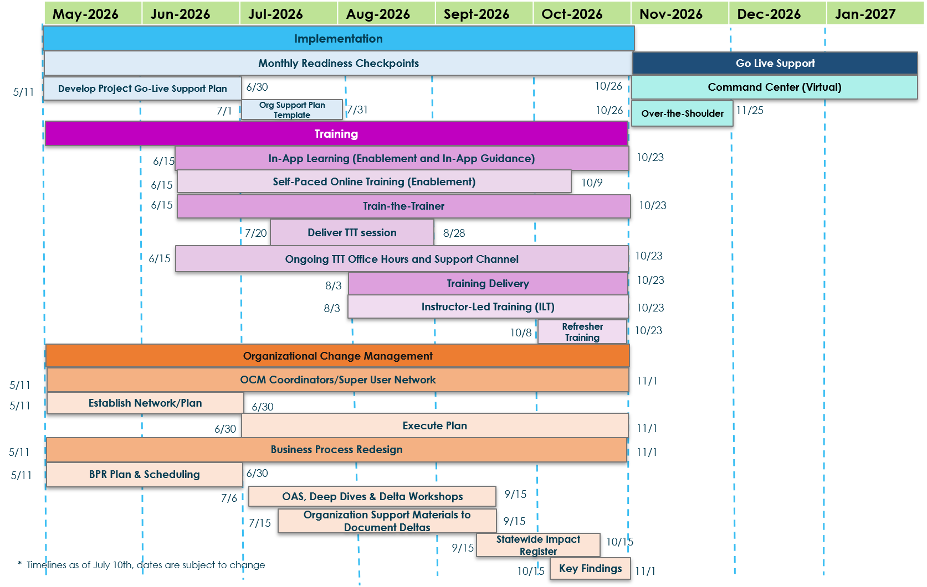
Implementation Timeline
The implementation timeline outlines the major workstreams, sequencing, and critical milestones that guide the path to Go‑Live.

Slide 5
Organizational Change Management (OCM) Overview
Organizational Change Management (OCM) has a crucial role in the success of the CWS-CARES Go-Live.
Strategic Planning & Preparation
Aligns people, processes, and technology for Go‑Live readiness
Identifies how changes will affect end users and workflows
Builds a structured approach to minimize disruption and resistance
Ensures stakeholders understand what is changing and why
Stakeholder Engagement & Transparency
Analyzes the stakeholder landscape to identify key groups and influencers
Clarifies worker permissions and role‑specific impacts
Provides clear, timely, and consistent communication
Reduces uncertainty by keeping stakeholders informed throughout the transition
Adoption, Support & Trust Building
Drives acceptance and adoption of the new CWS‑CARES system
Supports end users through training, readiness activities, and ongoing engagement
Builds trust by addressing concerns early and reinforcing benefits
Ensures a smooth transition at Go‑Live and beyond

Slide 6
Change Impacts

Slide 7
Change Impacts Overview
Change Impact Assessment helps to provide a view of the breadth of expected changes and enables the ability for Organizations to identify risks early.
Definition
Change Impact Assessment is a systemic way to identify impacted stakeholder groups and determine the level change impacts at an organizational and stakeholder level. It provides a broad view of the affected stakeholder groups for each component of the CWS-CARES V1 implementation. The purpose of this assessment is to identify the degree and perception of the changes that will take place and provide an overview of the potential impacts.
Outcome
Provides a view of the breadth and depth of the changes resulting from CARES Go-Live
Identifies high risk areas early based on the degree of impact and perception of the changes
Provides a clear statement of the approach to be used for the development and execution of all communication activity and defines the parameters for delivering key messages to stakeholders
Key Activities
1 | Document: Review to-be processes as documented in the PIS documentation and executed within the Production Simulation (Prod Sim) environment to identify and document the change impacts.
2 | Analyze: Use the rating scales for change impacts to determine the degree of impact and the expected perception of the change.
3 | Validate: Review change impacts with the appropriate subject matter experts (SMEs) to validate the expected impacts and ratings.
4 | Report: Provide the populated CWS-CARES V1 Change Impact Validation template to the Implementation OCM Team for further analysis and CWS-CARES planning.
5 | Plan: Develop communication and engagement activities to help reduce risks associated with the planned changes.

Slide 8
Document Change Impacts
Purpose: The Implementation OCM Team works to identify and validate change impacts resulting from the implementation of CWS-CARES V1. Change Impacts were identified from reviewing Jira stories, confluence and interviews with Service Managers and PDLs. Once developed, the process is validated by walking through each map with the Service Managers based on the updates to the application through End User Scenario Testing (EUST) 3. Change impacts will continue to be identified through the BPR Delta sessions held with Organizations.
Involved Stakeholders: The OCM Team will document these change impact details through discussions with Service Managers for each service area.
Key Details: Change impacts are documented and maintained in the Implementation Change Impact Tracker as reflected below:
Process Area | Activity / Process Map | Change Impact | Worker Permission(s) Impacted | Degree of Impact Rating (H/M/L) | Perception of the Change (Positive, Neutral, Negative) | Proposed OCM Mitigation Strategy
CWS-CARES V1 process areas | Note the documented process map applicable to the identified change impact | Describe the new way of working and the impact to people, process, or technology | CWS-CARES V1 stakeholder group(s) impacted by the change | Rate the degree of impact as High (H), Medium (M), or Low (L) | Rate how impacted stakeholders may perceive the impact as Positive (+), Neutral (/), or Negative (-) | Risk mitigations for key change impacts

Slide 9
Analyze Change Impacts
Purpose: Populate the change impact template, completing each of the key detail fields in the Implementation Change Impact Tracker, as well as any other applicable fields to track each change impact.
Involved Stakeholders: The OCM Team will utilize notes from conversations with Service Managers for Intake Screening to define, analyze and score change impacts prior to validation with all Service Managers, County Consultants, and PDLs.
Key Details: Meet with all Service Managers and PDLs to analyze the change impacts and rank them according to the guide listed in the appendix. To calculate the Overall Rating, consider the following:
  Score the change impacts for each worker permission
  Evaluate the degree of each impact as High, Medium, or Low
  Identify the overall level of impact using the rating scale
To assess change impacts, each stakeholder segment has been evaluated based on the degree of impact (High, Medium, or Low) for job activities and/or workload that will change as part of CWS-CARES V1. The degree of impact criteria is listed below, with additional scoring details on the next slide.
NOTE: High impacts don’t imply a negative change (most represent significant benefits or efficiency gains); the color coding is for magnitude only.
Impacts | Criteria/Examples – People, Process, and Technology Changes
High Impact | Significant changes to the way work is performed, decisions are made, and relationships are approached. Work may shift to a new department/division or be centralized to one team; job series and/or titles may change. Extensive training and/or new skills required for the performance of future job duties.
Medium Impact | Some changes to the way work is performed, decisions are made, and relationships are approached. Some changes to skills required. Process and/or system training required.
Low Impact | Few changes to the way work is performed, decisions are made, and/or relationships are approached. No structural or reporting relationship changes anticipated. Limited process or system training required; few to no new skills needed.

Slide 10
Validate Change Impacts & Plan OCM Activities
Validate with Service Managers, County Consultants and Product Delivery Leads (PDL)
Purpose: Conduct regular meetings with the Service Managers, County Consultants and PDLs for each milestone to review the populated change impact template and validate the details. Complete edits/updates as needed and share with stakeholders for a final round of validation.
Involved Stakeholders: The OCM Team will meet on a regular basis with the milestone’s assigned Service Managers, County Consultants and PDLs to complete change impact validation and will subsequently share the updated change impacts with stakeholders for a final round of validation.
Key Details: The change impact validation process across all groups occurred with the extended team prior to posting to the Implementation Portal.
Plan OCM Activities to Reduce Risk
Purpose: Develop a change impact assessment report and use the insights to determine the appropriate OCM activities to mitigate the risk associated with the change. This activity could include communications, training, or specific engagement strategies tailored to the stakeholder group.
Involved Stakeholders: Local OCM teams, OCM Coordinators, Implementation OCM Team
Key Details: Details from the Change Impact Assessment Report will be used to help create communications, training materials, and additional change resources for the Organizations.

