Slide 1
CWS-CARES Training
ILT Course: Courts
July-October 2026
https://cwds.ca.gov/
Notes:
Instructor Notes
Do: Display slide
Say:

Slide 2
Course Introduction

Slide 3
Ground Rules & Housekeeping
01
02
03
04
Stay Engaged
Ask Questions​
Minimize Distractions
Vegas Rules
Follow along with your trainer(s) throughout the session.
If you are in-person, raise your hand in the main sessions to ask questions.
If you are virtual, use the Microsoft Teams chat to type your questions directly in the chat.​ We will get to them as soon as possible.
Avoid checking your cell phone, email, or CWS-CMS during the session.
Do not share any sensitive or confidential information you may encounter during the class outside the session.
Please use fictional names in the Training Environment
Notes:
Instructor Notes:
Do:
Display PPT slide.
Review the slide.

Slide 4







About This Course
Course Content
Tech Support
Parking Lot
Recording Notice
Training
Environment
Q&A Options
Course Feedback

Slide 5
Meet Your Facilitators!

Slide 6
Course Objectives
Item | Objectives
1. | Understand key processes to create and process Warrants in CWS-CARES, including: Creating a Protective Custody Warrant Documenting a Warrant Ruling Document Warrant Service Attempts Closing a Warrant
2. | Understand key processes to create and prepare Detention Hearing documents for Court in CWS-CARES, including: Petitions Notices ICWA 30 Minute Orders Court Reports Court Officer Notes Scheduling Next Hearing
3. | Understand key processes to support the 366.26 Hearing documents for Court in CWS-CARES, including: Due Diligence Search Notices 366.26 Court Report Findings & Orders (Minute Orders) Court Officer Notes
4. | Understand key processes to support court-related functionality in CWS-CARES, including: Ex Parte Completing Discovery Requests
5. | Understand the process to attach a Case Plan to a Court Report in CWS-CARES.

Slide 7
Course Agenda
Activity | Duration
Welcome | 10 min
Lesson 1: Review Activity | 15 min
Lesson 2: Warrants | 30 min
Lesson 3: Detention Hearings | 30 min
Break | 15 min
Lesson 4: Other Courts Functionality | 30 min
Lesson 5: 366.26 Hearings | 45 min
Review/Questions/Wrap-up | 15 min
Estimated Total Duration | 3.25 Hours

Slide 8
Logging in to CWS-CARES

Slide 9
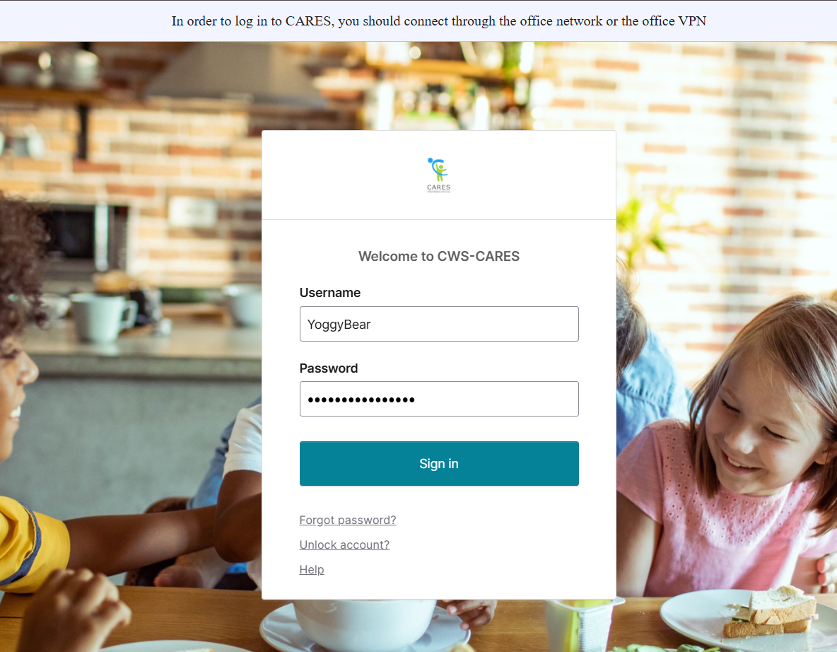
Logging into CWS-CARES
Navigate to: CWS-CARES
Enter your County Email associated with the CARES account in the Username field.
Enter the password you created for your CARES account in the Password field.
Click Sign in.
2
3
4
Important Note: If you have difficulty logging in, we will capture your information and route it to the support team for action.

Slide 10
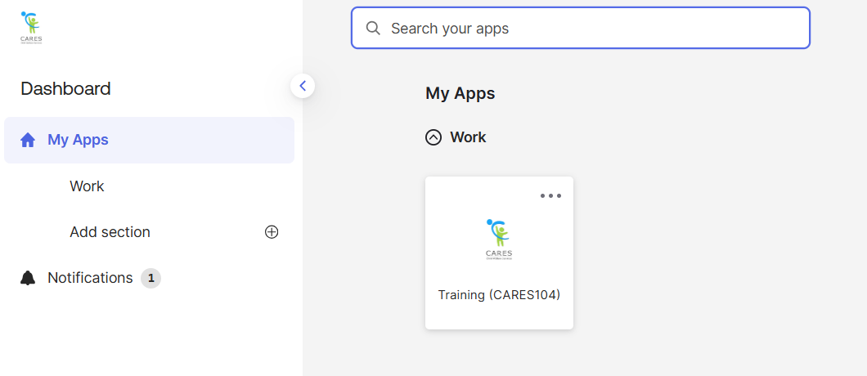
Accessing the CARES Training Environment (104)
The first screen shown upon login is the Okta My Apps dashboard.
To enter CWS-CARES training environment, choose the Training (CARES 104) tile

Slide 11
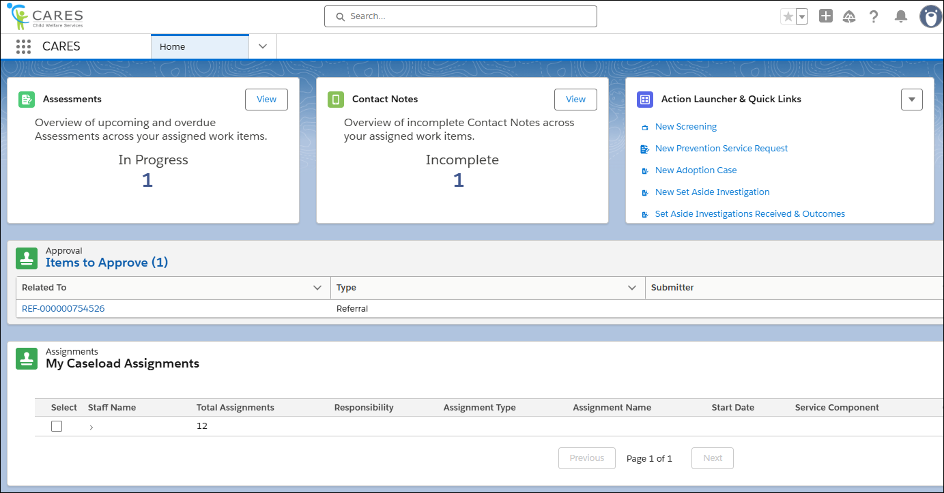
How to Know You're In the Right Place: CWS-CARES
Verify that you are in CARES application tile in the App Launcher in the top left corner of your homepage.
After clicking the CARES tile in the App Launcher, the CWS-CARES Home Page displays.
Important Note: If you are NOT in the CARES application, click the App Launcher (highlighted in the screenshot). Then, select the CARES application.

Slide 12
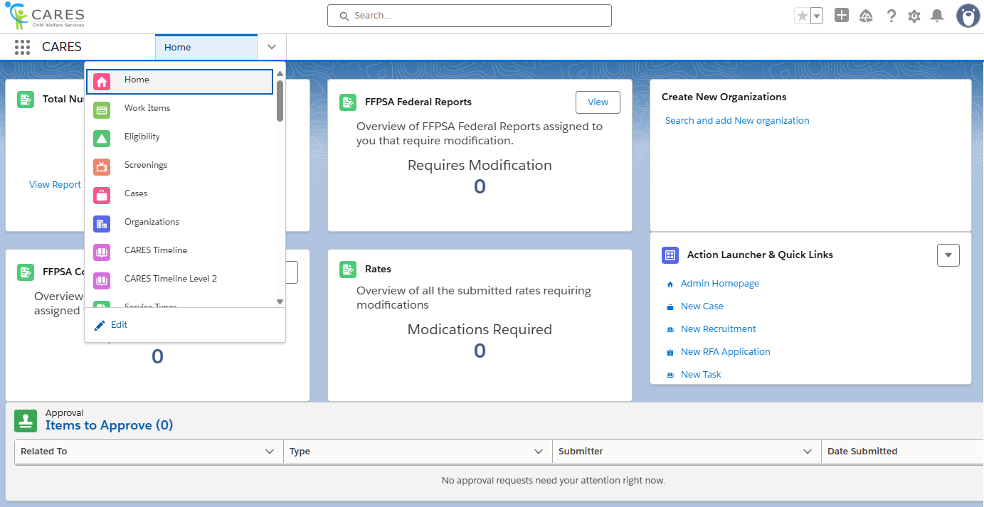
Navigation Menu
The Navigation Menu consists of a dropdown that contains links to sections of CWS-CARES that you have permission to access.
Common selections are:
Home
Screenings
Eligibility
Cases
Reports
Person Search
Work Items

Slide 13
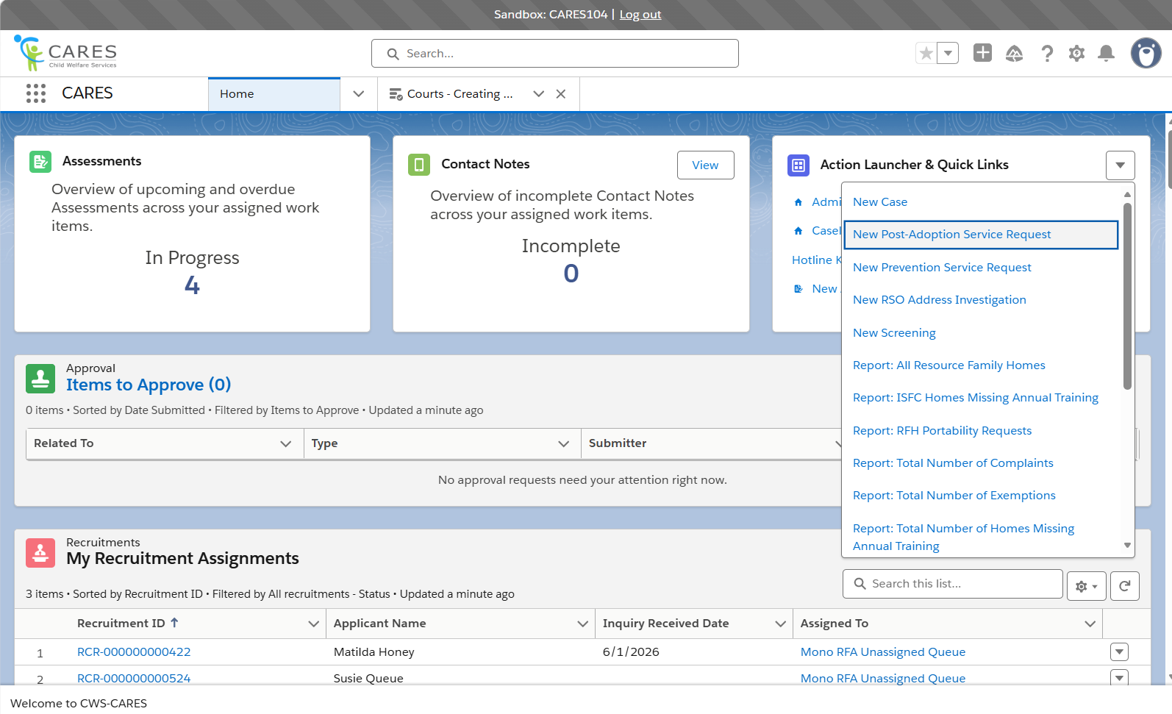
Action Launcher & Quick Links
Role-dependent links reside here for you to navigate to common tasks in CWS-CARES.
You may find links here to begin a New Screening, or a New Case. If your role permits, you may have a link here to the Admin Homepage.
Due to your hybrid permissions in the training environment, you will see many more options here than the typical user. For this reason, clicking the drop-down caret on the right of the header will display additional item options.

Slide 14
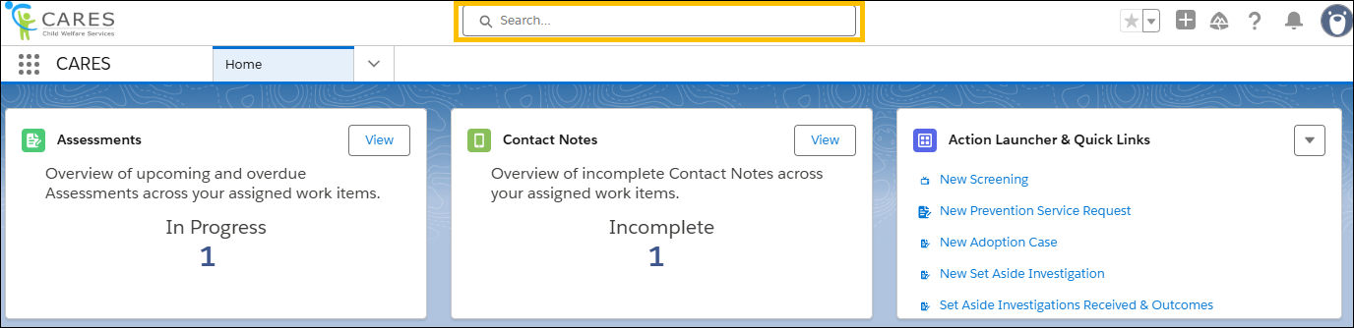
Global Search
Use Global Search to broadly search across the system. This search is best suited for:
Locating knowledge articles
Searching for glossary terms
Finding general content using keywords
To perform a Global Search, enter a keyword or phrase in the search bar available at the top of the screen. The system will begin to pull areas that meet the search criteria as text is entered.

Slide 15
Lesson 1: Review Activity
Notes:
Instructor Notes
Do: Display slide
Say:

Slide 16
Accessing Pre-Seeded Cases for this Scenario
For this session, you should be able to use the case created during the Screenings & Referrals course.
If there are issues, Pre-Seeded cases have been created for TTT Trainings
To access Pre-Seeded cases, please utilize the spreadsheet given to your training facilitators and open the tab that corresponds to the relevant scenario
For CARES Trainers, find the folder for cases seeded for your regional session here: Train the Trainer
  Please make sure you use the tab based on the specific course being taught (i.e., Courts)
2026

Slide 17
Lesson 2: Warrants
Notes:
Instructor Notes
Do: Display slide
Say:

Slide 18
Scenario Warrants
Since the circumstances for the children are not exigent, the worker pursues a Protective Custody Warrant with the Court. The worker completes the warrant and submits it to the supervisor who reviews and approves it. When the warrant is submitted to Court, the Court agrees and grants the warrant. The worker and law enforcement serve the warrant to the parents, and the children are removed from the home. The worker reports to the Court that the warrant was successfully served and notes this in the system.

Slide 19
Lesson 2 Key Actions
Create Protective Custody Warrant
Document Warrant Ruling
Serve a Warrant
Document Warrant Outcome
Close the Warrant

Slide 20

Lesson
Follow-Up
Any questions?

Slide 21
Let’s Take a Break!
Please be back and ready to continue in X minutes.

Slide 22
Welcome Back!
We are excited you are here! Let’s get to work!
Notes:
Instructor Notes
Do: Display & review slide
Say:

Slide 23
Lesson 3: Detention Hearings
Notes:
Instructor Notes
Do: Display slide
Say:

Slide 24
Scenario Detention Hearings
Upon removal, the worker requests a hearing date with their court to be held within 72 hours. They immediately begin drafting a petition providing details about the allegations of general neglect of Victor and Peter by their parents and physical abuse of Victor by Paul using the JV110 Petition. The worker also begins drafting the Detention Hearing court report. Once a hearing date is scheduled by the court, the worker files the petition along with the completed Detention Hearing court report to the court at a minimum of 24hours before the scheduled hearing date and time. The worker will document that the appropriate parties were noticed and the method in which they were noticed. At the hearing, the Court decides that the children will remain in protective custody and schedules a Jurisdiction/Disposition Hearing; the Court Officer writes notes in CWS-CARES. When the Minute Orders are issued, the worker records them in the system and uploads the document, associates the assigned attorneys to the cases, and creates the Jurisdiction/Disposition Hearing in CWS-CARES.

Slide 25
Lesson 3 Key Actions
Create Petition
Generate Petition Document
Generate ICWA 10 (A)
Submit Petition for Approval
Create Detention Hearing
Add Participants
Create Notice
Document Notice Distribution
Generate Notice Documents
Generate ICWA 30
Create the Court Report
Generate Court Report
Download the Court Report
Merge Documents
Packet/Document Distribution
Document the Court Officer Notes
Update Hearing Details
Document Court Case Numbers
Document Court Minute Orders
Add Attorney
Schedule Jurisdiction/Jurisdiction-Disposition Hearing
Linking the Petition to the Hearing

Slide 26
Lesson 3
Follow-Up
Any questions?

Slide 27
Let’s Take a Break!
Please be back and ready to continue in 10 minutes.

Slide 28
Welcome Back!
We are excited you are here! Let’s get to work!
Notes:
Instructor Notes
Do: Display & review slide
Say:

Slide 29
Lesson 4: Other Courts Functionality
Notes:
Instructor Notes
Do: Display slide
Say:

Slide 30
Scenario: Other Courts Functionality (Discovery)
The court orders Discovery based on a request from the mother’s attorney. The CWS-CARES user initiates the Discovery Request and completes the Discovery.

Slide 31
Lesson 4 Key Actions
Discovery Requests
Redaction

Slide 32
Scenario: Other Courts Functionality (Ex-Parte)
The MGM Veronica requests to take the brothers on a vacation together for some sibling time and has planned a trip to Yellowstone Park. The worker speaks to the parents and the attorneys involved and submits an Ex-Parte to the Court requesting permission to travel out of state.

Slide 33
Lesson 4 Key Actions
Ex-Parte
Attorney-Client Logs

Slide 34
Lesson
Follow-Up
Any questions?

Slide 35
Lesson 5: 366.26 Hearings
Notes:
Instructor Notes
Do: Display slide
Say:

Slide 36
Scenario 366.26 Hearings
Reunification services continue with the parents who have already had a WIC 366.21(e) Six-Month Review Hearing and a WIC 366.21(f) Twelve-Month Permanency Hearing. However, Penny and Paul fail to complete and benefit from the services. Therefore, reunification services are terminated by the Court, which schedules a WIC 366.26 Selection and Implementation Hearing in 120 days, where the worker will be recommending to the Court that parental rights for Peter should be terminated. However, the father, Paul’s whereabouts are unknown, which necessitates an Absent Parent Search that will populate into the Due Diligence report for him, and the worker will need to request an Application for Publication. The worker ensures that the recipients receive appropriate notice for the 366.26 Hearing, the court report is generated, and all attachments are merged into the hearing Packet.

Slide 37
Lesson 5 Key Actions
Preparing for the 366.26 Hearing
Open the Scheduled Hearing
Noticing- Create a Notice
Notice Distributions
Generate the Noticing Document
Create Notice Task
Create 366.26 Court Reports
Create the Due Diligence Report
Update Hearing Details
366.26 Minute Orders

Slide 38
Lesson 5
Follow-Up
Any questions?

Slide 39
Course Survey
Thank you for completing the course!
Please take a few minutes to fill out the Course Survey, which can be found here:
https://cahhscwds.gov1.qualtrics.com/jfe/form/SV_024TW5uq8KQSBGm

Slide 40
Thank you!
You have reached the end of this training. Congratulations!
Notes:
Instructor Notes
Do: Display & review slide
Say:

